Slide 1
© Oxford University Press 2024

Slide 2
Multiply pairs of fractions
Year 6 (P7) | Fractions
Notes:
Teacher information slide

Slide 3
Learning outcomes
Are children ready?
  I can multiply a unit fraction by an integer.
  I can use a fraction as an operator.
  Not ready? Try Numicon Essentials: Multiply a unit fraction by an integer (Year 5/P6)
Learning outcomes
  I can make connections between multiplying by a fraction and using a fraction as an operator.
  I can multiply pairs of proper fractions.
  I can identify patterns and general rules about multiplying with fractions.
Lesson summary
  In this lesson, children will be building on their knowledge of multiplying fractions by integers to explore multiplying a proper fraction by another proper fraction. They will be provided with meaningful, real-life contexts to develop their understanding.
Where next?
  I can divide proper fractions by whole numbers.
  I can make connections between dividing by a whole number, finding a fraction of an amount and multiplying a pair of fractions.
  Ready to move on? Try Numicon Essentials: Divide a fraction by a whole number
Notes:
Teacher information slide

Slide 4
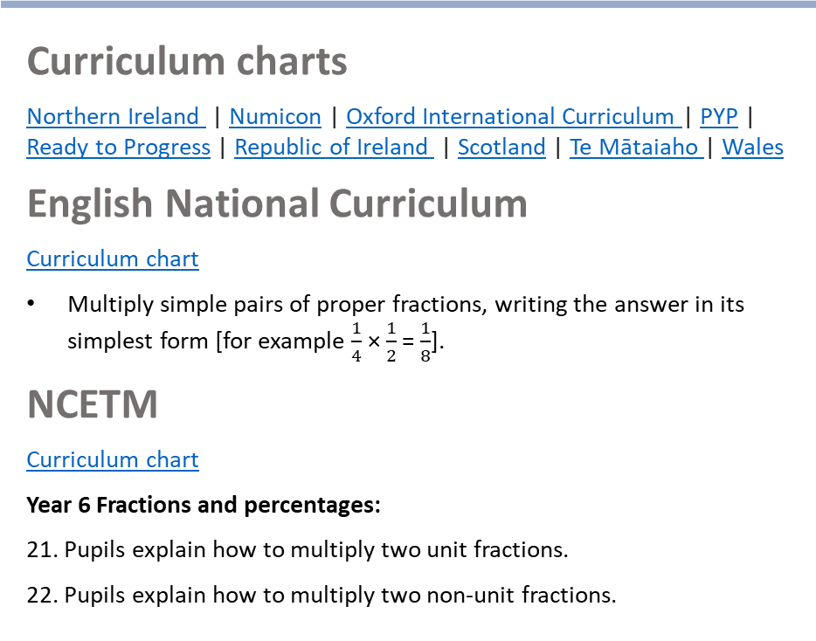
Curriculum links
White Rose small steps
  Year 6 | Autumn term | Block 4 ‒ Fractions B
Curriculum charts
Northern Ireland | Numicon | Oxford International Curriculum | PYP |
Ready to Progress | Republic of Ireland | Scotland | Te Mātaiaho | Wales
English National Curriculum
  Curriculum chart
  Multiply simple pairs of proper fractions, writing the answer in its simplest form [for example $\frac{1}{4}$ × $\frac{1}{2}$ = $\frac{1}{8}$].
NCETM
  Curriculum chart
  Year 6 Fractions and percentages:
  21. Pupils explain how to multiply two unit fractions.
  22. Pupils explain how to multiply two non-unit fractions.
This Numicon Essentials lesson could be used as an introduction to this White Rose small step. The lesson focuses on real-life contexts of multiplying pairs of fractions. The White Rose small step could then be used to offer more fluency practice.
  This step:: Step 1 Multiply fractions by integers
  ▮ Step 2 Multiply fractions by fractions
  Step 3 Divide a fraction by an integer
  Step 4 Divide any fraction by an integer
  Step 5 Mixed questions with fractions
Click here for the full White Rose curriculum mapping chart.
Click here for a full list of Numicon Essentials lessons.
Notes:
Teacher information slide

Slide 5
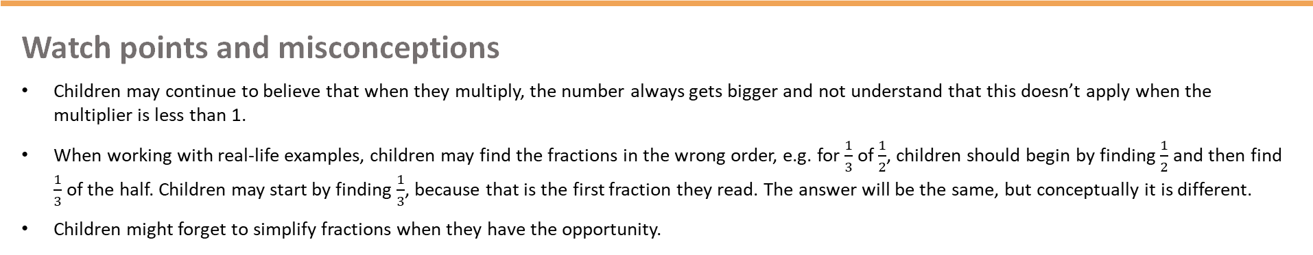
Lesson essentials
Resources
  Sticky notes | Large rectangular pieces of paper | Smaller rectangular pieces of paper | Numicon pieces | Numicon pegs | Visualiser (optional) | Print-outs of Extend and explore slide
  Resource pack (PCMs):
  Fraction multiplication problems
Key vocabulary
  multiply, fraction, proper fraction, multiplier, product, numerator, denominator, simplify, repeated, whole number, value, half, third
  Click here for glossary definitions.
Discussion stems
  Instigate: ‘I’d think that…’
  Build: ‘I agree because…’
  Challenge: ‘I disagree because…’
Sentence stems
  I know that __ of __ is the same as __ × __.
  When we multiply pairs of fractions, we multiply the … and the …
Key ideas and tips
  Fractions can be multiplied by multiplying both the numerators and denominators.
Watch points and misconceptions
  Children may continue to believe that when they multiply, the number always gets bigger and not understand that this doesn’t apply when the multiplier is less than 1.
  When working with real-life examples, children may find the fractions in the wrong order, e.g. for $\frac{1}{3}$ of $\frac{1}{2}$, children should begin by finding $\frac{1}{2}$ and then find $\frac{1}{3}$ of the half. Children may start by finding $\frac{1}{3}$, because that is the first fraction they read. The answer will be the same, but conceptually it is different.
  Children might forget to simplify fractions when they have the opportunity.
Notes:
Teacher information slide

Slide 6
Multiply pairs of fractions
Notes:
Title slide

Slide 7



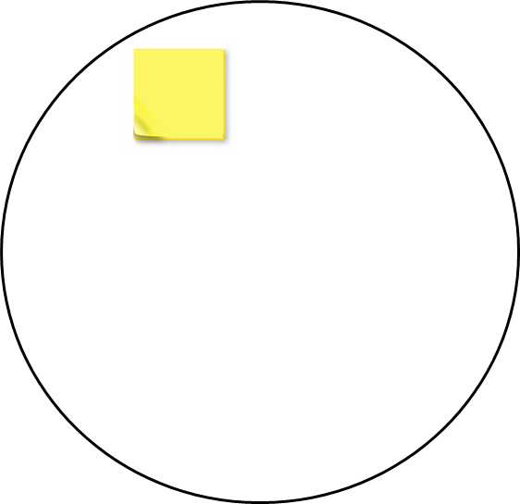

Talk task
Always, sometimes or never?
Key words
whole number
repeated
multiply
product
multiplier
value
fraction
When we multiply, the product is greater than the original number.
Write your answer on a sticky note. Share with the consensus circle.
Ravi
Instigate: ‘I think that …’
Build: ‘I agree because …’
Challenge: ‘I disagree because …’
Notes:
Talk task notes
Resources: sticky notes
Oracy groupings: Trios
This is an opportunity to recall and rehearse vocabulary previously explored.
Set the scene: Ravi says that when we multiply, the product is greater than the original number.
Ask: Is this always true, sometimes true or never true?
Ask children to work in trios to start with. They should take turns to discuss their ideas. Encourage the use of the discussion stems provided.
When they come to an agreement, they should write their response (‘always’, ‘sometimes’ or ‘never’) on a sticky note. ​Children may choose to write or draw responses that prove or support their thinking.
Look and listen for children who:
recall and use the language of multiplication as repeated addition
begin to think wider than integer × integer and extend their thinking into fractions, decimals or negative numbers and start to question the possibility of a number not increasing in size as a result of multiplication.
Watch out for children who:
struggle to articulate previous learning around multiplication or cannot use the key vocabulary around multiplication with accuracy and precision.
For trios who are struggling, prompt them to think about what happens if one of the numbers is a fraction (e.g. one half), or a decimal (e.g. 0.1) or a negative number.
Share the sticky notes as a class and decide what you all agree upon.
Place those which the class agree upon inside the consensus circle.

Slide 8


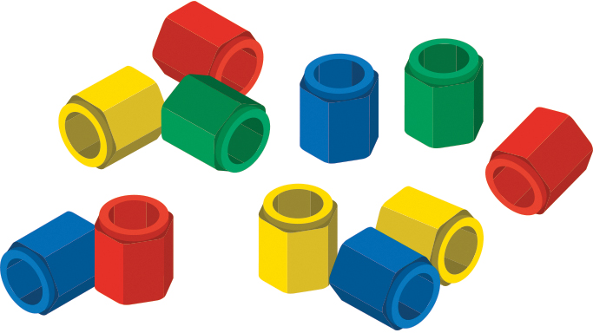

Switch on
Tia bakes a batch of 12 brownies.
She decorates half of her brownies with pink icing.
One-third of the brownies with pink icing also have sprinkles.
What fraction of Tia’s original batch of brownies have sprinkles on?
Tia
fraction | half | third
Notes:
Switch on notes
Resources: Numicon pieces, Numicon pegs
Oracy groupings: Trios
Set the scene: Tia bakes a batch of 12 brownies. She decorates half of the brownies with pink icing. One-third of the brownies with pink icing also have sprinkles.
Ask: What fraction of Tia’s original batch of brownies have sprinkles on?
Ask children to discuss in trios. Encourage them to use Numicon pieces and pegs when explaining their answer.
Listen for children explaining that $\frac{1}{6}$ of Tia’s original brownies have sprinkles, because 2 out of 12 have sprinkles on and this can be simplified to 1 out of 6.
Ask: What did you have to find first? Can you describe your method?
What do you notice about your answer after you found a third of a half?
How do you think this could be written as a calculation?
Ask the same questions for if 18 brownies had been made. (Half of 18 is 9; one-third of 9 is 3; 3 out of 18 brownies have sprinkles, which can be simplified to one-sixth.)

Slide 9

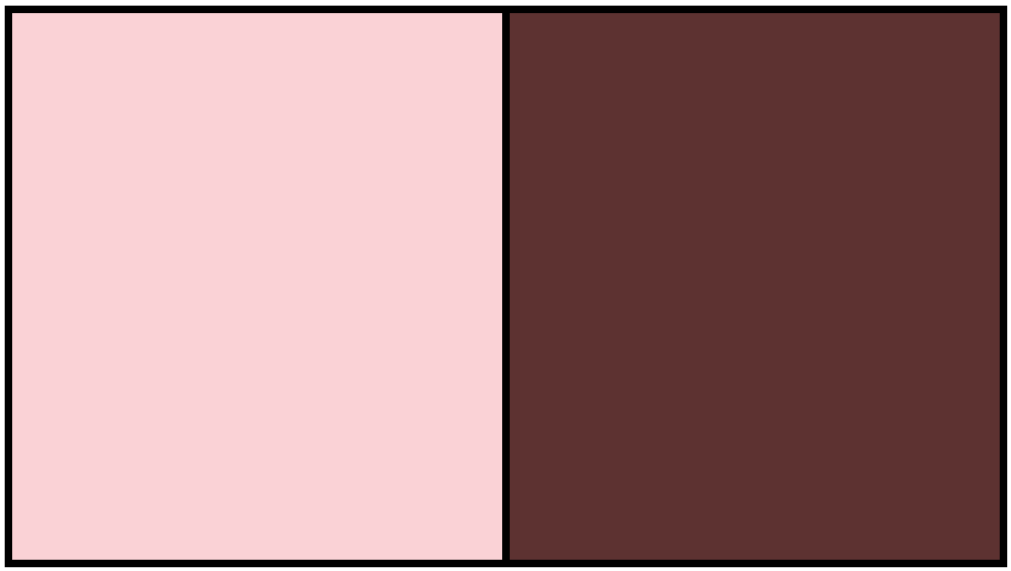
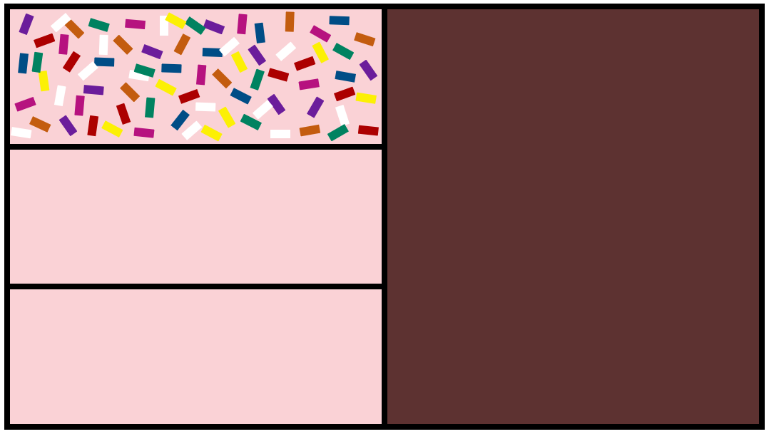
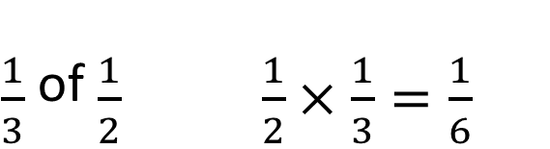
Teach: I do (1)
Tia decorates half of the brownies with pink icing.
One-third of the brownies with pink icing also have sprinkles.
What fraction of the brownies have sprinkles on them?
Video demo
$\frac{1}{3}$ of $\frac{1}{2}$ $\frac{1}{2}×\frac{1}{3}=\frac{1}{6}$
I know that __ of __ is the same as __ × __.
multiply | proper fraction | multiplier | product | numerator | denominator | simplify
Notes:
Teach: I do (1) notes
Before the lesson: Watch the video showing how to model this first 'I do' phase and use it to help prepare for your own modelling. It is beneficial that this is done live by you with the children.
Resources: a large rectangular piece of paper, visualiser (optional)
We recommend that you model your thinking and what to do practically by folding a piece of paper.
Remind children of the ‘Switch on’ task.
Say: Tia bakes a batch of 12 brownies. She decorates half of the brownies with pink icing. One-third of the brownies with pink icing also have sprinkles. We want to find out what fraction of the brownies have sprinkles on them.
Fold a rectangular piece of paper in half, to model finding $\frac{1}{2}$ first. Remind children of the context: Tia decorates half of the brownies with pink icing.
Click to reveal the second image on the slide if needed.
Then fold the halved paper into thirds to model finding $\frac{1}{3}$ of the half. Draw sprinkles on the section that can be seen. Remind children of the context: Tia adds sprinkles to one-third of the iced brownies.
Unfold the paper to show the part with sprinkles drawn on, in comparison to the whole.
Click to reveal the third image on the slide if needed.
Explain that we do not need to think about the number of brownies, just the fraction.
Say: We want to find the fraction of the brownies that have sprinkles on. Our product will be a fraction.
Using the folded paper, model the observation that the product at the end is smaller than both fractions that you were multiplying together.
Ask: What fraction of the whole tray of brownies has sprinkles? (one-sixth)
Say: I can see that 1 part out of the 6 parts has sprinkles on. 1 part out of 6 parts, one-sixth.
Write: $\frac{1}{3}$ of $\frac{1}{2}$.
Model the sentence stem: I know that $\frac{1}{3}$ of $\frac{1}{2}$ is the same as $\frac{1}{2}$ multiplied by $\frac{1}{3}$.
Say: I know that the product is one-sixth.
Write: $\frac{1}{2}$ × $\frac{1}{3}$ = $\frac{1}{6}$.
Click to reveal the number sentences on the slide if needed.
Say: Look at the numerators and denominators. What do I notice? 1 multiplied by 1 equals 1. 2 multiplied by 3 equals 6.
Make an initial conjecture that you have multiplied the numerators and the denominators.

Slide 10
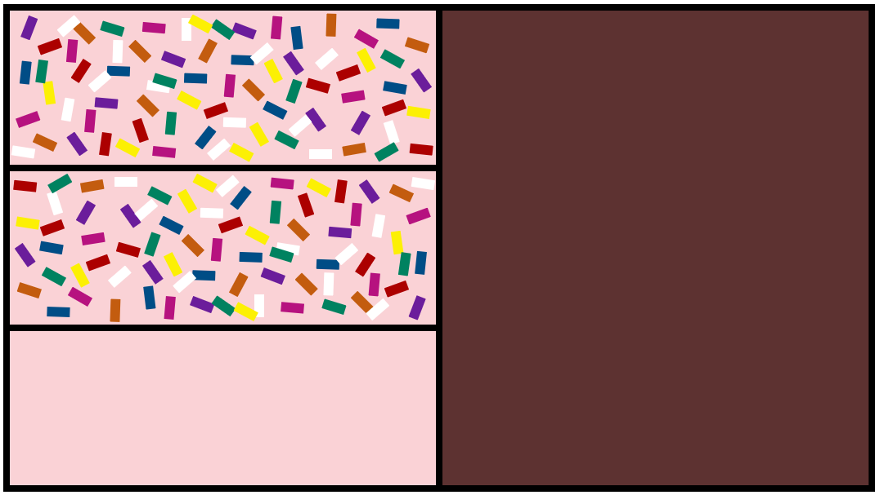
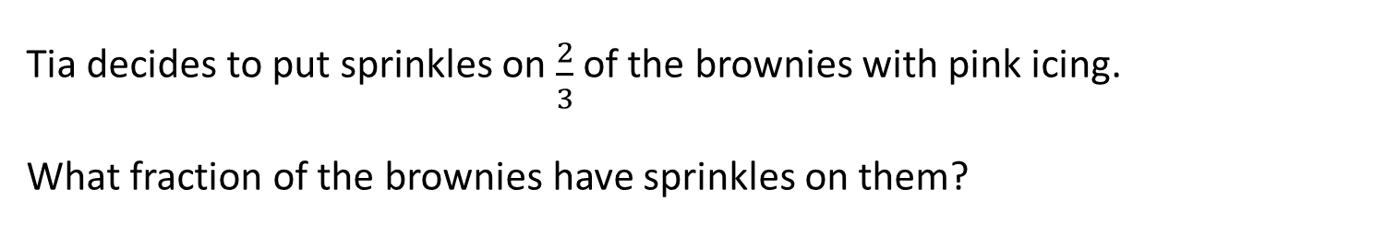
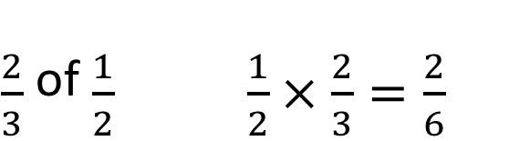
Teach: I do (2)
Tia decides to put sprinkles on $\frac{2}{3}$of the brownies with pink icing.
What fraction of the brownies have sprinkles on them?
Video demo
$\frac{2}{3}$ of $\frac{1}{2}$ $\frac{1}{2}×\frac{2}{3}=\frac{2}{6}$
When we multiply pairs of fractions, we multiply the … and the …
I know that __ of __ is the same as __ × __.
multiply | proper fraction | multiplier | product | numerator | denominator | simplify
Notes:
Teach: I do (2) notes
Before the lesson: Watch the video showing how to model this second 'I do' phase and use it to help prepare for your own modelling. It is beneficial that this is done live by you with the children.
Resources: a large rectangular piece of paper, visualiser (optional)
We recommend that you model your thinking and what to do practically by folding a piece of paper.
Set the scene: Tia decides to put sprinkles on two-thirds of the brownies with pink icing.
Ask: What is different about this scenario, compared with the last one?
Agree that now we are finding two-thirds of one-half, instead of one-third of one-half.
Move through the same modelling process as outlined in the first ‘I do’ phase.
Click twice to reveal the second and third images on the slide if needed.
Ask: What fraction of the whole tray of brownies has sprinkles? (two-sixths) Agree that 2 parts out of the 6 parts have sprinkles on.
Write: $\frac{2}{3}$ of $\frac{1}{2}$.
Model the sentence stems: I know that $\frac{2}{3}$ of $\frac{1}{2}$ is the same as $\frac{1}{2}$ multiplied by $\frac{2}{3}$.
Write: $\frac{1}{2}$ × $\frac{2}{3}$ = $\frac{2}{6}$.
Say: Look at the numerators and denominators. What do I notice?
1 multiplied by 2 is 2. 2 multiplied by 3 equals 6.
Repeat your initial conjecture that you have multiplied the numerators by each other and the denominators by each other.
Model the use of the sentence stem: When we multiply pairs of fractions, we multiply the numerators and denominators.
Ask: What do I need to do to the product now?
Agree that this needs to be simplified.
Use your folded paper or the final image on the slide as a visual scaffold to show that $\frac{2}{6}$ can be simplified to $\frac{1}{3}$.

Slide 11

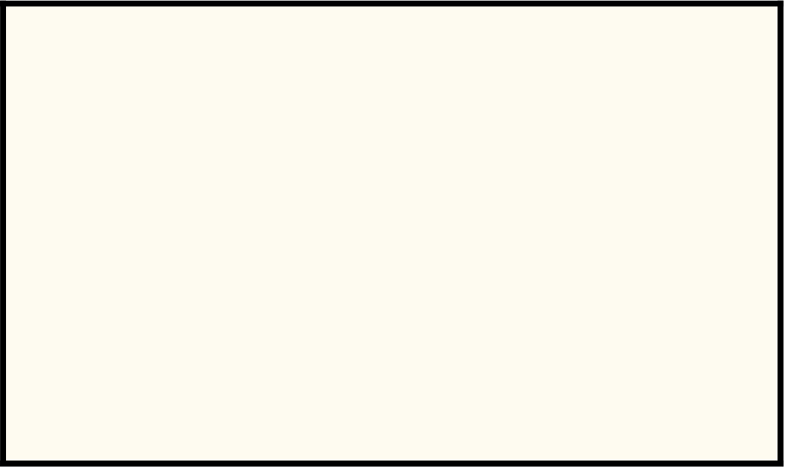
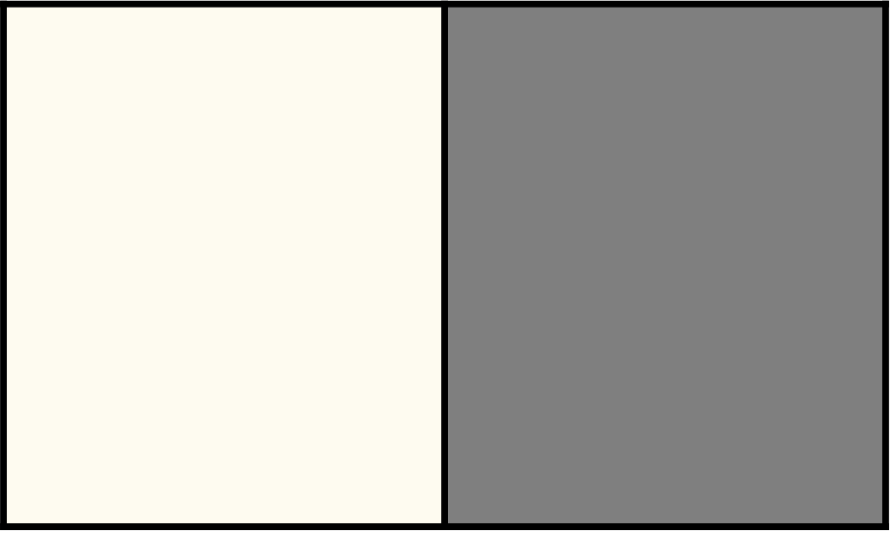
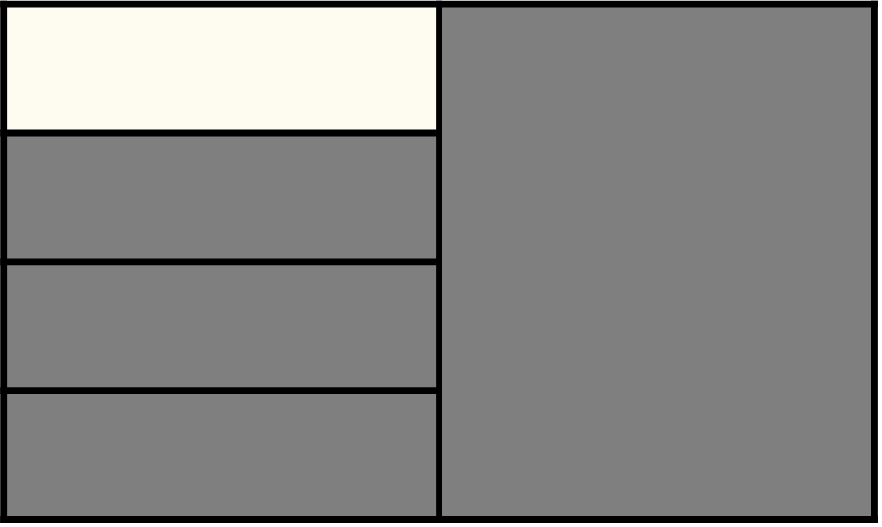
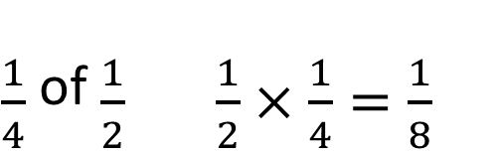
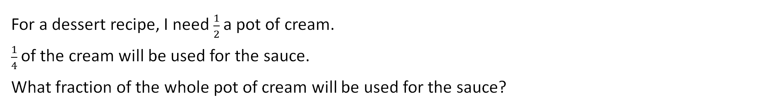
Teach: We do (1)
For a dessert recipe, I need $\frac{1}{2}$ a pot of cream.
$\frac{1}{4}$ of the cream will be used for the sauce.
What fraction of the whole pot of cream will be used for the sauce?
$\frac{1}{4}$ of $\frac{1}{2}$ $\frac{1}{2}×\frac{1}{4}=\frac{1}{8}$
When we multiply pairs of fractions, we multiply the … and the …
I know that __ of __ is the same as __ × __.
multiply | proper fraction | multiplier | product | numerator | denominator | simplify
Notes:
Teach: We do (1) notes
Resources: rectangular pieces of paper
Oracy groupings: Pairs
Repeat the ‘I do’ phase, but this time children will complete the example and make observations with you in guided practice.
Set the scene: For a dessert recipe, I need half a pot of cream. One-quarter of the cream will be used for the sauce.
Ask: What fraction of the whole pot of cream will be used for the sauce?
To help children to retrieve the equivalence of ‘of’ and ‘×’, encourage them to orally rehearse using the sentence stem: ‘I know that $\frac{1}{4}$ of $\frac{1}{2}$ is the same as $\frac{1}{2}$ multiplied by $\frac{1}{4}$.’
Give each pair of children a rectangular piece of paper. Ask them to fold their paper, first finding half, then finding one-quarter of the half.
Look and listen for children:
folding their paper in half, to represent finding $\frac{1}{2}$ first, and linking that to the half pot of cream
then folding the halved paper into quarters to find $\frac{1}{4}$ of the half, and linking that to the amount of cream used for the sauce.
Click twice to reveal the second and third images on the slide.
You may wish to label the images (or ask a child to come and do so) to reflect the paper folding, e.g. ‘whole pot’, ‘half pot’ and ‘quarter of a half pot’.
Click to reveal the number sentences on the slide.
Draw children’s attention to the numerators and denominators in the calculation.
Together, rehearse the sentence stem: ‘When we multiply pairs of fractions, we multiply the numerators and the denominators.’

Slide 12
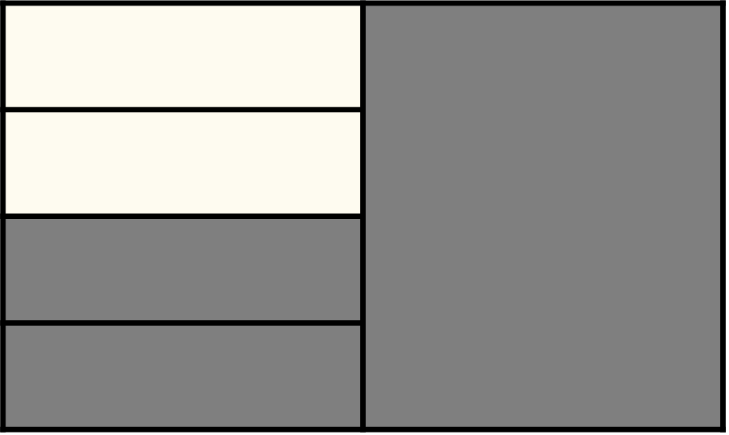
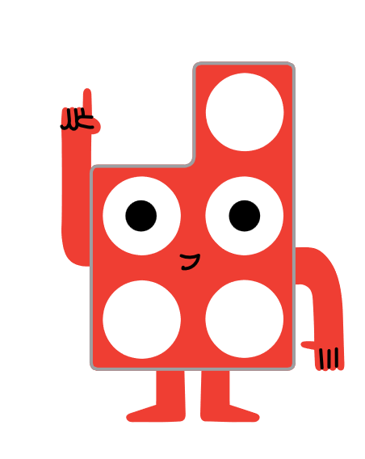
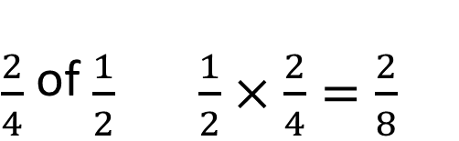
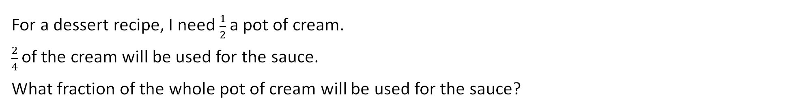
Teach: We do (2)
For a dessert recipe, I need $\frac{1}{2}$ a pot of cream.
$\frac{2}{4}$ of the cream will be used for the sauce.
What fraction of the whole pot of cream will be used for the sauce?
$\frac{2}{4}$ of $\frac{1}{2}$ $\frac{1}{2}×\frac{2}{4}=\frac{2}{8}$
Remember to simplify.
I know that __ of __ is the same as __ × __.
multiply | proper fraction | multiplier | product | numerator | denominator | simplify
Notes:
Teach: We do (2) notes
Resources: rectangular pieces of paper
Oracy groupings: Pairs
Set the scene: For a dessert recipe, I need half a pot of cream. Two-quarters of the cream will be used for the sauce.
Ask: What is different about this scenario, compared with the last one?
Agree that now we are finding two-quarters of one-half, instead of one-quarter of one-half.
To help children to retrieve the equivalence of ‘of’ and ‘×’, encourage them to orally rehearse using the sentence stem: ‘I know that $\frac{2}{4}$ of $\frac{1}{2}$ is the same as $\frac{1}{2}$ multiplied by $\frac{2}{4}$.’
Give each pair of children a rectangular piece of paper. Ask them to fold their paper, first finding half, then finding two-quarters of the half.
Look and listen for children:
folding their paper in half, to represent finding $\frac{1}{2}$ first, and linking that to the half pot of cream
then folding the halved paper into quarters and finding two of those quarters to find $\frac{2}{4}$ of the half, and linking that to the amount of cream used for the sauce.
Click twice to reveal the second and third images on the slide.
You may wish to label the images (or ask a child to come and do so) to reflect the paper folding, e.g. ‘whole pot’, ‘half pot’ and ‘two-quarters of a half pot’.
Click to reveal the number sentences on the slide.
Give pairs time to simplify the fraction.
Ask: Can you check your answer and prove that $\frac{2}{4}$ of $\frac{1}{2}$ is $\frac{1}{4}$?
Encourage children to generalise about a rule for multiplying fractions, using the sentence stem: ‘When we multiply pairs of fractions, we multiply the numerators and the denominators.’

Slide 13
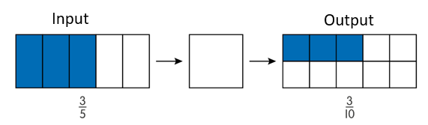
Hinge
What is the missing function in the machine?
multiply | proper fraction | multiplier | product | numerator | denominator | simplify
Notes:
Hinge notes
Oracy groupings: Trios
Give children the opportunity to think independently about the question and then ask them to write the function that fits the model on their individual whiteboards.
Assessment opportunities:
Strategy: visual
If a significant number of children answer incorrectly, pause the lesson here to revisit/consolidate the key concepts before moving onto the ‘You do’ phase.
Encourage children who correctly wrote ‘× $\frac{1}{2}$’ to explain their thinking.
Probe those who wrote a different function to identify misconceptions.
Then ask children to work in trios to come up with a real-life context to match the model, and make up a story for it.
They might want to follow the ‘I do’ and ‘We do’ examples closely (trays of brownies, or pots of cream for a recipe), or they may want to come up with something totally different.
Example:
I gave $\frac{3}{5}$ of a packet of raisins to my sister. She then gave $\frac{1}{2}$ of her raisins to a friend. What fraction of my original packet of raisins did my sister give to her friend?
$\frac{1}{2}$ of $\frac{3}{5}$ is the same as $\frac{3}{5}$ multiplied by $\frac{1}{2}$.
$\frac{3}{5}$ × $\frac{1}{2}$ = $\frac{3}{10}$.

Slide 14
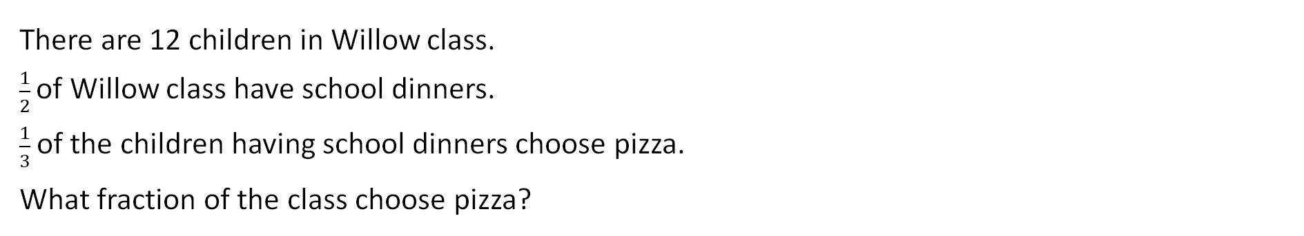
Teach: You do
1.
There are 12 children in Willow class.
$\frac{1}{2}$of Willow class have school dinners.
$\frac{1}{3}$ of the children having school dinners choose pizza.
What fraction of the class choose pizza?
2.
Molly sees 20 vehicles.
One-fifth are buses.
One-half of the buses are red.
What fraction of the vehicles Molly sees are red buses?
multiply | proper fraction | multiplier | product | numerator | denominator | simplify
Notes:
You do notes
Resources: Fraction multiplication problems (photocopy master), rectangular pieces of paper, Numicon pieces, Numicon pegs
Oracy groupings: Pairs
Give children the photocopy master. Ask them to work in pairs to solve the two problems.
For each problem, they should:
represent it in two different ways: drawing, paper folding or Numicon pieces and pegs
complete the sentence stem: ‘To solve the problem, I need to find __ of __’
write a multiplication calculation to match: __ × __ = __.
Look and listen for children who:
make/draw/fold an accurate model of each problem, e.g. using a Numicon 10-piece and a 2-piece to represent the 12 children in Willow class, using a 6-piece to represent half, then placing 2 pegs in the 6-piece to represent one-third of one-half
make clear links between their models and the problem, e.g. ‘These 2 pegs represent the children who choose pizza. This is 2 children out of a total of 12, which is the same as one-sixth’
complete the sentence stems correctly ($\frac{1}{3}$ of $\frac{1}{2}$ and $\frac{1}{2}$ of $\frac{1}{5}$)
write a multiplication calculation to match each problem, simplifying the product for the first problem ($\frac{1}{2}$ × $\frac{1}{3}$ = $\frac{2}{12}$ = $\frac{1}{6}$ and $\frac{1}{5}$ × $\frac{1}{2}$ = $\frac{1}{10}$)
give their answer as a fraction, rather than as a number of children/vehicles ($\frac{1}{6}$ and $\frac{1}{10}$).
Watch out for children who:
give their answer as a number (of children/vehicles) rather than a fraction
write the fractions in the wrong order in the sentence stem (while this will result in the same product, children’s understanding and comprehension of the information would be incorrect).
Assessment opportunities:
Strategy: marking

Slide 15

Exit
Always, sometimes or never?
When we multiply, the product is greater than the original number.
Ravi
Reflect on the ‘always, sometimes, never’ statement from the Talk task statement.
Would you answer differently now? Why?
When we multiply a pair of fractions, we multiply the … and the …
multiply | proper fraction | multiplier | product | numerator | denominator | simplify
Notes:
Exit notes
Resources: Numicon pieces, Numicon pegs, rectangular pieces of paper
Oracy groupings: Pairs
At the end of this lesson, children should be able to:
make connections between multiplying by a fraction and using a fraction as an operator
multiply pairs of proper fractions
identify patterns and general rules about multiplying with fractions.
Ask children to think back to the ‘Talk task’, where they discussed whether Ravi’s statement is always, sometimes or never true.
Ask pairs to discuss whether they would answer differently now, and why.
Look and listen for children who:
recognise that Ravi’s statement is sometimes true
distinguish between multiplying by a whole number (integer) and multiplying by a fraction
articulate that when multiplying by a whole number, the product will be greater, but when multiplying by a fraction, the product will be smaller
generalise that when we multiply a pair of fractions, we multiply the numerators and the denominators.
Children might use paper folding or Numicon pieces and pegs to prove or support their thinking.

Slide 16
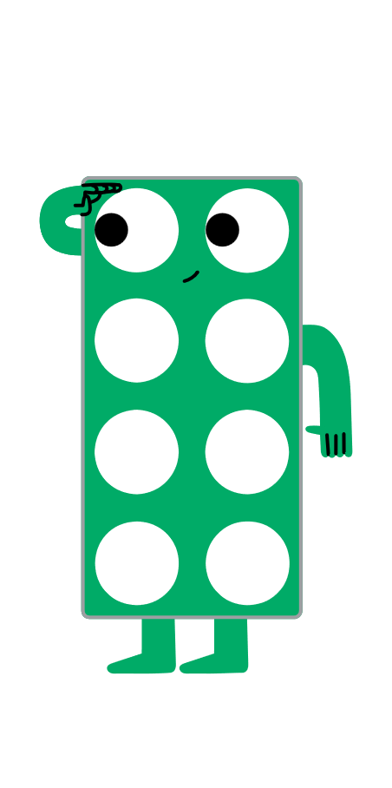
Reflection
Find the Numicon piece to show how you feel about multiplying pairs of fractions.
Notes:
Reflection notes
Resources: Numicon pieces
Ask children to hold up a Numicon piece to show how they feel about multiplying pairs of fractions.
Encourage children to choose a higher number if they feel more confident about their learning.
Assessment opportunities:
Strategy: visual
Make a note of any children who show a lower number.

Slide 17
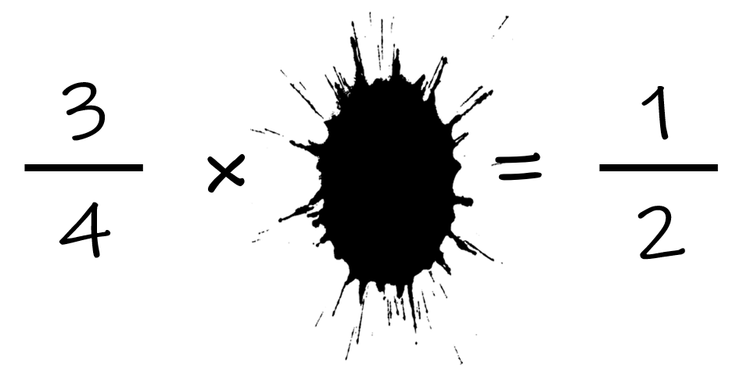
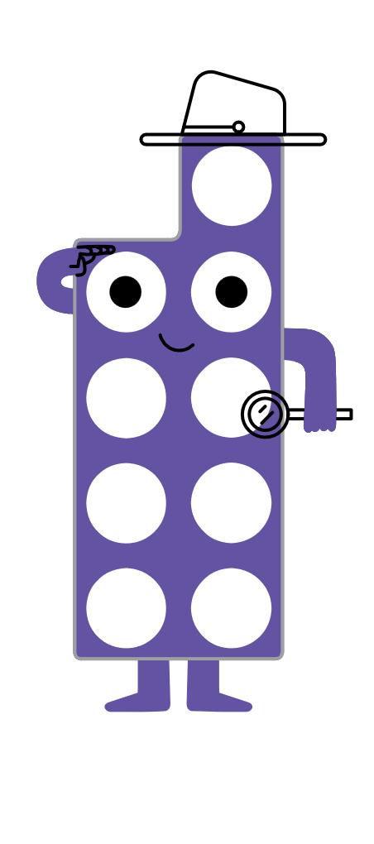
Extend and explore
Ben has spilt ink on his maths homework.
What fraction could be hidden by the ink?
Is there more than one possibility?
Paper folding might be useful here.
multiply | proper fraction | multiplier | product | numerator | denominator | simplify
Notes:
Extend and explore notes
Resources: print-outs of this slide, rectangular pieces of paper (optional)
This has been provided as an extra resource you can use as a follow-up to the lesson, for retrieval practice, or as an activity you can print out and give to children who need meaningful extension during the lesson.
Ask: What possible fractions could be hidden by the spilt ink?
If children are struggling to make a start, prompt them by reminding them that there are other fractions that are equivalent to $\frac{1}{2}$.
Look and listen for children who:
find fractions that are equivalent to $\frac{1}{2}$
write equations with products equivalent to $\frac{1}{2}$, e.g. $\frac{3}{4}$ × __ = $\frac{6}{12}$
use the rule they have learned about multiplying fractions: the numerators and the denominators need to be multiplied in order to find the product
find the multiplier in fraction form.
Watch out for children who:
try to multiply $\frac{3}{4}$ by a whole number
do not find fractions equivalent to $\frac{1}{2}$ and instead try to find $\frac{3}{4}$ × __ = $\frac{1}{2}.$
Answers:
The hidden fraction must be equivalent to two-thirds, e.g. the calculation could have been $\frac{3}{4}$ × $\frac{2}{3}$ = $\frac{6}{12}$, $\frac{3}{4}$ × $\frac{4}{6}$ = $\frac{12}{24}$ or $\frac{3}{4}$ × $\frac{6}{9}$ = $\frac{18}{36}$, all of whose products can be simplified to $\frac{1}{2}$.

