Slide 1
© Oxford University Press 2024

Slide 2
Multiply a unit fraction by an integer
Year 5 (P6) | Fractions
Notes:
Teacher information slide

Slide 3
Learning outcomes
Are children ready?
  I can add fractions and mixed numbers.
  I can add two or more fractions.
  Not ready? Try Numicon Essentials: Add fractions and mixed numbers (Year 4/P5)
Learning outcomes
  I can multiply a unit fraction by an integer.
Lesson summary
  In this lesson, children will be building on their knowledge of adding fractions and explore multiplying unit fractions by integers. Through their practice, they will use repeated addition to multiply a unit fraction by a given whole number. They will work with different manipulatives, including Numicon pieces, pegs and number lines.
Where next?
  I can multiply a non-unit fraction by an integer.
  I can multiply a mixed number by an integer.
  Ready to move on? Try Numicon Essentials: Multiply a non-unit fraction by an integer
Notes:
Teacher information slide

Slide 4
Curriculum links
White Rose small steps
  Year 5 | Spring term | Block 2 – Fractions B
Curriculum charts
  Northern Ireland | Numicon | Oxford International Curriculum | PYP |
  Ready to Progress | Republic of Ireland | Scotland | Te Mātaiaho | Wales
English National Curriculum
  Curriculum chart
  Multiply proper fractions and mixed numbers by whole numbers, supported by materials and diagrams.
NCETM
  Curriculum chart
  Year 5 Fractions:
  3. Pupils multiply a proper fraction by a whole number (within a whole).
  4. Pupils multiply a proper fraction by a whole number (greater than a whole).
This Numicon Essentials lesson could be used as an introduction, intervention, replacement and/or to deepen understanding of the White Rose small step shown below. This lesson does not include the use of bar models and combines the use of number lines and manipulatives to bring the learning to life.
  ▮ This Step 1 Multiply a unit fraction by an integer
  Step 2 Multiply a non-unit fraction by an integer
  Step 3 Multiply a mixed number by an integer
  Step 4 Calculate a fraction of a quantity
  Step 5 Fraction of an amount
Click here for the full White Rose curriculum mapping chart.
Click here for a full list of Numicon Essentials lessons.
Notes:
Teacher information slide

Slide 5
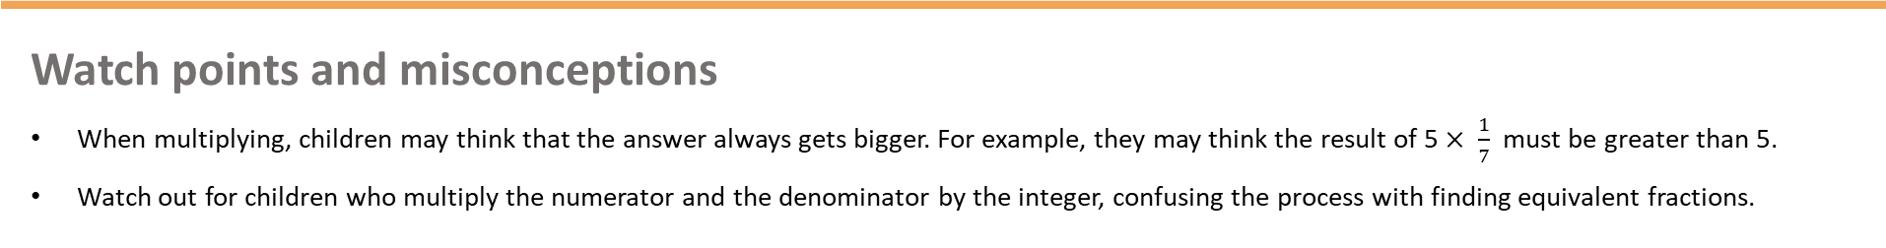
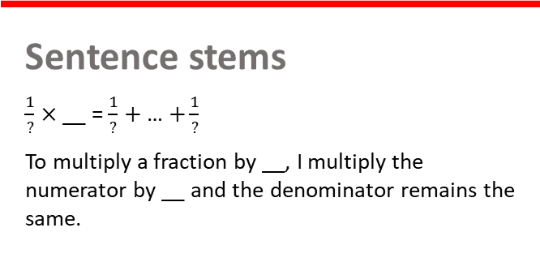
Lesson essentials
Resources
  Numicon pieces
  Numicon pegs or equivalent (marbles, beads, counters)
  Numicon spinners (optional)
  Visualiser (optional)
  Numicon IWB Software (optional)
  Print-outs of You do slide (optional) and Extend and explore slides
  Resource pack (PCMs):
  Fraction and integer spinners with cards
Key vocabulary
  numerator, denominator, part, whole, equal, multiply, unit fraction, non-unit fraction, integer, product, for every, proper fraction, improper fraction, mixed number
  Click here for glossary definitions.
Discussion stems
  Instigate: ‘I’d like to start by saying …’
  Build: ‘I agree, and I would like to add …’
  Challenge: ‘But have you considered …’
Sentence stems
  $\frac{1}{?}×$__ = $\frac{1}{?}+$ … $+\frac{1}{?}$
  To multiply a fraction by __, I multiply the numerator by __ and the denominator remains the same.
Key ideas and tips
  Refer to understanding of adding fractions with the same denominator when multiplying unit fractions by integers.
Watch points and misconceptions
  When multiplying, children may think that the answer always gets bigger. For example, they may think the result of 5 $× \frac{1}{7}$ must be greater than 5.
  Watch out for children who multiply the numerator and the denominator by the integer, confusing the process with finding equivalent fractions.
Notes:
Teacher information slide

Slide 6
Multiply a unit fraction by an integer
Notes:
Title slide
Check children’s recall and understanding of the vocabulary ‘unit fraction’ and ‘integer’.
Definition: A unit fraction is any fraction with 1 as its numerator (top number), and a whole number for the denominator (bottom number).
When a fraction shows 1 equal part of a whole, it is called a ‘unit fraction’. For example, $\frac{1}{4}$ or $\frac{1}{5}$ .
When a fraction shows more than 1 equal part of a whole, it is called a ‘non-unit fraction’. For example: $\frac{2}{4}$ or $\frac{3}{6}$ .
Definition: An integer is any whole number. (Note: Zero is also an integer.)

Slide 7



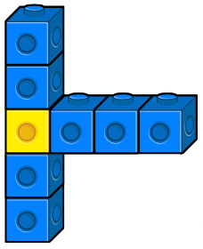
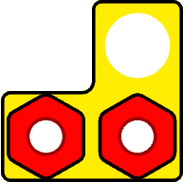


Talk task
Look at the models. Which one does not belong?
Explain your thinking.
Key words
part
whole
numerator
denominator
unit fraction
non-unit fraction
A
B
C
D
Instigate: ‘I’d like to start by saying …’
Build: ‘I agree, and I would like to add …’
Challenge: ‘But have you considered …’
Notes:
Talk task notes
Oracy groupings: Fishbowl or Traverse
Ask: What do you see or notice about the models on the screen? Which one does not belong?
Traverse option: Give children some thinking time then put them in two parallel lines. The children say their sentence to their partner and then move down the line.
Fishbowl option: Give children some thinking time then put them in groups with three children on the inside and three children on the outside. The children on the inside discuss the question while the children on the outside listen. During class feedback, the outside children feed back the inside children’s discussions.
Look and listen for children who:
recognise that each model is made up of several equal parts
recognise that 10p could be understood as a fraction of £1 (one-tenth)
recognise that B, C and D can all be described as a unit fraction: 1 part out of X (B = $\frac{1}{6}$, C = $\frac{1}{8}$, D = $\frac{1}{10}$)
recognise that A is the only non-unit fraction as it is $\frac{2}{3}$.
Watch for children who:
do not associate the money with fractions
do not recall the terms unit and non-unit fraction or cannot attribute the term unit fraction to any of the fractions on the board.
Bring children back together and ask them to share any findings with the class.
Assessment opportunities: ​​
Strategy: verbal ​​

Slide 8

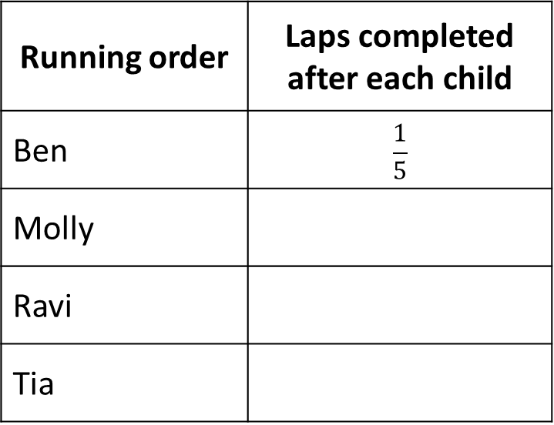
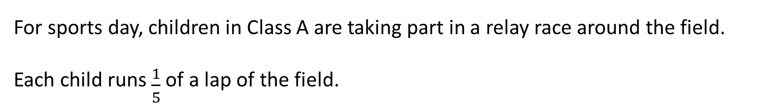
Switch on
For sports day, children in Class A are taking part in a relay race around the field.
Each child runs $\frac{1}{5}$ of a lap of the field.
Running order | Laps completed after each child
Ben | $$\frac{1}{5}$$
Molly
Ravi
Tia
Ben runs first, followed by Molly.
How far do they run between them?
How far do all four children run between them?
numerator | denominator | part | whole | multiply | unit fraction | integer
Notes:
Switch on notes
Resources: Numicon pieces, Numicon pegs
Oracy groupings: Pairs
Set the scene: For sports day, children in Class A are taking part in a relay race around the field. Each child runs one-fifth of a lap of the field.
Say: Ben runs first. He runs one-fifth of a lap. (Point to ‘$\frac{1}{5}$’ in the table.)
Ask: How far do Ben and Molly run between them?
Ask children to explore the problem, using Numicon pieces and pegs to support their thinking.
Look and listen for children who:
make a model to represent one-fifth, using a Numicon 5-piece and 1 peg
model adding another fifth by adding a second peg
recognise that the total distance run by Ben and Molly is two-fifths of a lap.
If children are struggling, use the following questions to break down the task further:
How can we show how far each child runs?
How can we show how far Ben and Molly run between them?
Agree that Ben and Molly run two-fifths of a lap between them. Write $\frac{2}{5}$ in the table next to Molly’s name.
Invite a child to show their model to the rest of the class.
Click to reveal the next question.
Ask: How far do all four children run between them?
Give children time to think about and model the problem.
Agree that by the time Ravi has run, the children have completed three-fifths of a lap. Record this next to Ravi’s name.
Agree that all four children run four-fifths of a lap between them. Record this next to Tia’s name.
Invite a child to show their model to the rest of the class.
Extension: You could ask children to answer the same questions if each child ran $\frac{1}{4}$ of a lap of the field.
Assessment opportunities:
Strategy: verbal​
Circulate the classroom, making note of children’s understanding. ​

Slide 9
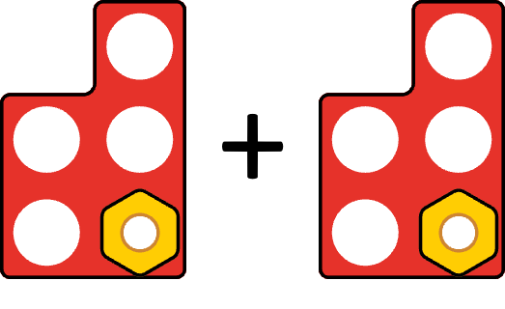
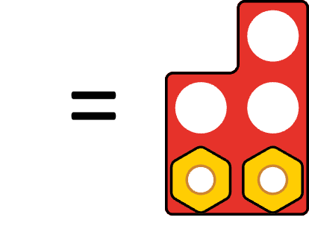
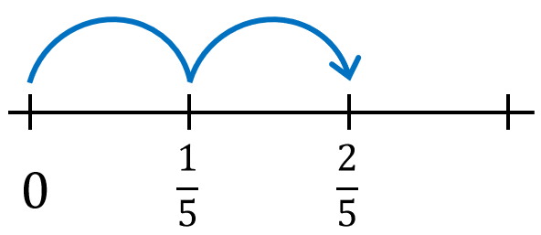



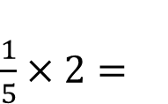
Teach: I do (1)
$\frac{1}{5}×2=$
Video demo
$$\frac{2}{5}$$
This is the same as $\frac{1}{5}+\frac{1}{5}$
$=\frac{2}{5}$
numerator | denominator | part | whole | multiply | unit fraction | integer
Notes:
Teach: I do (1) notes
Before the lesson: Watch the video showing how to model this first 'I do' phase and use it to help prepare for your own modelling. It is beneficial that this is done live by you with the children.
Resources: Numicon pieces, Numicon pegs, visualiser (optional), Numicon IWB Software (optional)
You can choose to model your thinking and what to do physically with manipulatives or using the Numicon IWB Software. If possible, we recommend using manipulatives.
Write: $\frac{1}{5}$ × 2 =
Ask: What is multiplying by 2 the same as doing?
Say: It is the same as adding the same number twice. So, $\frac{1}{5}$ × 2 is the same as $\frac{1}{5}$ + $\frac{1}{5}$ .
Write: $\frac{1}{5}$ + $\frac{1}{5}$
Click to reveal ‘This is the same as $\frac{1}{5}$ + $\frac{1}{5}$’ on the slide if needed.
Say: I am going to make a model of this.
Make a model of $\frac{1}{5}$ by using a Numicon 5-piece with a single peg in it to represent 1 of 5 parts. Repeat this using a second Numicon 5-piece and peg. Share your observations of multiplying as repeated adding.
Click to show the models on the slide if needed.
Say: We have one-fifth repeated two times. One-fifth add one-fifth.
Ask: How many fifths is that in total?
Model by taking an empty Numicon 5-piece and using this to show the total.
Say: One-fifth add one-fifth (move the pegs over into the Numicon 5-piece and take the empty pieces away). It is the same as two-fifths.
Click to reveal the completed Numicon model on the slide if needed.
Say: $\frac{1}{5}$ × 2 = $\frac{2}{5}$ (one-fifth multiplied by 2 is two-fifths) is the same as $\frac{1}{5}$ + $\frac{1}{5}$ = $\frac{2}{5}$ (one-fifth repeated 2 times or one-fifth add one-fifth is two-fifths).
Write $\frac{2}{5}$ as the answer to each of the number sentences.
Click to reveal the answer on the slide if needed.
Say: I notice that, like when adding fractions, the denominator does not change when we add more parts through multiplying.
The denominator is 5, because the whole has been split into 5 parts. The numerator is 2 because I had 1 repeated 2 times.1 part add 1 part is 2 parts. So, I have two-fifths in total.
If children need further consolidation, you could use the number line on the slide to reinforce the learning.
Click to reveal the number line.
Say: We can see here we’ve taken 2 equal-sized jumps of one-fifth along the number line.
One-fifth multiplied by 2 (point out the 2 jumps) is two-fifths.
One-fifth multiplied by 2 is the same as 2 groups of one fifth. One-fifth (move your finger from 0 to $\frac{1}{5}$ along the bottom of the number line) add another one-fifth (continue to move your finger along the bottom of the line to stop at $\frac{2}{5}$ ) is two-fifths.

Slide 10
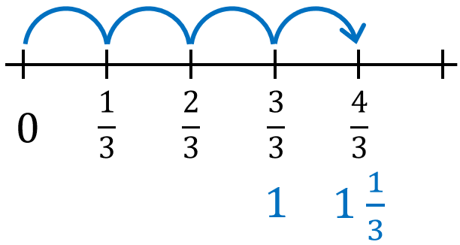
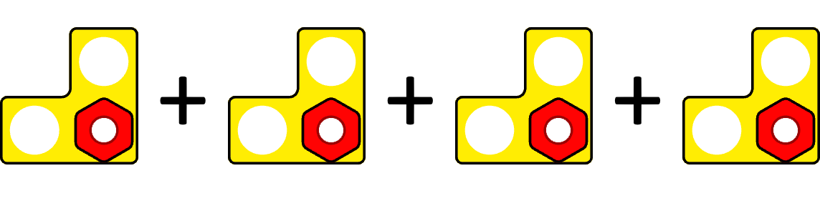
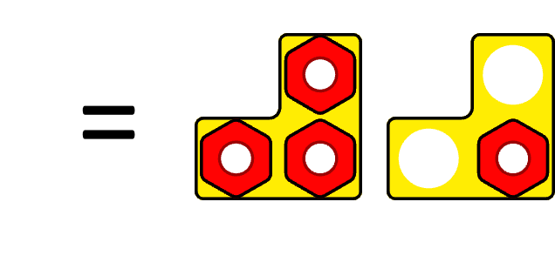

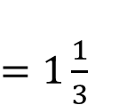
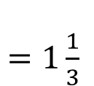


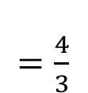
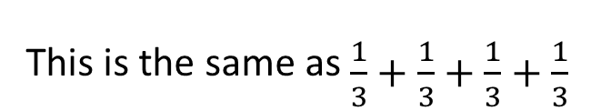
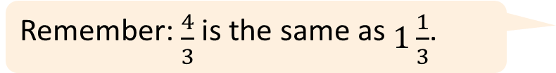
Teach: I do (2)
$\frac{1}{3}×4=$
$=1\frac{1}{3}$
Video demo
$\frac{4}{3}$
This is the same as $\frac{1}{3}+\frac{1}{3}+\frac{1}{3}+\frac{1}{3}$
$=\frac{4}{3}$
$=1\frac{1}{3}$
Remember: $\frac{4}{3}$ is the same as $1\frac{1}{3}$.
numerator | denominator | part | whole | multiply | unit fraction | integer
Notes:
Teach: I do (2) notes
Before the lesson: Watch the video showing how to model this second 'I do' phase and use it to help prepare for your own modelling. It is beneficial that this is done live by you with the children.
Resources: Numicon pieces, Numicon pegs, visualiser (optional), Numicon IWB Software (optional)
You can choose to model your thinking and what to do physically with manipulatives or using the Numicon IWB Software. If possible, we recommend using manipulatives.
Write: $\frac{1}{3}$ × 4 =
Ask: What is multiplying by 4 the same as doing? (It is the same as adding the same number 4 times.)
Say: One-third multiplied by 4.
Write: $\frac{1}{3}$ + $\frac{1}{3}$ + $\frac{1}{3}$ + $\frac{1}{3}$
Click to reveal ‘This is the same as as $\frac{1}{3}+\frac{1}{3}+\frac{1}{3}+\frac{1}{3}$‘ on the slide if needed.
Model your observations of multiplying as repeated adding, counting how many groups of one-third you have.
Say: One, two, three, four … (pointing to each fraction as you count, to show you have 4 lots of $\frac{1}{3}$). I will make a model of this.
Make a model of 4 groups of $\frac{1}{3}$ by using four Numicon 3-pieces each with a single peg in to represent 1 of 3 parts.
Say: One-third, add one-third, add one-third, add one-third (as you lay out the pieces).
Click to reveal the models on the slide if needed.
Ask: How many thirds do I have in total? I can move my pegs to simplify my fraction.
Combine the pegs to fill as many Numicon pieces as possible and remove the remaining empty pieces.
Click to reveal the completed Numicon model on the slide if needed.
Say: I can see that I have 4 thirds in total. Or I have 1 whole and one-third.
Write $\frac{4}{3}$ and/or 1 $\frac{1}{3}$ as the answer to each of the number sentences.
Click to reveal the answer on the slide if needed.
Say: I notice that, like when adding fractions, the denominator does not change when we add more parts through multiplication. The whole has been split into 3 equal parts. The denominator stays the same.
Say: We have multiplied the number of parts. 1 part (point to a peg) multiplied by 4.The numerator changes. I know that the denominator is 3 (point to a Numicon 3-piece) and the numerator is 4 (indicate the 4 pegs), so I have $\frac{4}{3}$ in total.
If children need further consolidation, you could use the number line on the slide to reinforce the learning.
Click to reveal the number line.
Say: We can see here we’ve taken 4 equal-sized jumps of one-third along the number line.
One-third multiplied by 4 (point out the 4 jumps) is four-thirds.
One-third multiplied by 4 is the same as 4 groups of one third. One-third, add one-third, add one-third (move your finger from 0 along the bottom of the number line) add one-third (stop at $\frac{4}{3}$ ) is four-thirds, which is the same as 1 whole and one-third.

Slide 11
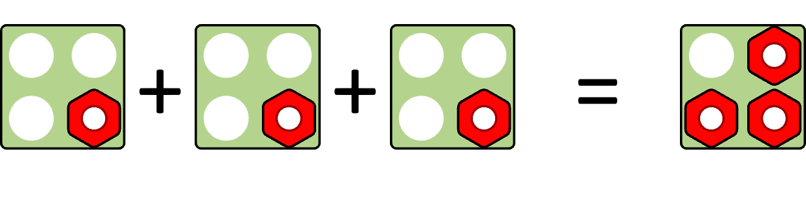
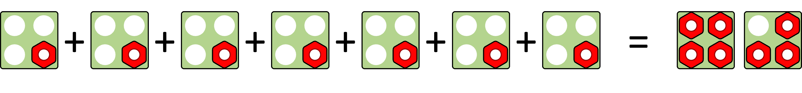
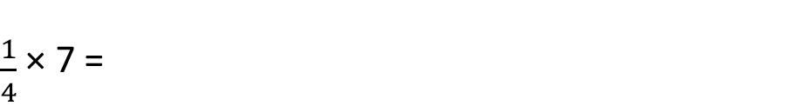
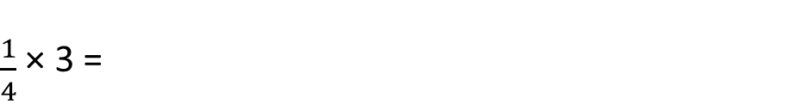
Teach: We do (1)
Find the answers.
$\frac{1}{4}$ × 3 =
$\frac{1}{4}$ × 7 =
numerator | denominator | part | whole | multiply | unit fraction | integer
Notes:
Teach: We do (1) notes
Resources: Numicon pieces, Numicon pegs
Oracy groupings: Pairs
Say: I would like you to try and find the answers for these two number sentences.
Ask children to work in pairs to represent the two problems using Numicon pieces and pegs.
Ask: What answer did you get for the first problem? ($\frac{3}{ 4}$)
Click to reveal Numicon pieces and pegs representing $\frac{1}{4}$ × 3.
Ask: What answer did you get for the second problem? ($\frac{7}{4}$)
Click to reveal Numicon pieces and pegs representing $\frac{1}{4}$ × 7.
Ask: Can you write this improper fraction in another way? (Yes, as a mixed number: 1 $\frac{3}{4}$.)
If any children used the apparatus to model either of the problems in a different way, invite them to explain their method to the class.

Slide 12
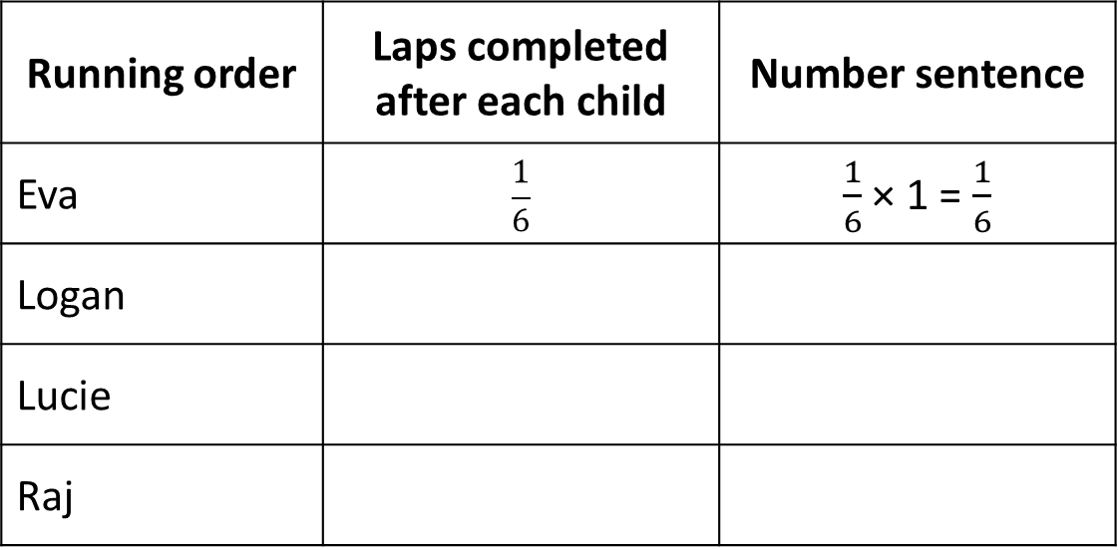
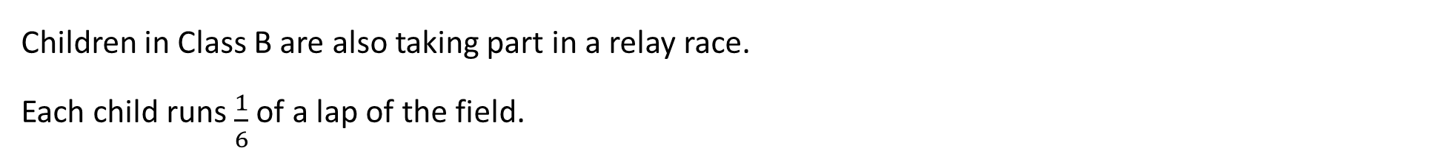
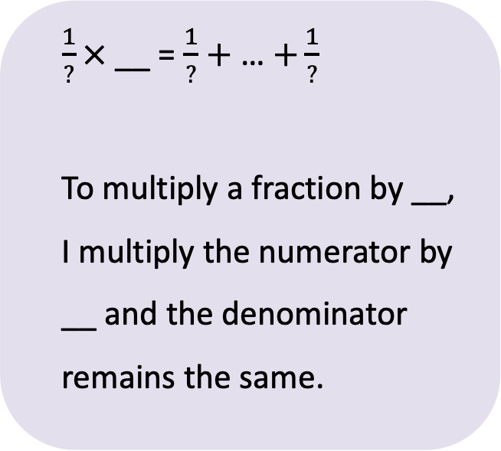
Teach: We do (2)
Children in Class B are also taking part in a relay race.
Each child runs $\frac{1}{6}$ of a lap of the field.
$\frac{1}{?}×$__ = $\frac{1}{?}+$ … $+\frac{1}{?}$
To multiply a fraction by __, I multiply the numerator by __ and the denominator remains the same.
Running order | Laps completed after each child | Number sentence
Eva | $$\frac{1}{6}$$ | $\frac{1}{6}$ × 1 = $\frac{1}{6}$
Logan
Lucie
Raj
numerator | denominator | part | whole | multiply | unit fraction | integer
Notes:
Teach: We do (2) notes
Resources: Numicon pieces, Numicon pegs
Oracy groupings: Pairs
Set the scene: At sports day, children in Class B are also taking part in a relay race. In Class B’s race, each child runs one-sixth of a lap of the field.
Say: We are going to use what we’ve learned so far in this lesson to do three things:
Fill in the table to show the laps completed after each child.
Write a number sentence to represent the scenario after each child has run.
Use apparatus to represent the scenario after Raj has finished running.
Ask children to work in pairs, talking through the problem together and modelling with Numicon pieces and pegs to support their discussion.
Model the sentence stems and encourage children to use them, e.g. $\frac{1}{6} × 3$= $\frac{1}{6}+$ $\frac{1}{6}$ $+\frac{1}{6}$ . To multiply a fraction by 3, I multiply the numerator by 3 and the denominator remains the same.
Go through the rows of the table one at a time, inviting different pairs to share their answers and writing them into the table.
Logan: $\frac{2}{6}$, $\frac{1}{6}×2=\frac{2}{6}$
Lucie: $\frac{3}{6}$, $\frac{1}{6}×3=\frac{3}{6}$
Raj: $\frac{4}{6}$, $\frac{1}{6}×4=\frac{4}{6}$
Look for children modelling the total distance run by using a Numicon 6-piece to represent a whole lap, and 4 pegs to represent the four-sixths run by the children.
Ask: If 10 children took part in the relay race, how many laps of the field would they have run?
Ask children to write a number sentence and give the answer as an improper fraction and a mixed number. ($\frac{1}{6}×10=\frac{10}{6} or 1\frac{4}{6}$)
Optional extension: Ask children how each fraction could be simplified.
Eva $\frac{1}{6}$, Logan $\frac{1}{3}$, Lucie: $\frac{1}{2}$, Raj $\frac{2}{3}$
For the question about 10 children running $\frac{1}{6}$ each, the answer could be simplified to $\frac{5}{3}$ or 1 $\frac{2}{3}$.
Assessment opportunities:
Strategy: ​written
Students self-mark as you go through the answers.

Slide 13

Hinge
Which of these calculations is correct?
A $\frac{1}{8}$ × 5 = $\frac{5}{8}$
B $\frac{1}{8}$ × 5 = $\frac{5}{40}$
C $\frac{1}{8}$ × 5 = $\frac{1}{40}$
numerator | denominator | part | whole | multiply | unit fraction | integer
Notes:
Hinge notes
Ask: Which of these calculations is correct? (A)
Give children the opportunity to think independently about the question and then ask them to write either A, B or C on their whiteboards.
Assessment opportunities:
Strategy: visual
If a significant number of children answer incorrectly, pause the lesson here to revisit/consolidate the key concepts before moving onto the ‘You do’ phase.
Make a note of which children wrote B or C (and therefore have not yet understood).
Encourage children who correctly selected A to think of a story to match the correct answer and probe those who chose a different answer to identify misconceptions.
During the class discussion, probe those who chose B or C to identify misconceptions. E.g. Why do you think …? What evidence do you have to support your idea? Could you provide an example?

Slide 14
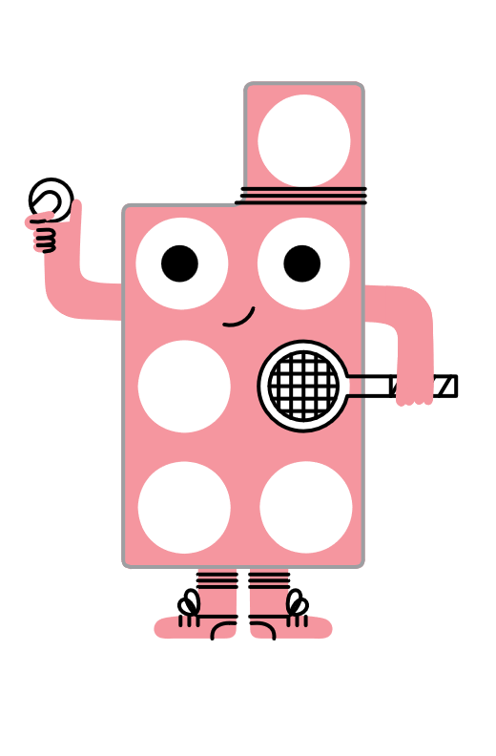
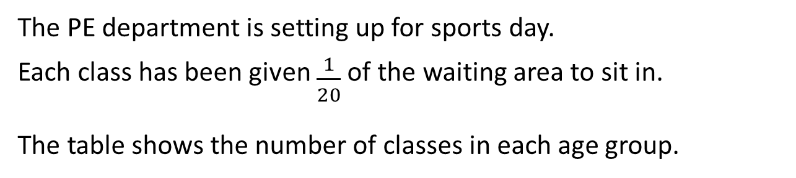
Teach: You do
The PE department is setting up for sports day.
Each class has been given $\frac{1}{20}$ of the waiting area to sit in.
The table shows the number of classes in each age group.
Age group | Number of classes
7 to 8 years | 2
8 to 9 years | 3
9 to 10 years | 4
10 to 11 years | 5
What fraction of the waiting area does each age group need?
Write these as multiplication calculations.
The remaining area is left for visitors to watch.
What fraction of the waiting area is left for visitors?
Use Numicon pieces and pegs to help you.
numerator | denominator | part | whole | multiply | unit fraction | integer
Notes:
Teach: You do notes
Resources: Numicon pieces, Numicon pegs, print-outs of this slide (optional)
Oracy groupings: Pairs
Read through the challenge on the slide together.
After reading the second sentence, you could pause to ask children to make $\frac{1}{20}$ with their Numicon pieces and pegs before moving on to the rest of the question.
Ask children to work in pairs, talking through the problem together and following the instructions on the slide.
Ask them to record their multiplication calculations in their books.
Watch out for children who:
multiply both the numerator and the denominator by the integer, confusing the process with finding equivalent fractions.
Extension: Ask children to simplify their fractions.
Assessment opportunities:
Strategy: marking
Mark children’s number sentences in their books.
Answers:
7 to 8 years: $\frac{1}{20}$ × 2 = $\frac{2}{20}$ 8 to 9 years: $\frac{1}{20}$ × 3 = $\frac{3}{20}$ 9 to 10 years:$\frac{1}{20}$ × 4 = $\frac{4}{20}$ 10 to 11 years: $\frac{1}{20}$ × 5 = $\frac{5}{20}$
What fraction of the waiting area remains:
$\frac{2}{20}$ + $\frac{3}{20}$ + $\frac{4}{20}$ + $\frac{5}{20}$ = $\frac{14}{20}$ This shows us that $\frac{14}{20}$ of the waiting area was filled. $\frac{20}{20}$ − $\frac{14}{20}$ = $\frac{6}{20}$. This shows us that $\frac{6}{20}$ of the waiting area was left for visitors.
Simplified fractions:
$\frac{2}{20}$ = $\frac{1}{10}$, $\frac{3}{20}$ (is already in its simplest form), $\frac{4}{20}$ = $\frac{1}{5}$, $\frac{5}{20}$ = $\frac{1}{4}$, $\frac{6}{20}$ = $\frac{3}{10}$

Slide 15
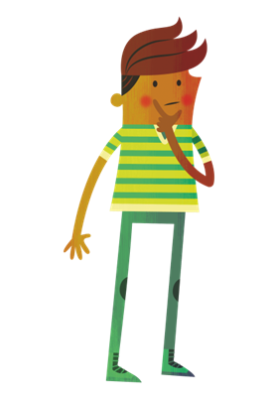

Exit
True or false?
When you multiply a unit fraction by an integer, the product is still a unit fraction.
Give an example to prove your thinking.
Ravi
numerator | denominator | part | whole | multiply | unit fraction | integer | product
Notes:
Exit notes
Resources: Numicon pieces, Numicon pegs
At the end of this lesson, children should be able to:
multiply a unit fraction by an integer
Ask children to think about whether this statement is true or false, then prove their thinking with an example or apparatus.
Look and listen for children who:
correctly identify that the fraction is no longer a unit fraction as, after multiplying, there is now more than 1 part (unless multiplying by 1 or 0).
Watch out for children who:
need reminding of the word ‘product’ (a product is the result of multiplying two or more numbers together).

Slide 16
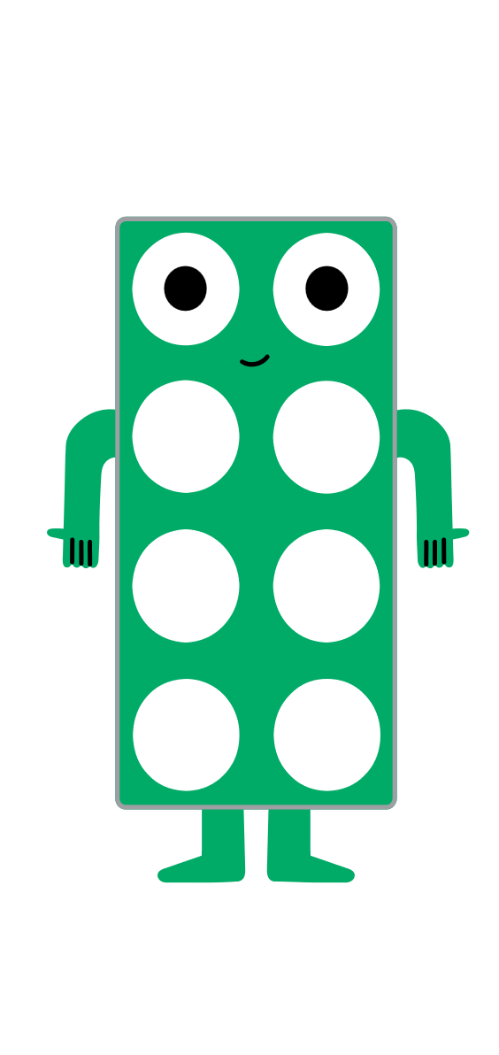
Reflection
Hold up the Numicon piece that shows how you feel about multiplying a unit fraction by an integer.
Notes:
Reflection notes
Resources: Numicon pieces
Ask children to hold up a Numicon piece to show how they feel about multiplying a unit fraction by an integer.
Encourage children to choose a higher number if they feel more confident about their learning.
Assessment opportunities:
Strategy: visual
Make a note of any children who show a lower number.

Slide 17
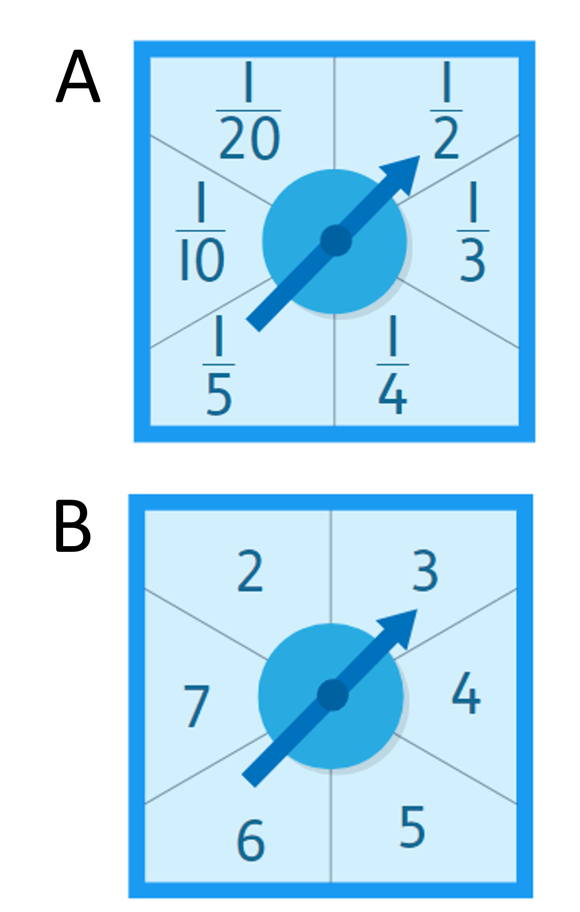

Extend and explore
Spin the first spinner (A) to get a unit fraction.
Spin the second spinner (B) to get an integer.
Write a number sentence to multiply the unit fraction by the integer.
You can use apparatus or a written calculation.
Spin again and repeat!
How many solutions can you find?
numerator | denominator | part | whole | multiply | unit fraction | integer
Notes:
Extend and explore notes
Before the lesson: Prepare the spinners (if using) by cutting out the overlays from the photocopy master and fitting them over Numicon spinners. Alternatively, cut out the number cards from the photocopy master.
Resources: Fraction and integer spinners with cards (photocopy master), Numicon spinners (optional), Numicon pieces, Numicon pegs, print-outs of this slide
Oracy groupings: Pairs
This has been provided as an extra resource you can use as a follow-up to the lesson, for retrieval practice, or as an activity you can print out and give to children who need meaningful extension during the lesson.
Children could work in pairs or independently. Ask them to spin each spinner (or select a number card from each set) to generate a fraction and an integer.
They then write the resulting number sentence into their books with their answer (e.g. $\frac{1}{2}$ × 4 = $\frac{4}{2}$ or 2).
Ask them to repeat this multiple times.
Assessment opportunities:
Strategy: marking or peer assessment
If children are working in pairs on this task, they could swap their books to check each other’s answers.

