Slide 1
© Oxford University Press 2024

Slide 2
Add two or more fractions
Year 4 (P5) | Fractions
Notes:
Teacher information slide

Slide 3
Learning outcomes
Are children ready?
  I can add fractions with the same denominator within the whole.
  I can express fractions greater than 1 as mixed numbers and improper fractions.
  Not ready? Try Numicon Essentials:
  Add fractions (Year 3 / P4) or Improper fractions and mixed numbers
Learning outcomes
  I can add two or more fractions with the same denominator, including totals greater than 1.
Lesson summary
  In this lesson, children will be building on and reviewing their learning of adding two fractions with the same denominator. They will practise adding two or more proper fractions, with a sum greater than one whole in some instances. They will practise writing fractions as adding sentences by writing a fraction as a sum of smaller fractions.
Where next?
  I can add a proper fraction to a mixed number.
  Ready to move on? Try Numicon Essentials: Add fractions and mixed numbers
Notes:
Teacher information slide

Slide 4
Curriculum links
White Rose small steps
  Year 4 | Spring term | Block 3 – Fractions
Curriculum charts
  Northern Ireland | Numicon | Oxford International Curriculum | PYP |
  Ready to Progress | Republic of Ireland | Scotland | Te Mātaiaho | Wales
English National Curriculum
  Curriculum chart
  Add and subtract fractions with the same denominator.
NCETM
  Curriculum chart
  Year 4 Review of fractions:
  1. Pupils identify a whole and the parts that make it up.
  2. Pupils identify the number of equal or unequal parts in a whole.
  4. Pupils explain the size of the part in relation to the whole.
  5. Pupils construct a whole when given a part and the number of parts.
This Numicon Essentials lesson can be used as a follow-up to this small step, to give a deeper understanding of adding more than two fractions.
  This step:: Step 9 Equivalent fractions on a number line
  Step 10 Equivalent fraction families
  ▮ Step 11 Add two or more fractions
  Step 12 Add fractions and mixed numbers
  Step 13 Subtract two fractions
Click here for the full White Rose curriculum mapping chart.
Click here for a full list of Numicon Essentials lessons.
Notes:
Teacher information slide

Slide 5
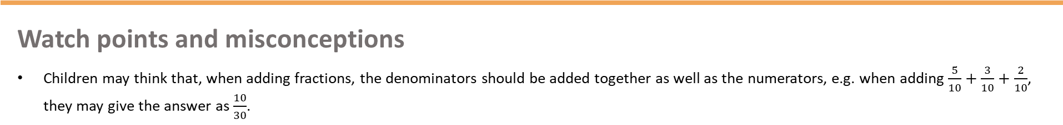
Lesson essentials
Resources
  Numicon pieces
  Numicon pegs or equivalent (marbles, beads, counters)
  Number rods
  Interlocking cubes
  Six-sided dice
  Visualiser (optional)
  Numicon IWB Software (optional)
  Print-outs of Extend and explore slides
  Resource pack (PCMs):
  Adding fractions
Key vocabulary
  greater, less, add, sum, total, fraction, numerator, denominator, whole, part, split, value, equal
  Click here for glossary definitions.
Discussion stems
  Build: ‘I agree because …’
  Challenge: ’I disagree because …’
  Clarify: ’So do you mean that …?’
Sentence stems
  The total of __ and __ is __.
Key ideas and tips
  The denominator represents how many equal parts the whole has been split into.​
  Fractions with the same denominator can be added together.
  Fractions can be added together to make a total greater than 1.
Watch points and misconceptions
  Children may think that, when adding fractions, the denominators should be added together as well as the numerators, e.g. when adding $\frac{5}{10}+\frac{3}{10}+\frac{2}{10}$, they may give the answer as $\frac{10}{30}$.
Notes:
Teacher information slide

Slide 6
Add two or more fractions
Notes:
Title slide

Slide 7



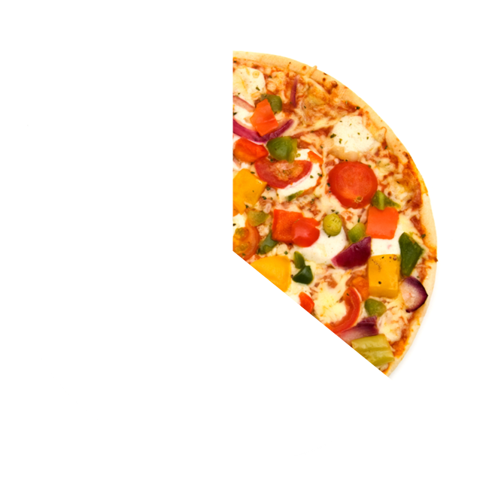
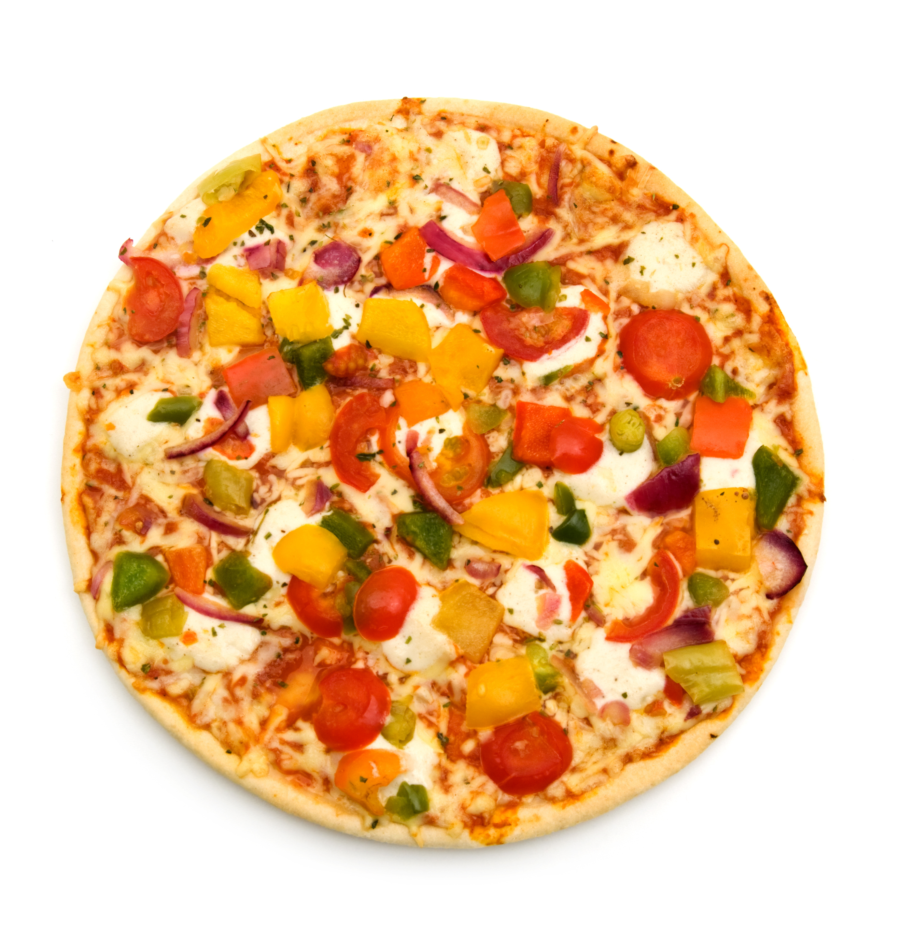

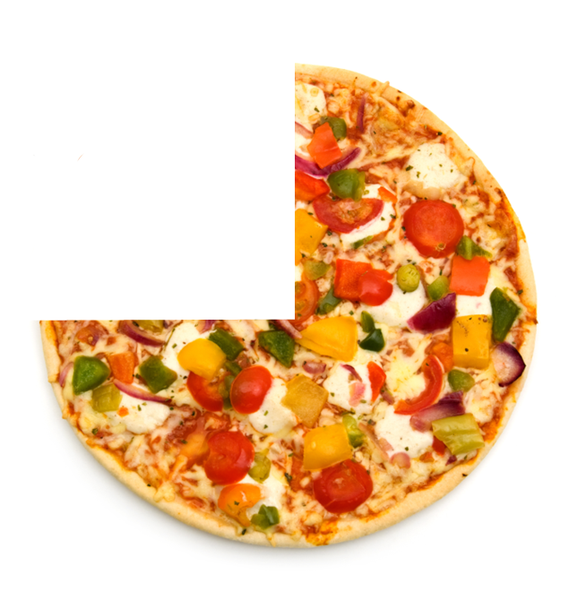
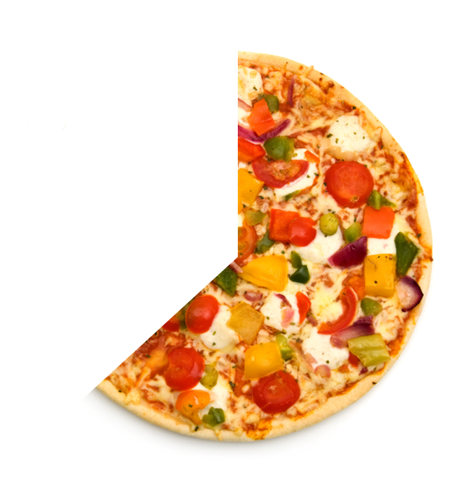

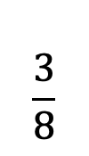




Talk task
Which pairs of fractions could you add together to make a whole?
Key words
total
fraction
part
whole
value
numerator
denominator
$$\frac{1}{4}$$
$$\frac{3}{8}$$
$$\frac{5}{6}$$
$$\frac{3}{4}$$
$$\frac{1}{6}$$
$$\frac{5}{8}$$
Build: ‘I agree because …’
Challenge: ‘I disagree because …’
Clarify: ‘So you mean that …’
How do you know that your pairs of fractions make a whole?
Notes:
Talk task notes
Oracy groupings: Pairs
This is an opportunity to remind children how to add two fractions together.
Say: Look at the different fractions of pizza. Can you find pairs of fractions that add together to make one whole pizza?
Ask children to work with their partner, talk about the reasons for their choices and write down the fraction pairs. ($\frac{1}{4}$ and $\frac{3}{4}$, $\frac{3}{8}$ and $\frac{5}{8}$, $\frac{5}{6}$ and $\frac{1}{6}$ )
Ask: How many whole pizzas can you make? (3)
Look and listen for children who:
recognise that the pizza slices with the common denominator combine to make a whole.
recognise that the two numerators add up to the same value as the denominator.
During class feedback, ask children to share their fraction pairs and to explain the reasons why they chose each pair.
Draw out the need for the denominators to be the same and for the numerators to add up to the value of the denominator.
Ways to adapt:
remove some or all of the pizza images and just use the fractions
remove some of the fractions and ask children in pairs to identify what the missing fractions are either before or after they have combined their pizzas together.

Slide 8
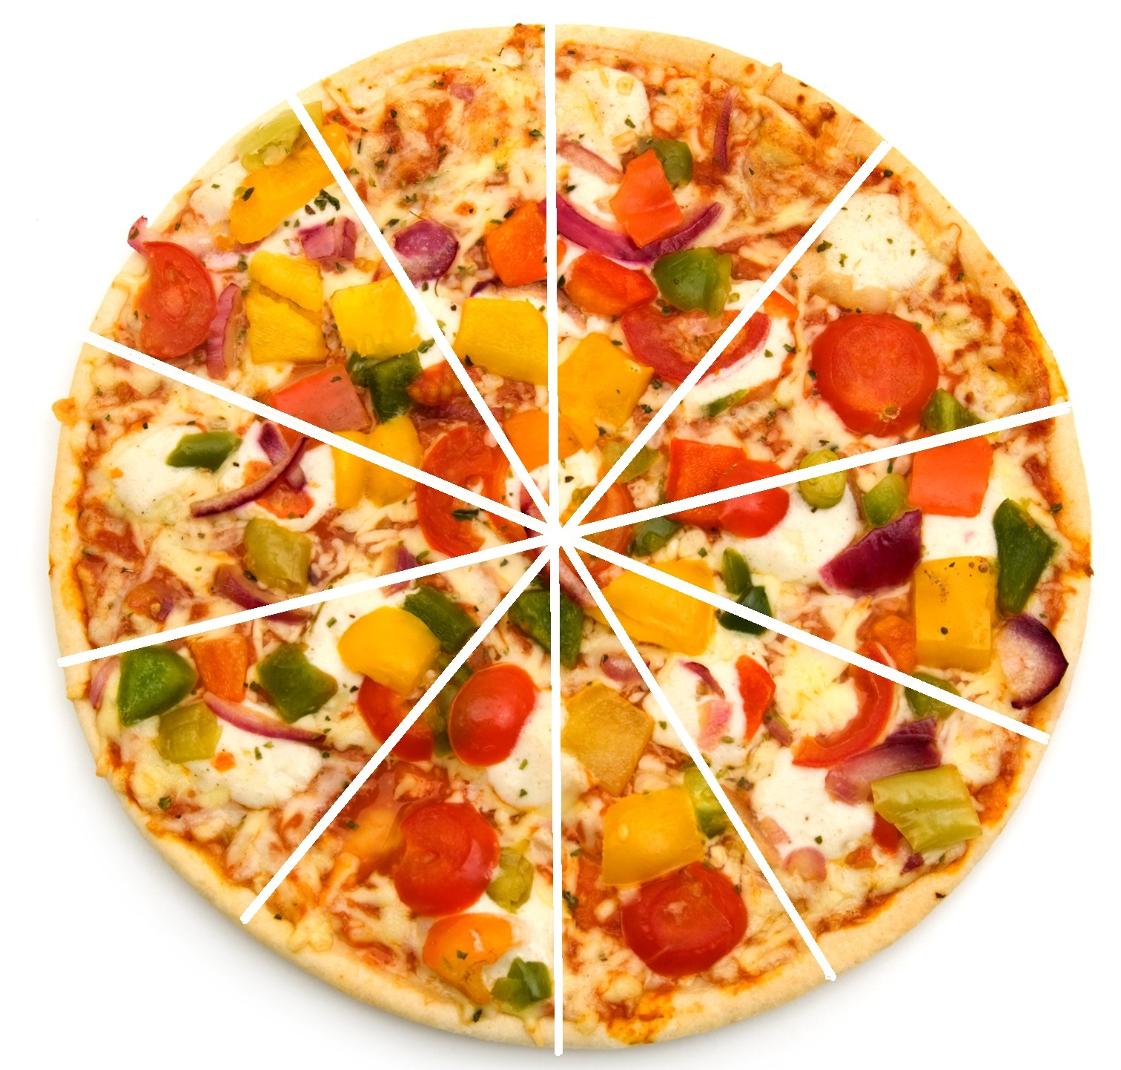
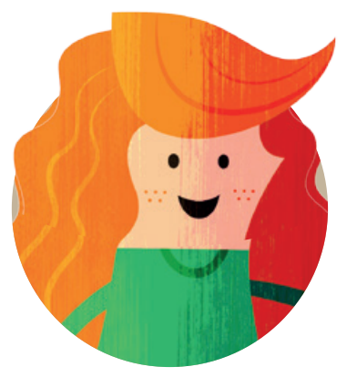


Switch on
The pizza was cut into 10 equal slices.
3 friends ate all of the pizza between them.
We all ate a different amount.
I ate more pizza than Molly or Tia.
I ate 1 slice less than Molly.
Molly
Ravi
Tia
Represent this using number rods or Numicon pieces and pegs.
Can you find more than one solution?
add | sum | total | fraction | numerator | denominator | whole | part | equal
Notes:
Switch on notes
Resources: Numicon pieces, Numicon pegs, number rods
Oracy groupings: Pairs
Set the scene: The pizza was cut into 10 equal slices. 3 friends ate all of the pizza between them.
Ask children to read each of the speech bubbles on the slide.
Ask them to work in pairs to represent the problem using their choice of manipulatives (either number rods or Numicon pieces and pegs).
Ask: Do you think there could be more than one solution?
Give children time to explore this with their partner, before taking feedback and asking pairs to demonstrate their solutions using their chosen manipulatives.
Look and listen for children who:
suggest more than one possible solution, e.g. Molly could have 3 slices, Ravi could have 5 slices, Tia could have 2 slices; or Molly could have 2 slices, Ravi could have 7 slices, Tia could have 1 slice.
Watch out for children who:
cannot represent the slices of pizza using their apparatus (particularly using the Numicon 10-piece to represent the whole pizza).

Slide 9
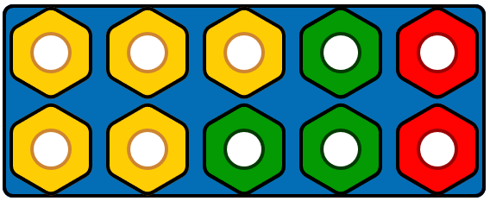
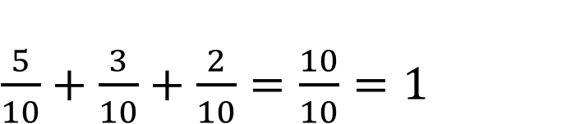
Teach: I do (1)
The pizza was cut into 10 equal slices. 3 friends ate all of the pizza.
Video demo
We all ate a different amount.
I ate more pizza than Molly or Tia.
I ate 1 slice less than Molly.
Molly
Ravi
Tia
What if Ravi ate 5 slices?
$\frac{5}{10}+\frac{3}{10}+\frac{2}{10}=\frac{10}{10}=1$
add | sum | total | fraction | numerator | denominator | whole | part | equal
Notes:
Teach: I do (1) notes
Before the lesson: Watch the video showing how to model this first 'I do' phase and use it to help prepare for your own modelling. It is beneficial that this is done live by you with the children.​
Resources: Numicon pieces, Numicon pegs, number rods (optional), visualiser (optional), Numicon IWB Software (optional)
You can choose to model your thinking and what to do physically with manipulatives or using the Numicon IWB Software. If possible, we recommend using manipulatives.
Set the scene: We are going to continue thinking about the problem from the ‘Switch on’ task. Remember:
all three children ate a different amount
Ravi ate more than Molly or Tia
Tia ate 1 slice less than Molly.
Take a Numicon 10-piece and tell children that this represents the whole pizza split into 10 equal parts.
Model one solution to the problem using Numicon pieces and pegs.
Say:
What if Ravi ate 5 slices of pizza? I know he ate the most.
So what if Molly ate 3 slices of pizza?
I know that Tia ate 1 slice less than Molly, so Tia has eaten 2 slices of the pizza.
Click to reveal the model on the slide if needed.
Explain the fraction eaten by each child, alongside modelling writing these as a sum of three fractions.
Ravi ate 5 slices out of 10 slices of pizza. Ravi ate five-tenths of the pizza. (Write $\frac{5}{10}$.)
Molly ate 3 slices out of the 10 slices. Molly ate three-tenths of the pizza. (Write + $\frac{3}{10}$.)
Tia ate the least. She ate 2 slices out of the 10 slices of pizza. (Write + $\frac{2}{10}$.)
$\frac{5}{10}$ add $\frac{3}{10}$ add $\frac{2}{10}$ (Write =.)
How many tenths is that in total? 5 add 3 add 2 equals 10. (Write $\frac{10}{10}$.) Ten-tenths of the pizza.
Ask: What do I notice?
Say: I can see that the three friends ate all of the pizza. I know that ten-tenths is the same as 1 whole.
Click to reveal the adding sentence on the slide if needed.
You could also choose to model the solution using number rods (an orange rod to represent the whole, then aligned above that: a yellow rod to represent Ravi’s 5 slices, a light green rod to represent Molly’s 3 slices and a red rod to represent Tia’s 2 slices).
You may choose to model a different solution in the same way before moving on (e.g. Ravi 7 slices, Molly 2 slices, Tia 1 slice).

Slide 10
Teach: We do (1)
What if the three friends only ate 9 out of the 10 slices?
What could the adding sentence be?
We all ate a different amount.
I ate more pizza than Molly or Tia.
I ate 1 slice less than Molly.
Molly
Ravi
Tia
Build: ‘I agree because …’
Challenge: ‘I disagree because …’
Clarify: ‘So you mean that …’
add | sum | total | fraction | numerator | denominator | whole | part | equal
Notes:
Teach: We do (1) notes
Resources: Numicon pieces, Numicon pegs, number rods
Oracy groupings: Pairs
Provide children with Numicon pieces, pegs and number rods.
Set the scene: This time, imagine that the pizza was cut into 10 equal slices, but the friends only ate 9 of them.
Ask: How many slices of pizza did each friend eat? Is there more than one solution this time?
Encourage children to work in pairs and use their apparatus to model their number sentences and check that they work.
Look and listen for children who:
work collaboratively to find new solutions
test the solutions using their Numicon pieces and pegs or their number rods.
Write the possible adding sentences on the board (children could do this on individual whiteboards) ensuring they notice that the three fractions need to total $\frac{9}{10}$ this time. For example:
Ravi 6 slices, Molly 2 slices, Tia 1 slice: $\frac{6}{10}$ + $\frac{2}{10}$ + $\frac{1}{10}$ = $\frac{9}{10}$.
Or
Ravi 4 slices, Molly 3 slices, Tia 2 slices: $\frac{4}{10}$ + $\frac{3}{10}$ + $\frac{2}{10}$ = $\frac{9}{10}$.
Watch out for children who:
struggle to understand that the denominator is still 10 but the number of parts (numerator) must now total 9. Explain that it is the number of slices that are eaten (numerator) that has changed and not the pizza itself.
Assessment opportunities: ​
Strategy: visual
Circulate the classroom, making note of children’s understanding.

Slide 11
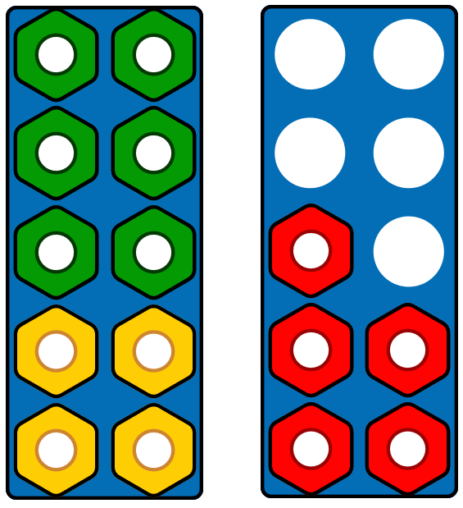
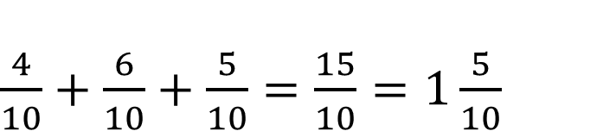
Teach: I do (2)
This time there are 2 pizzas, each cut into 10 equal slices.
Ravi eats 4 slices.
Molly eats 6 slices.
Tia eats 5 slices.
What could the adding sentence be?
$\frac{4}{10}+\frac{6}{10}+\frac{5}{10}=\frac{15}{10}=1\frac{5}{10}$
add | sum | total | fraction | numerator | denominator | whole | part | equal
Notes:
Teach: I do (2) notes
Resources: Numicon pieces, Numicon pegs, visualiser (optional), Numicon IWB Software (optional)
You can choose to model your thinking and what to do physically with manipulatives or using the Numicon IWB Software. If possible, we recommend using manipulatives.
Set the scene: This time there are 2 pizzas, each cut into 10 equal slices.
Molly eats 4 slices
Ravi eats 6 slices
Tia eats 5 slices
Take a Numicon 10-piece and tell children that this represents the first whole pizza cut into 10 equal parts.
Take a second Numicon 10-piece and tell children that this represents the second whole pizza cut into 10 equal parts.
Say:
I know that Ravi eats 4 slices. (Place 4 pegs into the first 10-piece.)
I know that Molly eats 6 slices. (Place 6 more pegs into the first 10-piece.)
I can see that the first 10-piece is full. What does that mean? (1 whole pizza has been eaten.)
I know that Tia eats 5 slices. (Place 5 pegs into the second 10-piece.)
Click to reveal the model on the slide if needed.
I can see that in total the children have eaten 1 whole pizza and five-tenths of a pizza.
I can also see that in total they have eaten 15 slices of pizza. (Count the pegs individually). This means that they have eaten fifteen-tenths of the pizza.
Write this as a sum of three fractions: $\frac{4}{10}$ + $\frac{6}{10}$ + $\frac{5}{10}$ = $\frac{15}{10}$ or 1$\frac{5}{10}$
Click to reveal the adding sentence on the slide if needed.

Slide 12
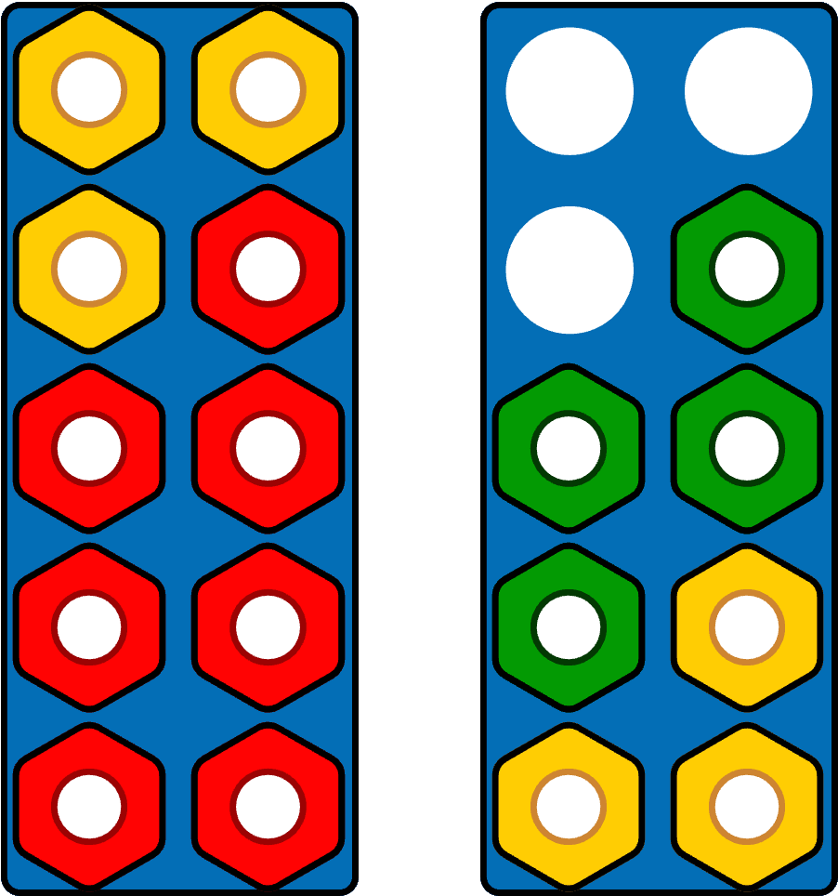
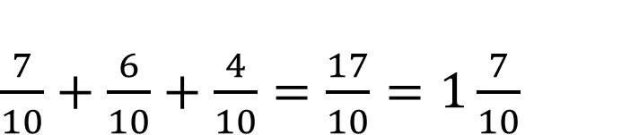
Teach: We do (2)
There are 2 pizzas, each cut into 10 equal slices.
Tia eats 7 slices.
Molly eats 6 slices.
Ravi eats 4 slices.
What could the adding sentence be?
$\frac{7}{10}+\frac{6}{10}+\frac{4}{10}=\frac{17}{10}=1\frac{7}{10}$
add | sum | total | fraction | numerator | denominator | whole | part | equal
Notes:
Teach: We do (2) notes
Resources: Numicon pieces, Numicon pegs
Provide children with Numicon pieces and pegs.
Set the scene: There are 2 pizzas, each cut into 10 equal slices. Tia eats 7 slices, Molly eats 6 and Ravi eats 4.
Ask: What adding sentence could represent how much the friends ate?
Ask children to use two Numicon 10-pieces and pegs to model the number of pizza slices each friend eats, adding 7 pegs to represent Tia’s slices, 6 pegs for Molly’s slices and 4 pegs for Ravi’s slices.
Click to reveal the model on the slide so children can compare theirs with yours.
Ask children to write the adding sentence.
Click to reveal the adding sentence $\frac{7}{10}$ + $\frac{6}{10}$ + $\frac{4}{10}$ = $\frac{17}{10}$ or 1$\frac{7}{10}$.
Look and listen for children who:
notice that more than 1 pizza has been eaten.
Say: I can see that the children have eaten 1 whole pizza and 7 slices of the second pizza.
Watch out for children who:
push the two 10-pieces together and view this as twentieths. If this arises, explore it to consider what it means, e.g. $\frac{17}{20}$ of a pizza. Is that greater or less than 1 whole? How many slices has the pizza then been cut into? Does that match the problem?
You may choose to explore further with another example, e.g. Molly takes 6 slices, Ravi takes 3 slices, Tia takes 5 slices. What could the adding sentence be?
Assessment opportunities: ​
Strategy: visual
Circulate the classroom, making note of children’s understanding.

Slide 13

Hinge
Will the total be greater than or less than 1?
$\frac{6}{12} + \frac{2}{12} + \frac{5}{12}$
A greater than 1
B less than 1
What would the total of the three fractions be?
add | sum | total | fraction | numerator | denominator | whole | part | equal
Notes:
Hinge notes
Resources: Numicon pieces, Numicon pegs
Ask children to look at the adding sentence: $\frac{6}{12} + \frac{2}{12} + \frac{5}{12}$.
Ask: Will the total be greater than or less than 1?
Ask children think independently and write A or B on their individual whiteboards, then hold them up to show their answers.
Then ask them to find the total of the three fractions, write the answer on their whiteboards and hold up them up.
Assessment opportunities:
Strategy: visual
If a significant number of children answer incorrectly, pause the lesson here to revisit/consolidate the key concepts before moving onto the ‘You do’ phase.
Then ask children to explain their reasoning to a partner, using Numicon pieces and pegs to make a model to support their thinking.
Look and listen for children who:
correctly identify that the answer will be $\frac{13}{12}$ (or 1$\frac{1}{12}$), therefore greater than 1
use the terms ‘numerator’ and ‘denominator’ correctly
can use Numicon pieces and pegs to explain their thinking and convince their partner.
Watch out for children who:
add the numerators incorrectly
add the denominators as well as the numerators
cannot use manipulatives to clearly explain their thinking
do not notice that $\frac{13}{12}$ could also be written as 1$\frac{1}{12}$ and so do not realise that it is greater than 1 whole.

Slide 14



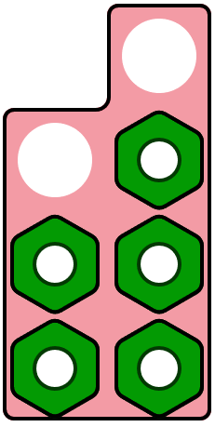

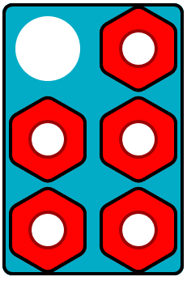
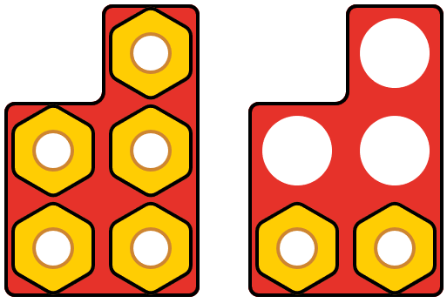
Teach: You do
For each model:
a) Write the fraction you can see.
b) Write the fraction as a sum of two smaller fractions.
c) Write the fraction as a sum of three smaller fractions.
Build: ‘I agree because …’
Challenge: ‘I disagree because …’
Clarify: ‘So you mean that …’
1.
2.
3.
4.
5.
add | sum | total | fraction | numerator | denominator | whole | part | equal
Notes:
Teach: You do notes
Resources: Adding fractions (photocopy master), Numicon pieces, Numicon pegs, number rods
Oracy groupings: Pairs
Provide children with the photocopy master and Numicon pieces, pegs and number rods.
Ask them to write the fraction shown by each representation, then write each fraction as a sum of two smaller fractions then as a sum of three smaller fractions.
Encourage children to make models to support their thinking, as necessary.
Look and listen for children who:
write fractions and fraction adding sentences correctly
use the terms ‘numerator’ and ‘denominator’ accurately
use models to explain their thinking
identify smaller fractions that can be added to make the total represented
notice when the total is greater than one whole (as in model 5: 1$\frac{2}{5}$ or $\frac{7}{5}$).
Watch out for children who:
do not correctly identify the fraction represented
are not able to identify smaller fractions to add together to make the total represented
do not recognise when an answer is greater than one whole (as in model 5).
Take feedback from pairs, selecting children to share some of their answers and use their models to explain their thinking, e.g. for model 1:
a) $\frac{5}{7}$ b) $\frac{2}{7}$ + $\frac{3}{7}$ = $\frac{5}{7}$ c) $\frac{1}{7}$ + $\frac{2}{7}$ + $\frac{2}{7}$ = $\frac{5}{7}$
Extension:
Ask: Is there more than one possibility for each question? How do you know that you have found them all?
Assessment opportunities:
Strategy: marking

Slide 15

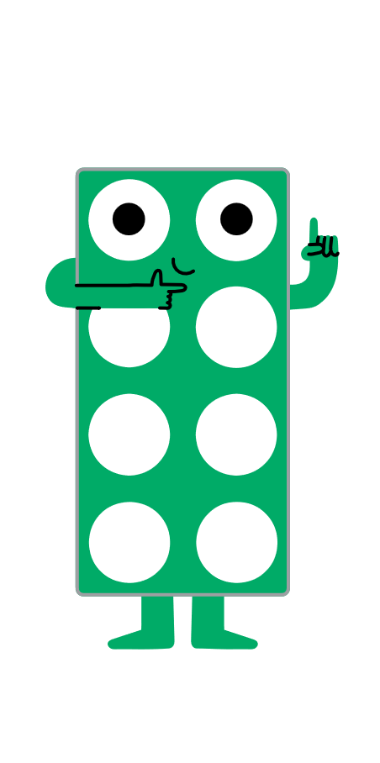
Exit
The tower below is made up of 8 cubes.
blue
Write an adding sentence to show the fraction of the tower that is pink, orange and green.
green
orange
pink
add | sum | total | fraction | numerator | denominator | whole | part | equal
Notes:
Exit notes
Resources: interlocking cubes
Oracy groupings: Pairs
At the end of this lesson, children should be able to:
add two or more fractions with the same denominator, including totals greater than 1.
Give children the opportunity to think independently about the question and write their adding sentence on their individual whiteboards.
Then ask children to share their thinking with a partner, using interlocking cubes to support their reasoning.
Look and listen for children who:
identify that there are 8 cubes in the tower, therefore the denominator is 8
identify that $\frac{2}{8}$ are pink, $\frac{3}{8}$ are orange and $\frac{1}{8}$ is green
write the adding sentence correctly: $\frac{2}{8}$ + $\frac{3}{8}$ + $\frac{1}{8}$ = $\frac{6}{8}$.
Watch out for children who:
do not identify the denominator correctly
do not write the adding sentence correctly.
Assessment opportunities:
Strategies: visual and verbal

Slide 16
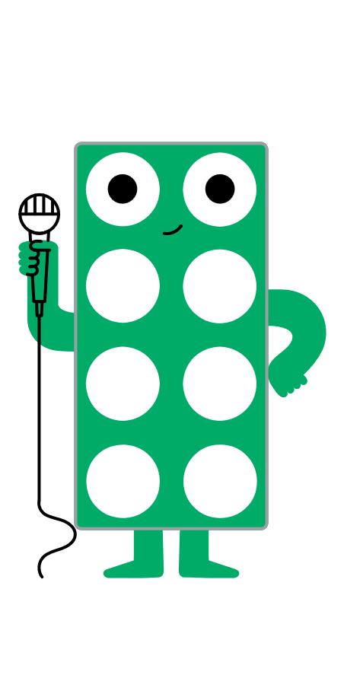
Reflection
Find the Numicon piece that shows how you feel about adding two or more fractions.
Notes:
Reflection notes
Resources: Numicon pieces
Ask children to hold up a Numicon piece to show how they feel about adding two or more fractions.
Encourage children to choose a higher number if they feel more confident about their learning.
Assessment opportunities:
Strategy: visual
Make a note of any children who show a lower number.

Slide 17
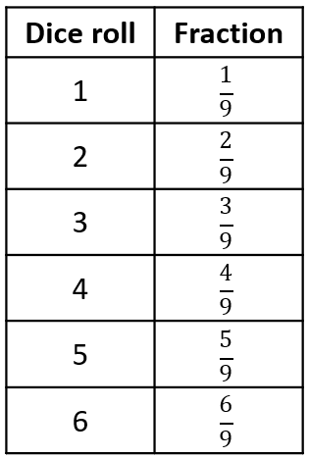

Extend and explore (1)
Roll the dice until you get three different fractions.
Write the three fractions in an adding sentence.
Find the total.
Repeat four times.
What is the largest total you can make?
Use Numicon pieces and pegs to build the fractions.
add | sum | total | fraction | numerator | denominator | whole | part | equal
Notes:
Extend and explore (1) notes
Resources: print-outs of this slide, six-sided dice, Numicon pieces, Numicon pegs
This has been provided as an extra resource you can use as a follow-up to the lesson, for retrieval practice, or as an activity you can print out and give to children who need meaningful extension during the lesson.
Read through the instructions together, modelling an example if necessary, e.g. if you roll a 1, a 3 and a 4 your fractions are $\frac{1}{9}$, $\frac{3}{9}$ and $\frac{4}{9}$.
Children use a dice to generate three fractions, record them in an adding sentence and find the total.
They should use Numicon pieces and pegs to model the fractions.
They could record their workings on their print-out of the slide.
Look and listen for children who:
use the terms ‘numerator’ and denominator’ correctly
identify when a fraction adding sentence has a total greater than 1
recognise that an improper fraction can also be written as a mixed number
convert improper fractions to mixed numbers correctly
work out that the largest total that can be made is $\frac{6}{9}+\frac{5}{9}+\frac{4}{9}=\frac{15}{9}=1\frac{6}{9}$ (which can be simplified to $\frac{5}{3}$ or 1$\frac{2}{3}$).
Watch out for children who:
do not add the fractions correctly, e.g. adding the denominators as well as the numerators
do not notice when a fraction adding sentence has a total greater than 1.
Assessment opportunities:
Strategies: visual/marking

Slide 18
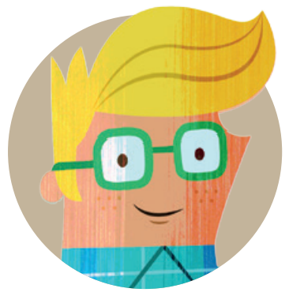
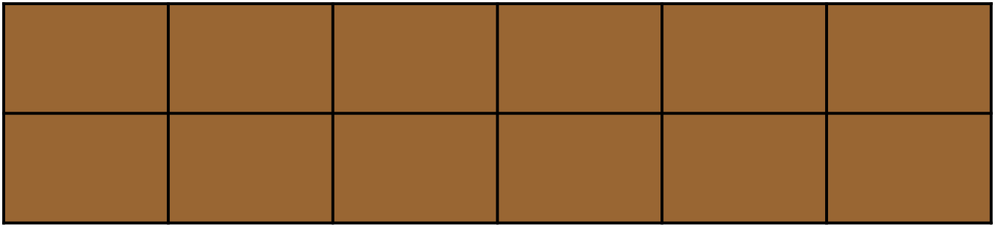
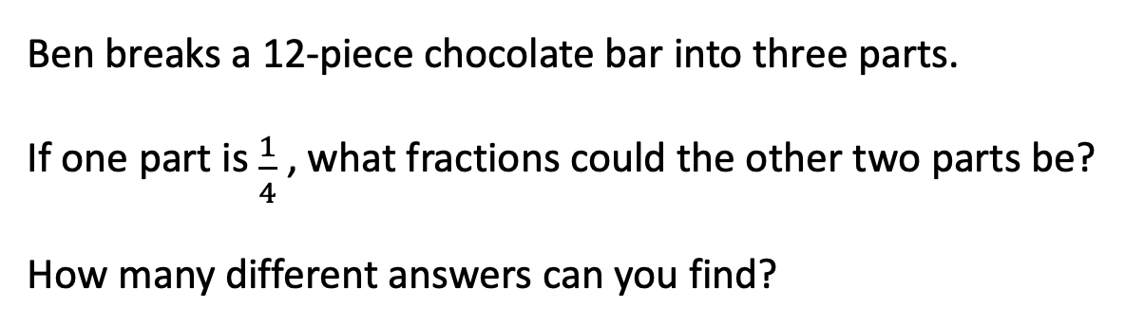
Extend and explore (2)
Ben breaks a 12-piece chocolate bar into three parts.
If one part is $\frac{1}{4}$ , what fractions could the other two parts be?
How many different answers can you find?
The three parts do not have to be equal.
add | sum | total | fraction | numerator | denominator | whole | part | equal
Notes:
Extend and explore (2) notes
Resources: print-outs of this slide, Numicon pieces, Numicon pegs
This has been provided as an extra resource you can use as a follow-up to the lesson, for retrieval practice, or as an activity you can print out and give to children who need meaningful extension during the lesson.
Provide children with Numicon pieces and pegs. Read through the instructions together.
Children then explore the questions using manipulatives as needed and record their solutions on their print-out of the slide. For example:
$\frac{1}{4}$ + $\frac{1}{4}$ + $\frac{2}{4}$ $\frac{1}{4}$ + $\frac{4}{12}$ + $\frac{5}{12}$ (or $\frac{1}{4}+\frac{1}{3}+\frac{5}{12}$) $\frac{1}{4}+\frac{1}{12}+\frac{8}{12}$ (or $\frac{1}{4}$ + $\frac{1}{12}$ + $\frac{2}{3}$)
Look and listen for children who:
explore and represent fractions of an amount correctly, e.g. representing $\frac{1}{4}$ of 12 by putting 3 pegs in a Numicon 12 piece (a 10-piece and 2-piece together)
identify two other fractions that could be added to $\frac{1}{4}$ to make 1 whole
add fractions with different denominators to make 1 whole.
Watch out for children who:
use 4 pegs to show $\frac{1}{4}$ because they see the ‘4’ rather than consider the value of $\frac{1}{4}$ of 12.

