Slide 1
© Oxford University Press 2024

Slide 2
Identify and represent equivalent fractions using bar models
Year 3 (P4) | Fractions
Notes:
Teacher information slide

Slide 3
Learning outcomes
Are children ready?
  I understand the numerators and denominators of unit and non-unit fractions.
  I can compare and order non-unit fractions.
  Not ready? Try Numicon Essentials: Compare and order non-unit fractions
Learning outcomes
  I can identify and represent equivalent fractions using bar models.
Lesson summary
  In this lesson, children will be deepening their understanding of equivalent fractions by representing them using bar models. Through practical work with number rods, they explore the relationships between wholes and their parts, comparing smaller and larger parts and finding equivalences.
Where next?
  I can add fractions with the same denominator within a whole.
  Ready to move on? Try Numicon Essentials: Add fractions
Notes:
Teacher information slide

Slide 4
Curriculum links
White Rose small steps
  Year 3 | Spring term | Block 3 – Fractions A
Curriculum charts
  Northern Ireland | Numicon | Oxford International Curriculum | PYP |
  Ready to Progress | Republic of Ireland | Scotland | Te Mātaiaho | Wales
English National Curriculum
  Curriculum chart
  Recognise and show, using diagrams, equivalent fractions with small denominators.
  Recognise and use fractions as numbers: unit fractions and non-unit fractions with small denominators.
NCETM
  Curriculum chart
  Year 3 Unit fractions:
  9. Pupils represent a unit fraction in different ways.
This Numicon Essentials lesson can be used as a pre-teach for this White Rose small step. In this lesson, children will explore using number rods to make physical bar models to identify and represent equivalent fractions.
  This step:: Step 6 Fractions and scales
  Step 7 Fractions on a number line
  Step 8 Count in fractions on a number line
  Step 9 Equivalent fractions on a number line
  ▮ Step 10 Equivalent fractions as bar models
Click here for the full White Rose curriculum mapping chart.
Click here for a full list of Numicon Essentials lessons.
Notes:
Teacher information slide

Slide 5
Lesson essentials
Resources
  Numicon pieces
  Pan balance (optional)
  Number rods
  Visualiser (optional)
  Numicon IWB Software (optional)
  Print-outs of Extend and explore slide
  Resource pack (PCMs):
  Equivalent fractions 1
  Equivalent fractions 2
Key vocabulary
  equivalent, equivalence, equal, represent, same, value, amount, total, size, fraction, part, whole, out of, numerator, denominator, half, third, quarter, fifth, sixth, eighth, tenth, different
  Click here for glossary definitions.
Discussion stems
  Investigate: ‘I think that …’
  Probe: ‘Why do you think … ?’
  Clarify: ‘Does that mean … ?’
Sentence stems
  __ lots of __ is equivalent to one whole.
  __ lots of __ is equivalent to __.
  I know __ is equivalent to __ because …
Key ideas and tips
  Fractions are equivalent when they are equal in value but they can look different.
  In fractions equivalent to one-half, the denominator is double the value of the numerator and the numerator is half the value of the denominator.
Watch points and misconceptions
  Children may have difficulty hearing and saying the fricative sounds (e.g. ‘f’ and ‘th’) in words like ‘sixths’ and ‘sevenths’.
  Children may not correctly understand the concept of equivalence. It does not mean the same; it means of equal value.
  Children may incorrectly add or subtract the same number to or from the equivalent numerator and denominator to try to create an equivalent fraction.
Notes:
Teacher information slide

Slide 6
Identify and represent equivalent fractions using bar models
Notes:
Title slide

Slide 7


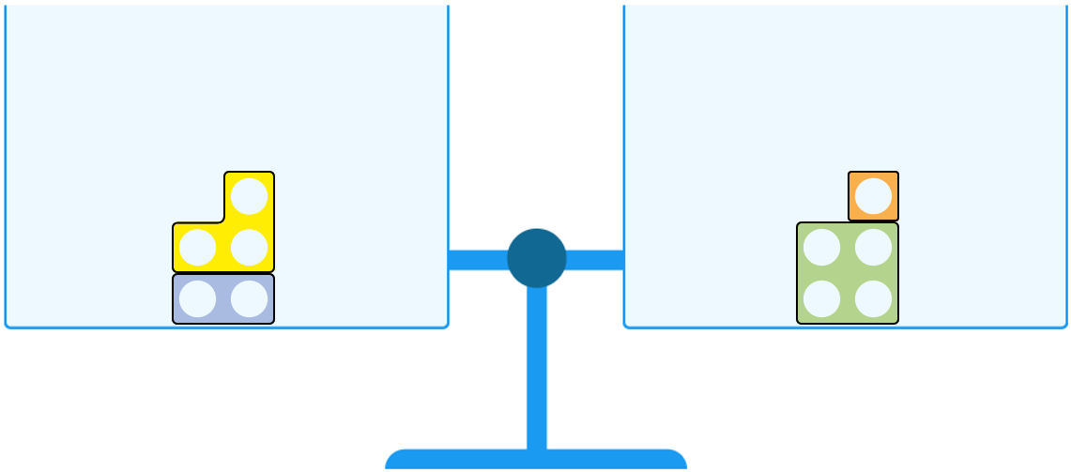
Talk task
What do you think equivalent means?
Use the image and the key words to help you.
Key words
equivalent
equal
value
amount
total
sum
size
Instigate: ‘I think that …’
Probe: ‘Why do you think … ?’
Clarify: ‘Does that mean … ?’
Notes:
Talk task notes
Resources: Numicon IWB Software or Numicon pieces, pan balance
Oracy groupings: Pairs
This is an opportunity to recall and rehearse vocabulary previously explored.
You may choose to use different models from those provided on screen; e.g. different combinations of Numicon pieces.
Children could also use a pan balance and Numicon pieces to explore equivalence practically.
Ask: What do you think equivalent means?
Say: Talk to a partner. Use the picture to help you.
Encourage the use of the discussion stems:
Investigate: ‘I think that …’
Probe: ‘Why do you think … ?’
Clarify: ‘Does that mean … ?’
If necessary, prompt children by asking: Why are the two pans balanced? What do you notice about the Numicon pieces in the pans?
Watch out for:
children saying that equivalent means the same.
If they do, use the image on the slide to draw out that equivalent does not mean ‘the same as’.
Ask: Are the pieces the same? (No.)
Say: We can see that the Numicon 3- and 2- pieces and the Numicon 4- and 1-pieces are not the same.
They are equal in value/amount.
3 plus 2 is equivalent to 4 plus 1. 3 plus 2 equals 4 plus 1.

Slide 8
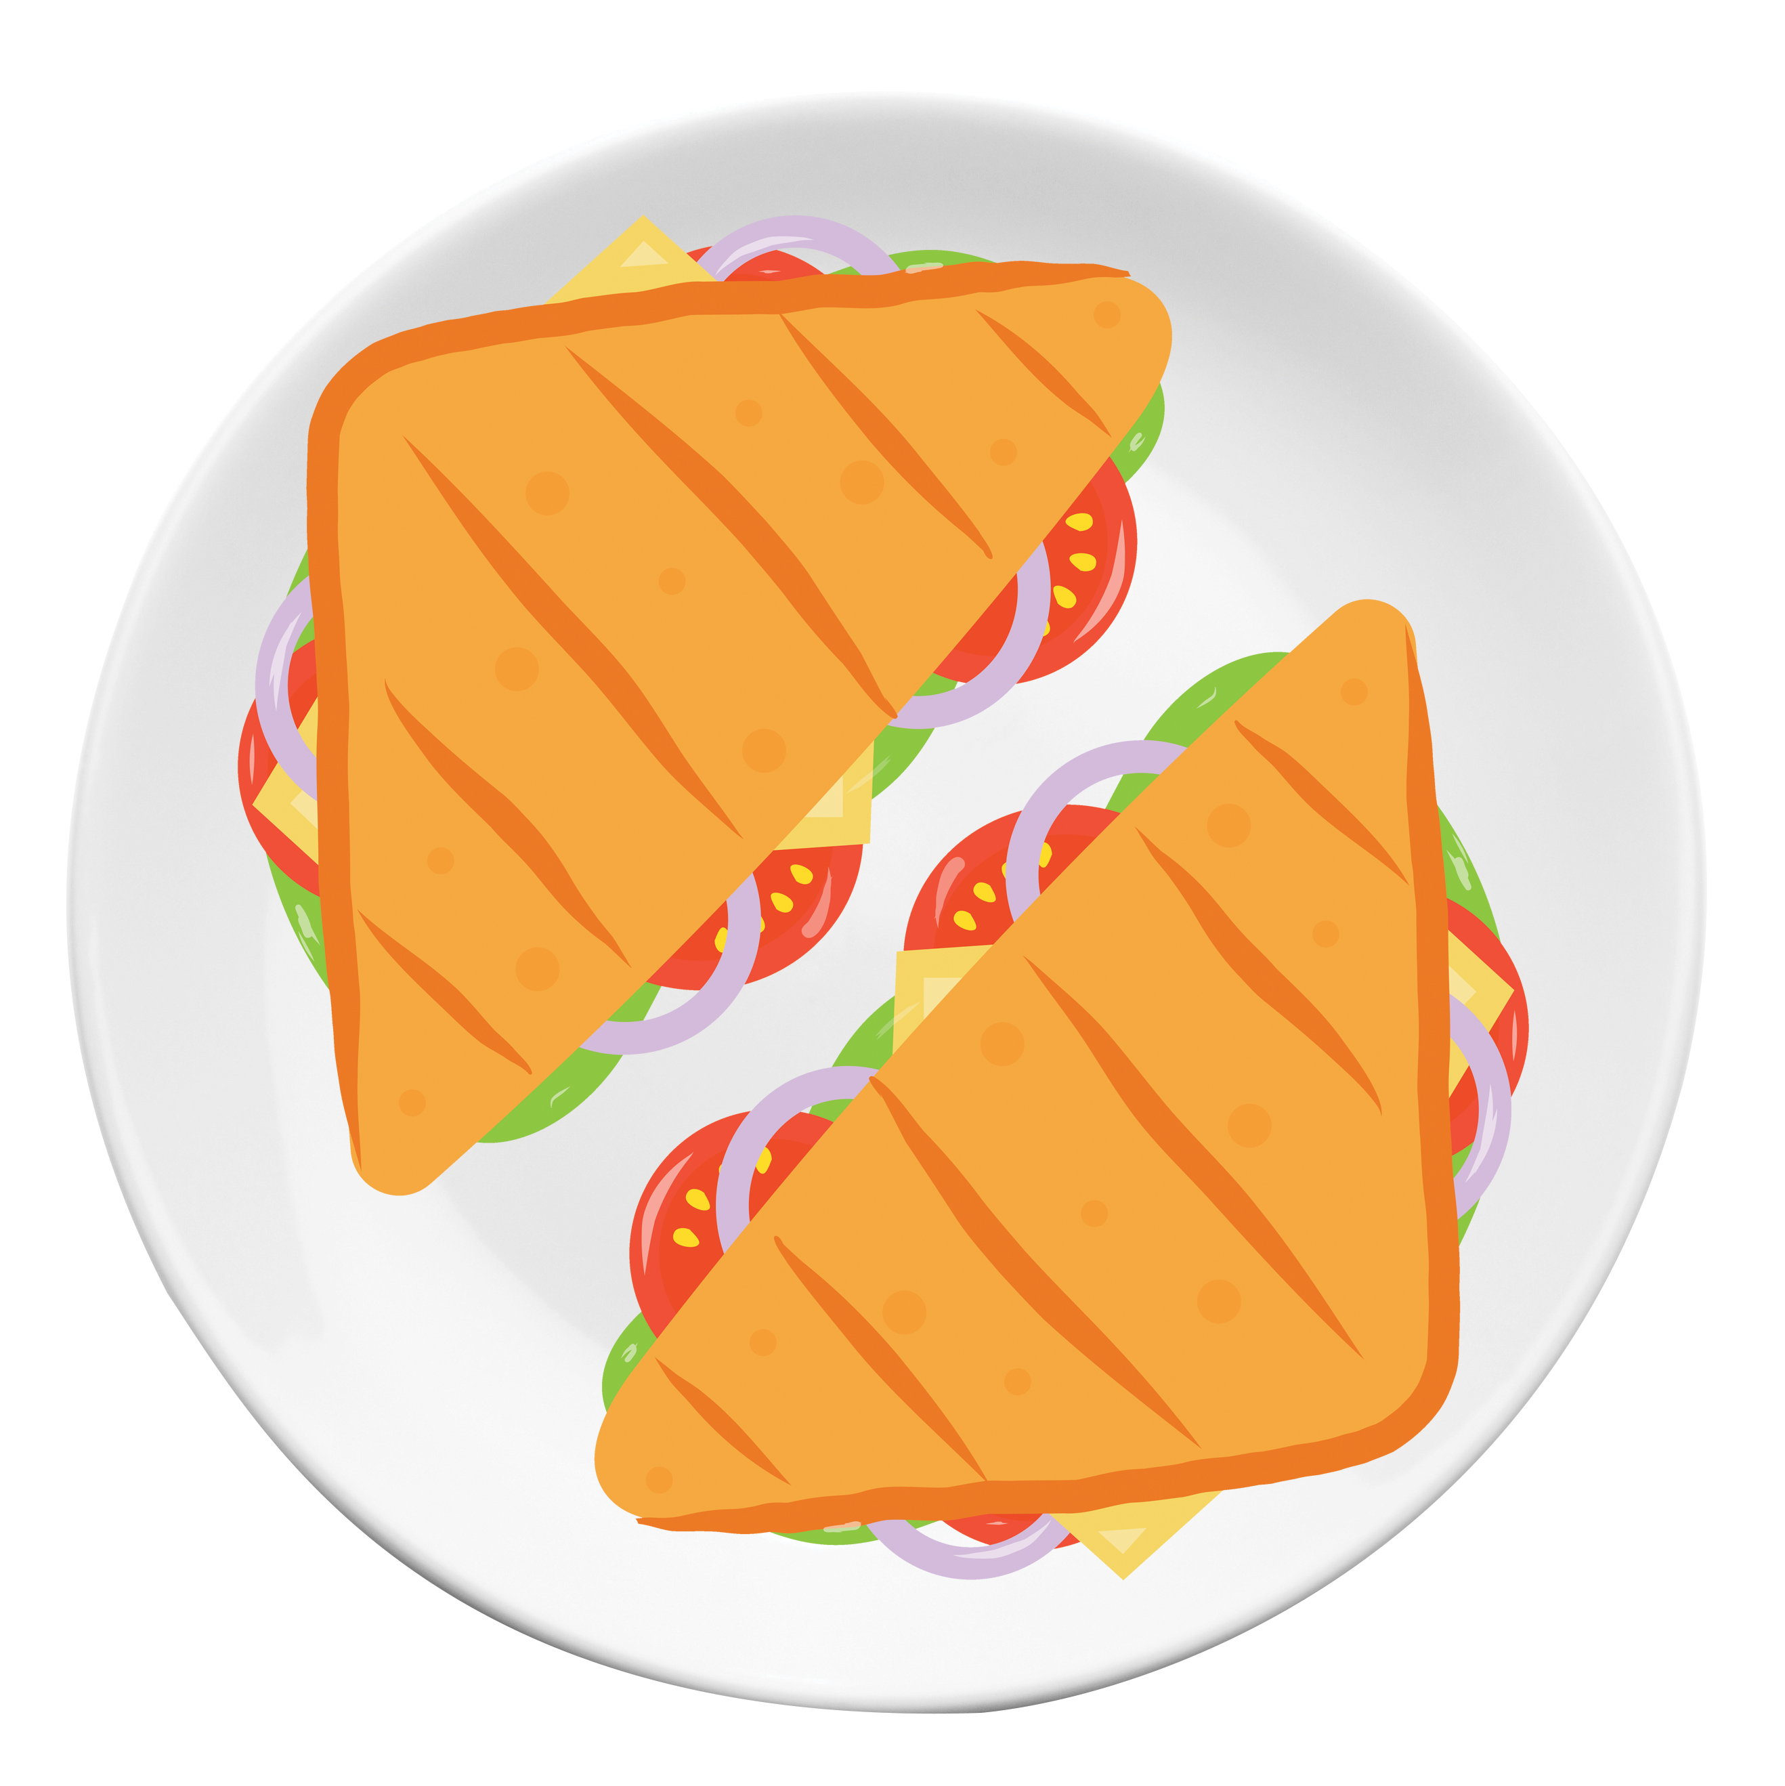
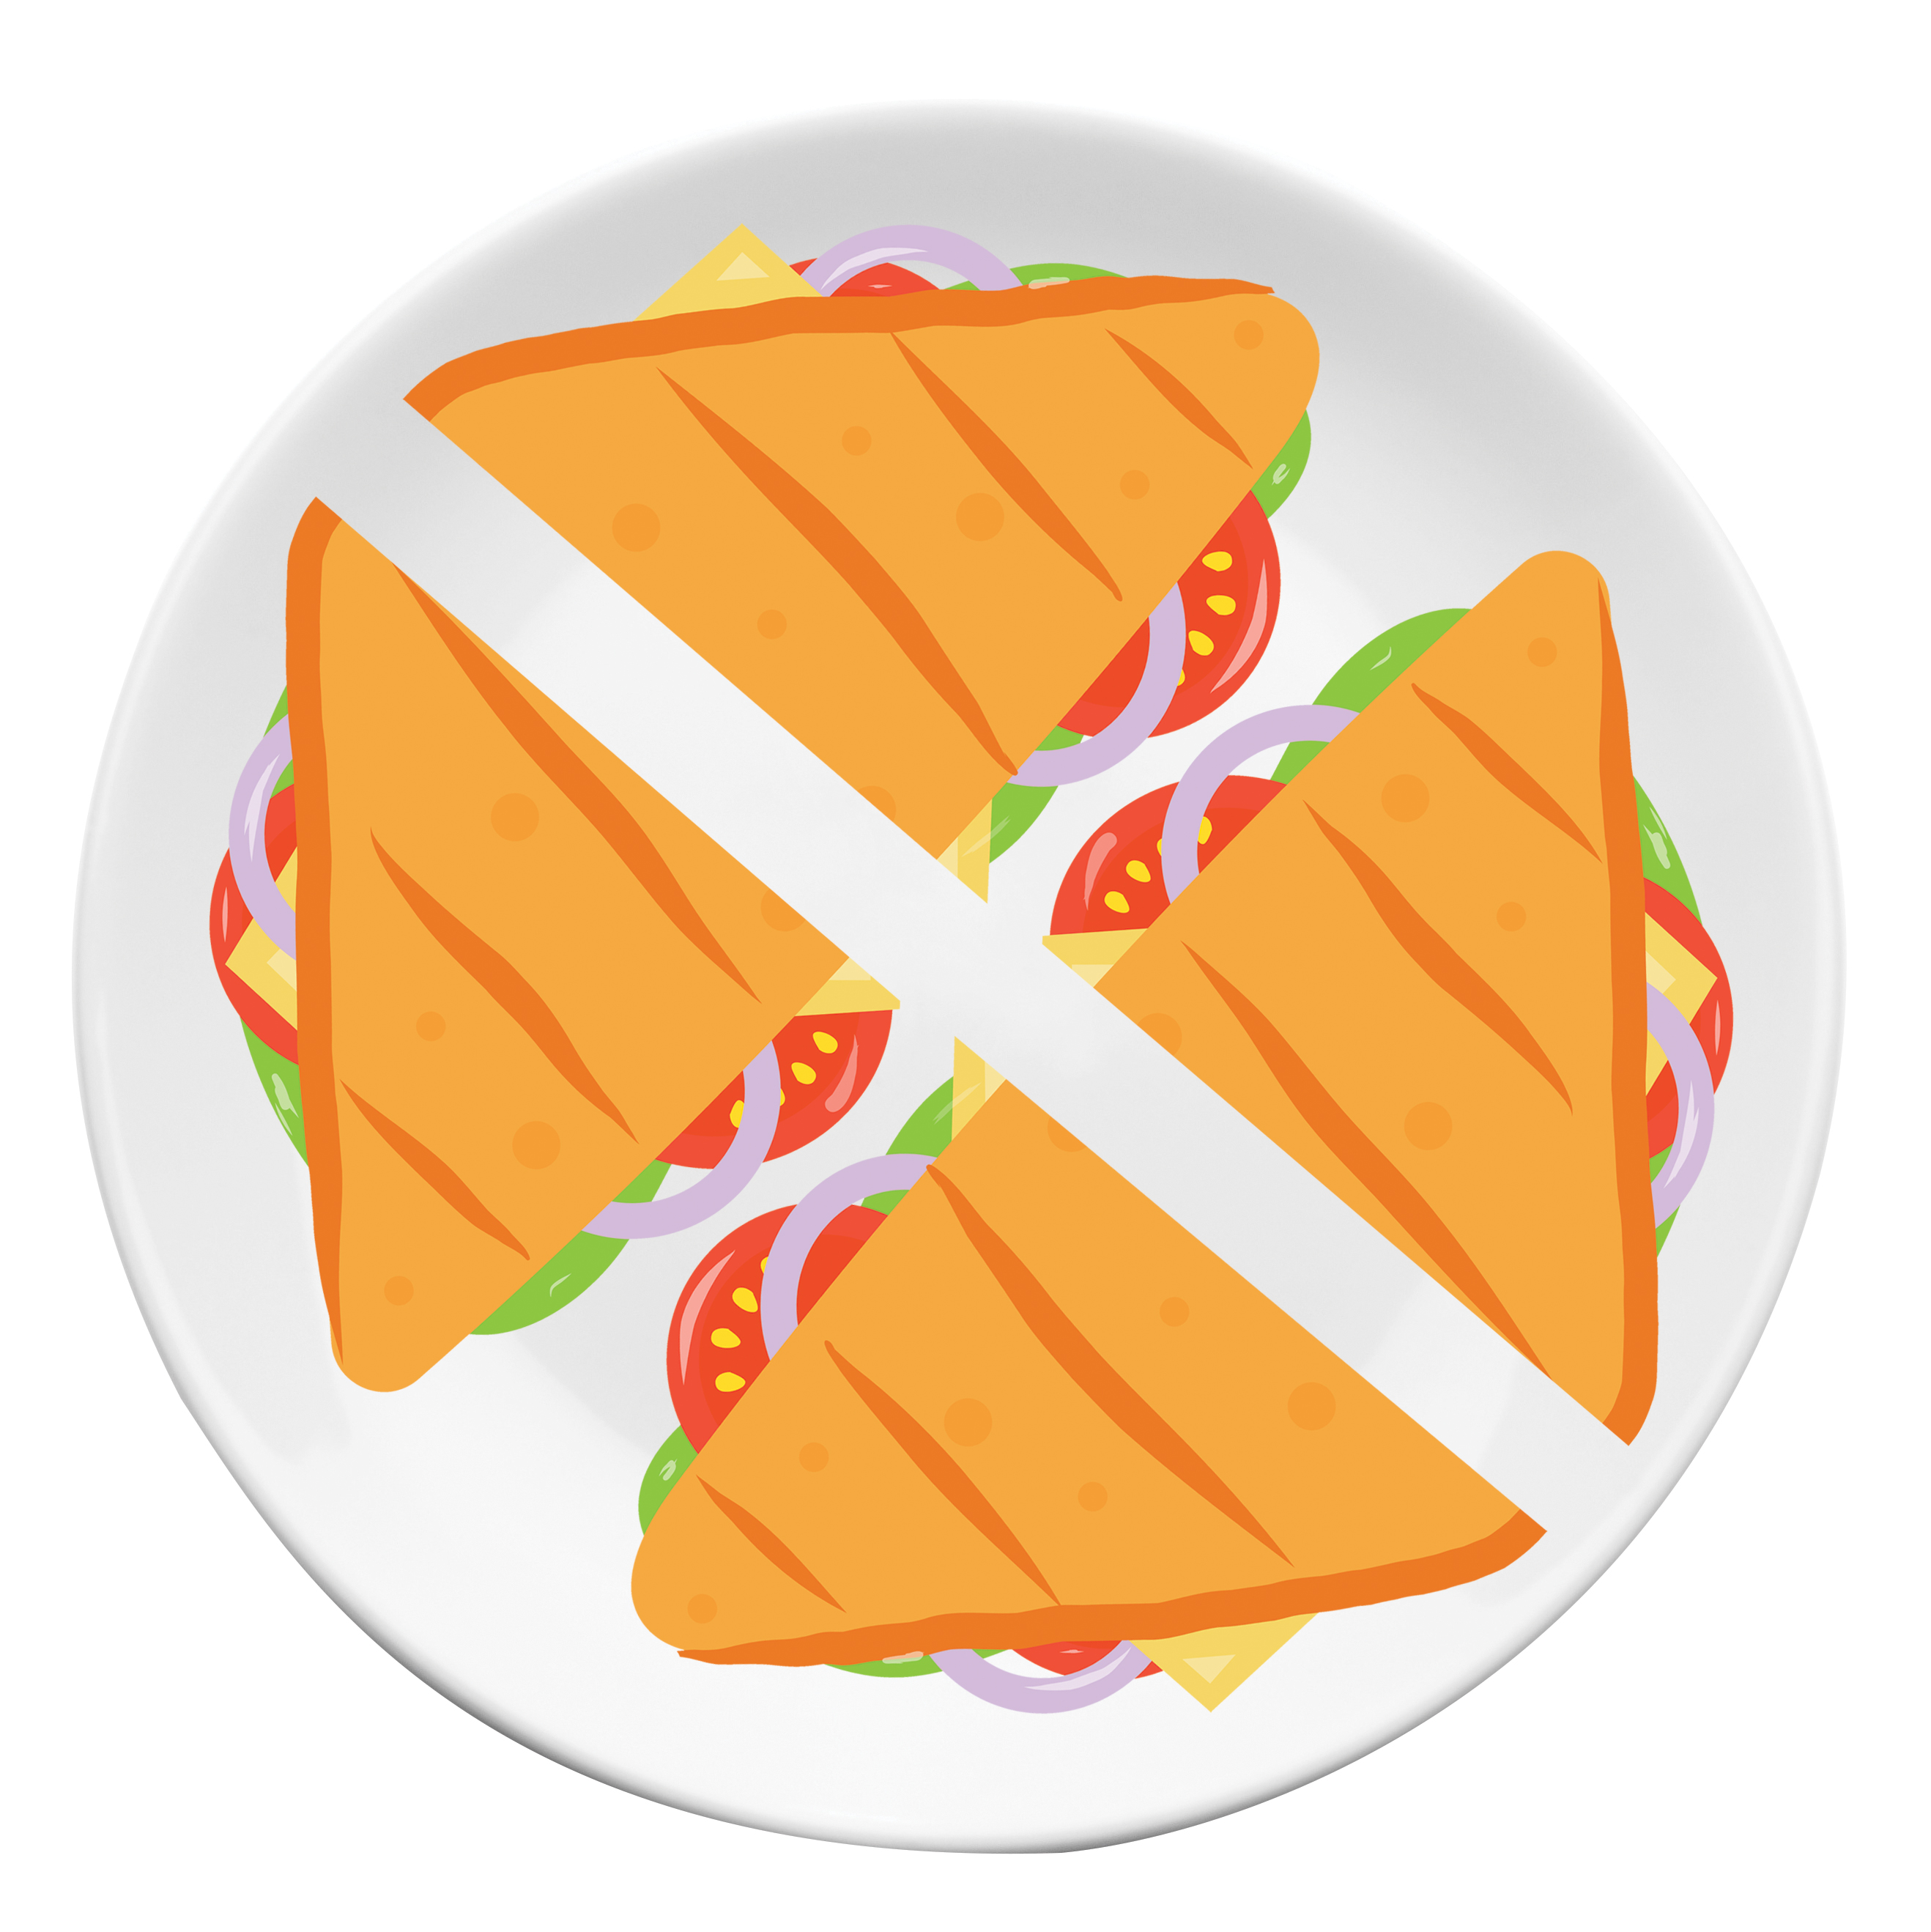
Switch on
Tia and Molly buy two identical sandwiches.
Tia eats one-half of her sandwich.
Molly eats two-quarters of her sandwich.
Who ate more?
represent | whole | part | out of | half | quarter | equal | equivalent | same | different
Notes:
Switch on notes
Oracy groupings: Pairs
Set the scene: Tia and Molly have bought two identical sandwiches.
Say: Tia eats one-half of her sandwich and Molly eats two-quarters of her sandwich.
Ask: Who ate more?
Ask children to discuss in pairs. Remind them to use the key words and the images to help them.
Look and listen for children who:
notice that Tia and Molly ate the same amount of their sandwiches
recognise that one-half and two-quarters are equal in size but look different
explain that one-half and two-quarters are equivalent.
Say: Can you write the fraction of a sandwich that Tia ate? ($\frac{1}{2}$)
Now can you write the fraction of a sandwich that Molly ate. ($\frac{2}{4}$)
Draw out that these two fractions are equivalent. They might look different, but they are of equal value.
Say:
I could chop half my sandwich into two equal parts and get two quarters. It’s a different way to show the same amount of sandwich.
In this lesson we are going to be using bar models and our number rods to help us find and show equivalent fractions.

Slide 9

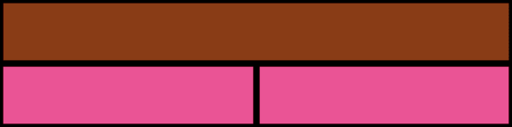
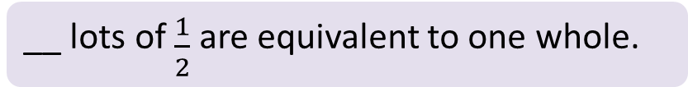
Teach: I do (1)
How many halves are equivalent to one whole?
Video demo
One pink rod represents __ of the whole.
__ lots of $\frac{1}{2}$ are equivalent to one whole.
__ halves are equivalent to one whole.
whole | part | equivalent | lots of | half
Notes:
Teach: I do (1) notes
Before the lesson: Watch the video showing how to model 'I do' phases (1) to (4) and use it to help prepare for your own modelling. It is beneficial that this is done live by you with the children.
Resources: number rods, visualiser (optional), Numicon IWB Software (optional)
You can choose to model your thinking and what to do physically with manipulatives or using the IWB Software.
For these ‘I do’ phases of the lesson you could choose to pause and give children the chance to explore which rods fit, before you model this.
Say: We can think of a whole like the one whole sandwich. How many halves are equivalent to one whole?
Some children may already know or remember from thinking about the sandwich, that two halves are equivalent to one whole.
Say: I am going to use number rods to explore this problem. I am going to use the brown rod to represent one whole.
Place a brown number rod horizontally.
Say: I can use the number rods to explore and find out which two number rods fit exactly into the brown rod.
(You may choose to encourage children to explore this themselves individually, in pairs or threes.)
Place 2 pink number rods end to end below the brown rod.
Click to reveal 2 pink rods on the slide if needed.
Say:
I found that 2 pink rods are equal to the brown rod. I know that one of these pink rods represents $\frac{1}{2}$ of the whole.
(Model writing $\frac{1}{2}$ on the board or in the sentence gap on the slide.) We can write $\frac{1}{2}$ with the numerator of 1 and with the denominator of 2.
(Model the sentence stems.) I can see that there are two lots of $\frac{1}{2}$ that are equivalent to one whole.
Therefore, two halves are equivalent to one whole.
We can write that as two halves are equal to one whole (write: $\frac{2}{2}$ = 1).

Slide 10
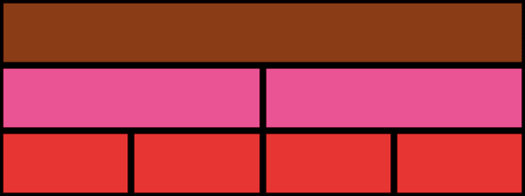
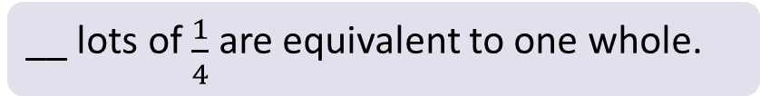
Teach: I do (2)
How many quarters are equivalent to a whole?
One red rod represents __ of the whole.
__ lots of $\frac{1}{4}$ are equivalent to one whole.
__ quarters are equivalent to one whole.
whole | part | equivalent | lots of | half | quarter
Notes:
Teach: I do (2) notes
Resources: number rods, visualiser (optional), Numicon IWB Software (optional)
You can choose to model your thinking and what to do physically with manipulatives or using the IWB Software.
Continue to display the brown number rod with two pink rods below it.
Ask: How many quarters are equivalent to one whole?
Some children may already know or remember from thinking about the sandwich, that four quarters are equivalent to one whole.
Explain that you are going to use number rods to explore this problem and find out which four number rods fit exactly into the brown rod.
(You may choose to encourage children to explore this themselves individually, in pairs or threes.)
Place 4 red number rods end to end below the pink rods.
Click to reveal 4 red rods on the slide if needed.
Say:
I found that 4 red rods fit equally into the brown rod. Therefore, I can see that one red rod represents $\frac{1}{4}$ of the whole.
We can write that as a fraction with the numerator of 1 and with the denominator of 4. (Model writing $\frac{1}{4}$ on the board or in the sentence gap on the slide.)
(Model the sentence stems.) I can see that four lots of $\frac{1}{4}$ are equivalent to one whole.
Therefore, four quarters are equivalent to one whole.
We can write that with my numerator of 4 and my denominator of 4 (write: $\frac{4}{4}$ = 1). Four quarters are equal to my one whole.

Slide 11
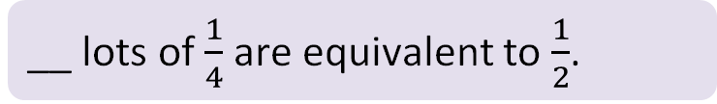
Teach: I do (3)
How many quarters are equivalent to one half?
__ lots of $\frac{1}{4}$ are equivalent to $\frac{1}{2}$.
__ quarters are equivalent to one-half.
whole | part | equivalent | lots of | half | quarter
Notes:
Teach: I do (3) notes
Resources: number rods, visualiser (optional), Numicon IWB Software (optional)
You can choose to model your thinking and what to do physically with manipulatives or using the IWB Software.
Continue to display the number rod model (1 brown rod, 2 pink rods, 4 red rods).
Ask: How many quarters are equivalent to one-half?
Say: Using number rods we can see that the brown rod represents one whole. We found out that one pink rod represents $\frac{1}{2}$ of the whole and one red rod represents $\frac{1}{4}$ of the whole.
Ask: So how many quarters are equivalent to one half?
Say:
I know my pink rod represents one-half and I can see that there are two quarters that are equal to my one-half.
(Model the sentence stems.) I can see that 2 lots of $\frac{1}{4}$ are equal (or equivalent) to $\frac{1}{2}$. So two quarters are equivalent to one-half.
(Model how to write this: $\frac{2}{4}$ = $\frac{1}{2}$ .) We can write this as $\frac{2}{4}$ with my numerator of 2 and my denominator of 4, is equivalent to $\frac{1}{2}$ , with my numerator of 1 and my denominator of 2.

Slide 12
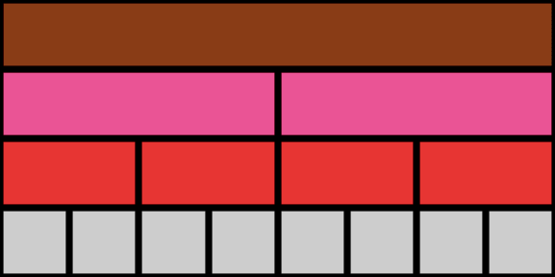

Teach: I do (4)
How many eighths are equivalent to one whole?
One white rod represents __ of the whole.
__ lots of $\frac{1}{8}$ are equivalent to one whole.
__ eighths are equivalent to one whole.
whole | part | equivalent | lots of | half | quarter | eighth
Notes:
Teach: I do (4) notes
Resources: number rods, visualiser (optional), Numicon IWB Software (optional)
You can choose to model your thinking and what to do physically with manipulatives or using the IWB Software.
Continue to display the number rod model (1 brown rod, 2 pink rods, 4 red rods).
Ask: How many eighths are equivalent to one whole?
Some children may already know that 8 eighths are equivalent to one whole.
Explain that you are going to use number rods to explore this problem and find out which eight number rods fit exactly into the brown rod.
(You may choose to encourage children to explore this themselves individually, in pairs or threes.)
Place 8 white number rods end to end below the red rods.
Click to reveal 8 white rods on the slide if needed.
Say:
I found that 8 white rods fit equally into the brown rod. So I know that one white rod represents $\frac{1}{8}$ of the whole.
I can write one-eighth with 1 as my numerator and 8 as my denominator. (Model writing $\frac{1}{8}$ on the board or in the sentence gap on the slide.)
(Model the sentence stems.) I can see that eight lots of $\frac{1}{8}$ are equivalent to one whole.
So, 8 eighths are equal (or equivalent) to one whole.
We can write that as 8 eighths, with 8 as my numerator and 8 as my denominator is equal to one-whole. (Write: $\frac{8}{8}$ = 1).

Slide 13
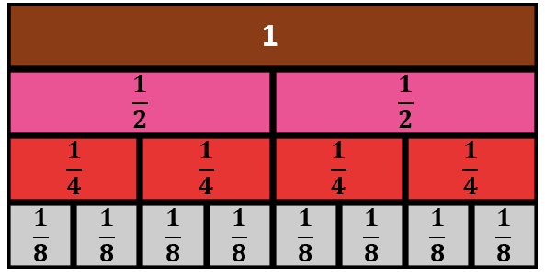
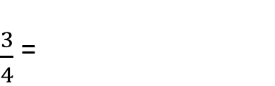
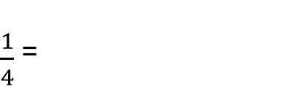
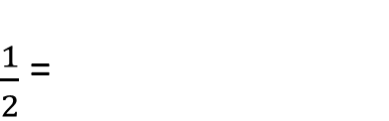
Teach: I do (5)
What equivalent fractions can I see?
Video demo
$\frac{1}{2}$ =
$\frac{1}{4}$ =
$\frac{3}{4}$ =
__ lots of __ are equivalent to __.
whole | part | equivalent | lots of | half | quarter | eighth
Notes:
Teach: I do (5) notes
Before the lesson: Watch the video showing how to model this fifth 'I do' phase and use it to help prepare for your own modelling. It is beneficial that this is done live by you with the children.
Resources: number rods, visualiser (optional), Numicon IWB Software (optional)
You can choose to model your thinking and what to do physically with manipulatives or using the IWB Software.
Continue to display the number rod model (1 brown rod, 2 pink rods, 4 red rods, 8 white rods).
Say:
Looking at the model we made, I can see lots of equivalent fractions.
I can see that one-half is equal to two-quarters, which is equal to four-eighths. (Write this as: $\frac{1}{2}=\frac{2}{4}=\frac{4}{8}$ .)
They all look different, but they are equal in size, so they are equivalent fractions.
Click to reveal the outline around the equivalent fractions of one-half if needed.
Say:
I can also see that one-quarter is equal to two-eighths. (Write this as: $\frac{1}{4}=\frac{2}{8}$ .)
Click to reveal the outline around the equivalent fractions of one-quarter if needed.
Say:
I can also see that three-quarters is equal to six-eighths. (Write this as: $\frac{3}{4}=\frac{6}{8}$.)
Click to reveal the outline around the equivalent fractions of three-quarters if needed.

Slide 14

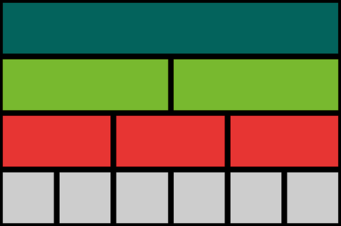
Teach: We do
If we use a dark green rod to represent one whole, how can we make a fraction wall?
What equivalent fractions can we show?
__ lots of __ are equivalent to __.
__ are equivalent to __.
whole | part | equivalent | lots of | half | third | sixth
Notes:
Teach: We do notes
Resources: number rods
Oracy groupings: Pairs
Say: If the dark green rod represents one whole, how can we make a fraction wall?
Give children time to discuss in pairs and build their fraction wall.
If children need support, ask the following questions:
Can you find the rod that is half of the dark green rod? How do you know?
Can you find the rod that is one-third of the dark green rod? How do you know?
Can you find the rod that is one-sixth of the dark green rod? How do you know?
Click to reveal the fraction wall and sentence stems.
Give pairs time to compare their fraction wall with the image on the slide.
Ask: What equivalent fractions can we show using our fraction wall?
Encourage children to find as many equivalent fractions as they can.
Take feedback and agree some equivalent fractions as a class.
Encourage children to use the sentence stems, e.g. ‘2 lots of $\frac{1}{6}$ are equivalent to $\frac{1}{3}$. $\frac{2}{6}$ are equivalent to $\frac{1}{3}$.’
Answers:
1 whole = 2 halves = 3 thirds = 6 sixths
1 half = 3 sixths
1 third = 2 sixths
2 thirds = 4 sixths

Slide 15
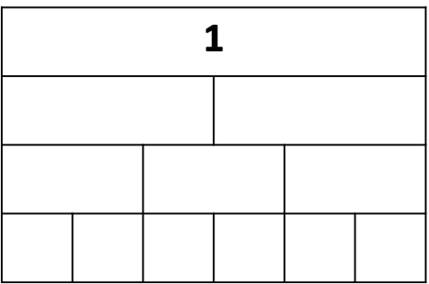
Hinge
Use the fraction model you made to complete the bar model.
Use the model to find the missing numerator or denominator in these equivalent fractions.
1. $\frac{1}{3}$ = $\frac{?}{6}$ 2. $\frac{1}{2}$ = $\frac{?}{6}$ 3. $\frac{2}{3}$ = $\frac{4}{?}$ 4. $\frac{3}{3}$ = $\frac{6}{?}$ 5. $\frac{2}{2}$ = $\frac{?}{3}$ 6. $\frac{2}{2}=\frac{3}{? }= \frac{?}{6}$
whole | part | equivalent | lots of | half | third | sixth
Notes:
Hinge notes
Resources: number rods, Equivalent fractions 1 (photocopy master)
Oracy groupings: Pairs
Give each child a copy of Equivalent fractions 1.
Say: Use the fraction wall you have made to fill in the missing bars. Then use the fraction wall and the bar model to find the missing numerator or denominator in these equivalent fractions.
Children record the fractions on the pictorial bar model.
Circulate as children complete the missing numerators or denominators on the photocopy master.
Assessment opportunities:
Strategy: visual/marking
If a significant number of children complete the photocopy master incorrectly, pause the lesson here to revisit/consolidate the key concepts before moving onto the ‘You do’ phase.
Ask questions to probe children’s understanding and address misconceptions. For example:
Ask: Is one-half equal to three-sixths? How do you know?
Look and listen for children who:
identify the statement is correct
use the language ‘one-half is equal/equivalent to three-sixths.’
Encourage the use of the sentence stem: ‘I know __ is equivalent to __ because …’
Look and listen for children who explain that they know that (for example) three-sixths is equal to one-half because:
3 is half of 6
the numerator is half the value of the denominator
6 is double 3
the denominator is double the value of the numerator.

Slide 16

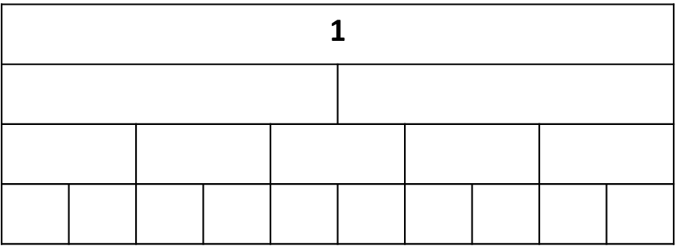
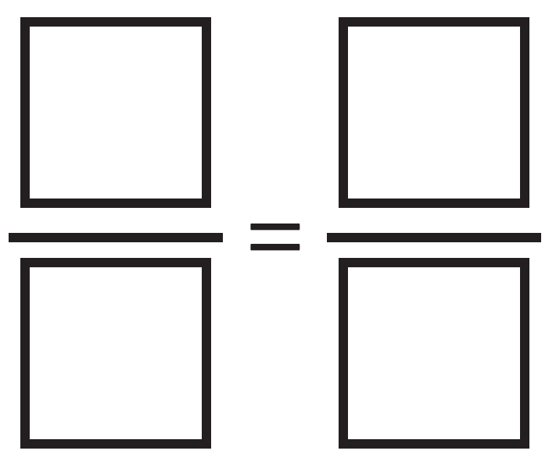
Teach: You do
Using the orange rod to represent one whole, make a fraction wall.
Use the fraction wall to label the bar model.
Find as many ways as you can to complete the statement:
whole | part | equivalent | lots of | half | fifth | tenth
Notes:
Teach: You do notes
Resources: number rods, Equivalent fractions 2 (photocopy master)
Oracy grouping: Pairs
Say: This time the orange rod represents one whole. Work with a partner to build a new fraction wall.
Ask pairs to build a fraction wall using the orange rod to represent one whole. (They will need one orange rod, two yellow, five red and ten white.)
Give children time to explore using the number rods.
When each pair has made the model, give each child a copy of the photocopy master.
Ask children to complete the bar model individually, then use the fraction wall and bar model to find as many pairs of equivalent fractions as they can.
Assessment opportunities:
Strategy: marking

Slide 17
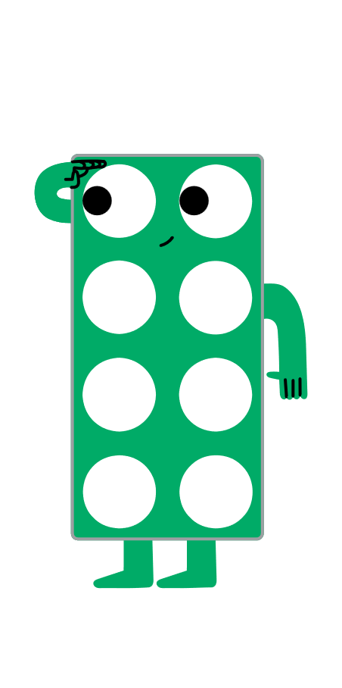
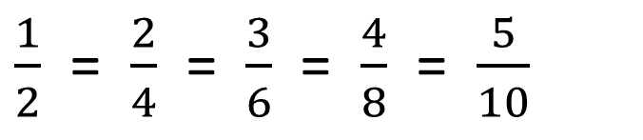
Exit
$\frac{1}{2}$ = $\frac{2}{4}$ = $\frac{3}{6}$= $\frac{4}{8}$ = $\frac{5}{10}$
What do you notice about the relationship between the numerator and the denominator?
Can you think of other fractions equivalent to $\frac{1}{2}$?
The denominator is __ the numerator.
The numerator is __ the denominator.
fraction | numerator | denominator | half | double | equals | equivalent
Notes:
Exit notes
At the end of this lesson, children should be able to:
identify and represent equivalent fractions using a bar model
Ask: Can you think of any other fractions that are equivalent to one-half?
Add suggestions from children to the board, e.g. six-twelfths, ten-twentieths.
Ask: What do you notice about the relationship between the numerator and the denominator in fractions that are equivalent to one-half?
Encourage children to use the sentence stems: ‘The denominator is double the numerator. The numerator is half the denominator.’
Look and listen for children who:
explain that the numerator is half the value of or 2 times as small as the denominator
explain that the denominator is double the value of or 2 times as big as the numerator.
Emphasise that in any fraction equivalent to one-half, the denominator will be double the numerator and the numerator will be half the denominator.
Emphasise that doubling is equivalent to multiplying by 2 and halving is equivalent to dividing by 2, by showing that 5 × 2 = 10 and 10 $÷$ 2 = 5.
Explain that we call this a generalisation, because it is a rule that applies to all fractions equivalent to one-half.
Assessment opportunities:
Strategy: verbal

Slide 18
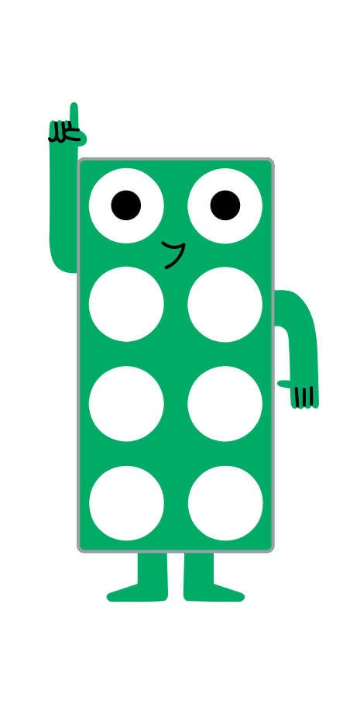
Reflection
Find the Numicon piece to show how you feel about identifying and representing equivalent fractions using a bar model.
Notes:
Reflection notes
Resources: Numicon pieces
Ask children to hold up a Numicon piece to show how they feel about finding equivalent fractions.
Encourage children to choose a higher number if they feel more confident about their learning.
Assessment opportunities:
Strategy: visual
Make a note of any children who show a lower number.

Slide 19
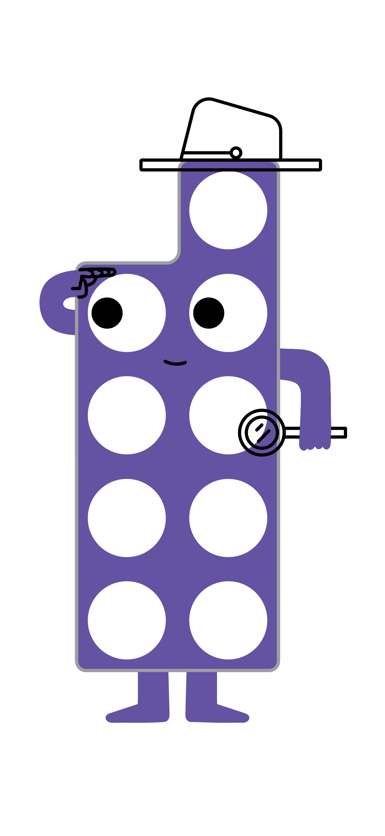
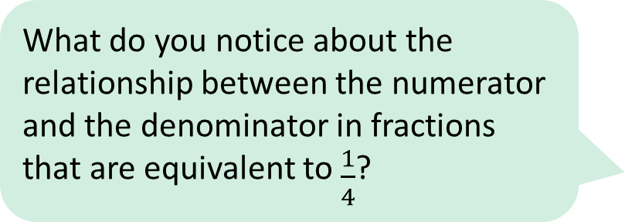
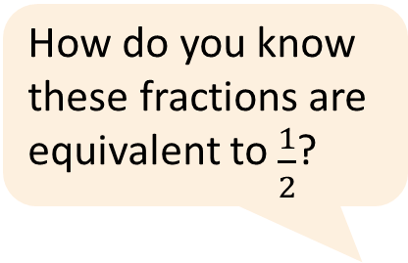
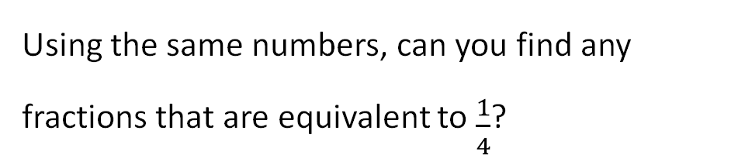
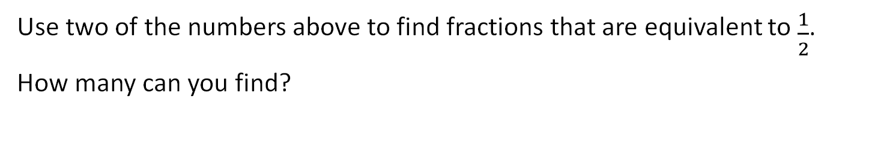
Extend and explore
2, 5, 34, 4, 120, 40, 15, 20, 17, 60, 10, 68, 30
Use two of the numbers above to find fractions that are equivalent to $\frac{1}{2}$.
How many can you find?
How do you know these fractions are equivalent to $\frac{1}{2}$?
Using the same numbers, can you find any fractions that are equivalent to $\frac{1}{4}$?
What do you notice about the relationship between the numerator and the denominator in fractions that are equivalent to $\frac{1}{4}$?
equivalent | numerator | denominator | half | quarter | fraction
Notes:
Extend and explore notes
Resources: print-outs of this slide
This has been provided as an extra resource you can use as a follow-up to the lesson, for retrieval practice, or as an activity you can print out and give to children who need meaningful extension during the lesson.
Answers:
Fractions equivalent to one-half: $\frac{2}{4}$, $\frac{5}{10}$, $\frac{17}{34}$, $\frac{60}{120}$, $\frac{20}{40}$, $\frac{15}{30}$.
Fractions equivalent to one-quarter: $\frac{10}{40}$, $\frac{5}{20}$, $\frac{15}{60}$, $\frac{30}{120}$, $\frac{17}{68}$.

