Slide 1
© Oxford University Press 2024

Slide 2
Unit and non-unit fractions
Year 2 (P3) | Fractions
Notes:
Teacher information slide

Slide 3
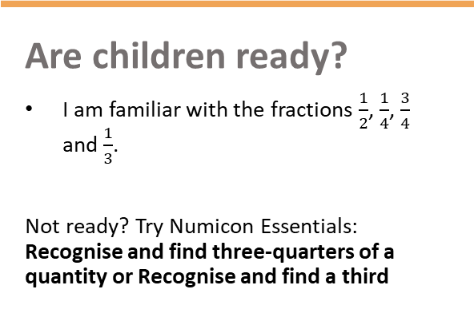
Learning outcomes
Are children ready?
  I am familiar with the fractions $\frac{1}{2}$, $\frac{1}{4}$, $\frac{3}{4}$ and $\frac{1}{3}$.
  Not ready? Try Numicon Essentials: Recognise and find three-quarters of a quantity or Recognise and find a third
Learning outcomes
  I can recognise unit and non-unit fractions.
  I can understand and accurately use the terms ‘fraction’, ‘numerator’ and ‘denominator’.
  I understand that fractions where the numerator and denominator are the same are equivalent to 1.
Lesson summary
  In this lesson, children will be considering different models that are used to represent fractions and identify the size of the numerator and denominator. Children will consider the characteristics of unit fractions and non-unit fractions and recognise and build them.
Where next?
  I can count in fractions up to 1 whole.
  I understand fractions as a position on a number line.
  Ready to move on? Try Numicon Essentials: Count in fractions up to 1 whole
Notes:
Teacher information slide

Slide 4
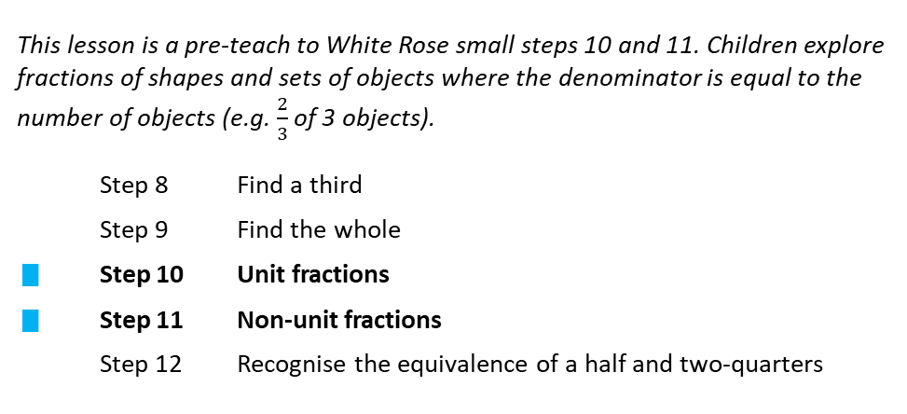
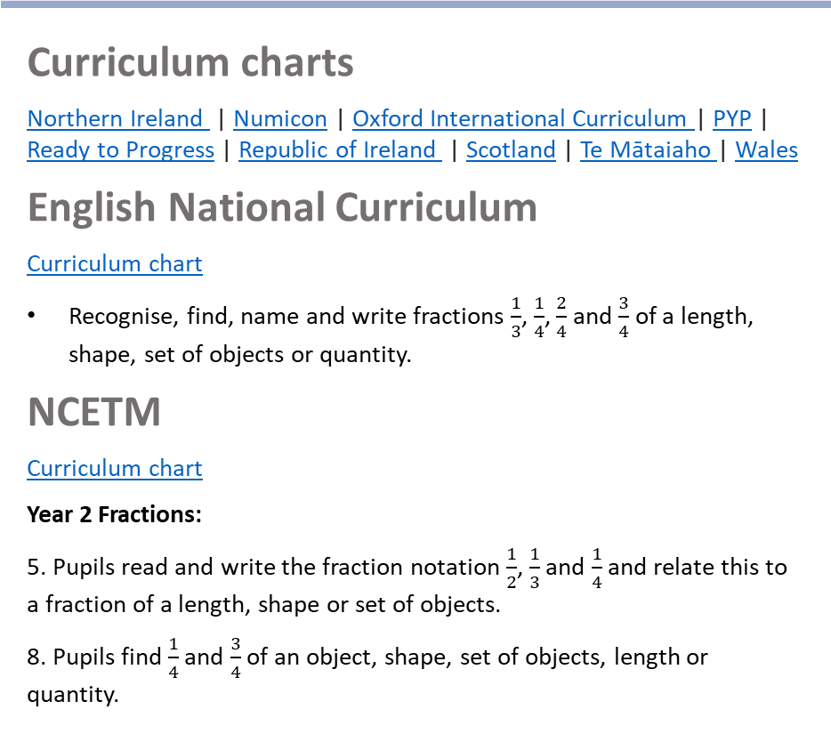
Curriculum links
White Rose small steps
  Year 2 | Summer term | Block 1 – Fractions
Curriculum charts
Northern Ireland | Numicon | Oxford International Curriculum | PYP |
Ready to Progress | Republic of Ireland | Scotland | Te Mātaiaho | Wales
English National Curriculum
  Curriculum chart
  Recognise, find, name and write fractions $\frac{1}{3}$, $\frac{1}{4}$, $\frac{2}{4}$ and $\frac{3}{4}$ of a length, shape, set of objects or quantity.
NCETM
  Curriculum chart
  Year 2 Fractions:
  5. Pupils read and write the fraction notation $\frac{1}{2}$, $\frac{1}{3}$ and $\frac{1}{4}$ and relate this to a fraction of a length, shape or set of objects.
  8. Pupils find $\frac{1}{4}$ and $\frac{3}{4}$ of an object, shape, set of objects, length or quantity.
This lesson is a pre-teach to White Rose small steps 10 and 11. Children explore fractions of shapes and sets of objects where the denominator is equal to the number of objects (e.g. $\frac{2}{3}$ of 3 objects).
  This step:: Step 8 Find a third
  Step 9 Find the whole
  ▮ Step 10 Unit fractions
  ▮ Step 11 Non-unit fractions
  Step 12 Recognise the equivalence of a half and two-quarters
Click here for the full White Rose curriculum mapping chart.
Click here for a full list of Numicon Essentials lessons.
Notes:
Teacher information slide

Slide 5
Lesson essentials
Resources
  Numicon pieces
  Numicon pegs
  Number rods
  Visualiser (optional)
  Numicon IWB Software (optional)
  Print-outs of Extend and explore slide
  Resource pack (PCMs):
  Fraction cards
  Make unit and non-unit fractions
Key vocabulary
  whole, part, fraction, unit fractions,
  non-unit fractions, numerator, denominator, same, different
  Click here for glossary definitions.
Key ideas and tips
  The denominator represents how many equal parts the whole has been split into.
  The numerator represents how many parts are available.
  A unit fraction has only one part, so the numerator is always 1.
  A non-unit fraction has more than one part, so the numerator is always more than 1.
Sentence stems
  The whole is split into __ equal parts.
  The denominator is __ parts altogether.
  The numerator is __ out of __ parts.
  We have __ out of __ parts.
  __ is __ out of __ equal parts.
Watch points and misconceptions
  Watch out for children who, when building unit fractions with Numicon pieces, think that the numerator can only be represented using a 1-piece.
  Watch out for children who build fractions by adding the numerator and denominator together.
Notes:
Teacher information slide

Slide 6
Unit and non-unit fractions
Notes:
Title slide

Slide 7



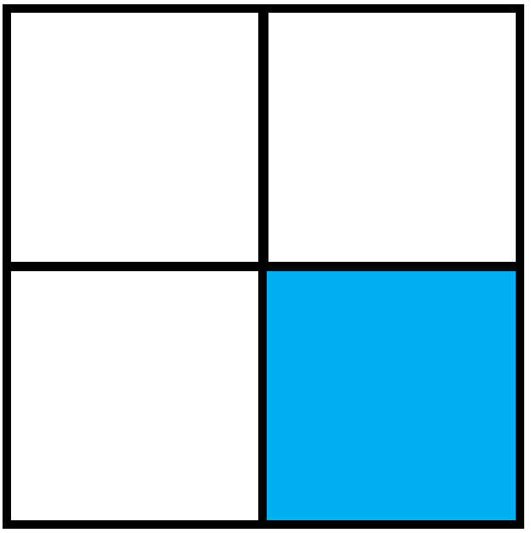
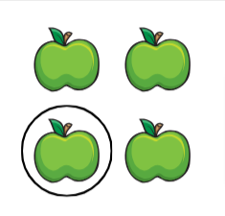

Talk task (1)
What is the same? What is different?
Key words
fraction
unit fraction
part
whole
same
different
__ out of __ parts.
Notes:
Talk task (1) notes​
Resources: alternative models to the ones shown on the slide (optional) ​
Oracy groupings: Pairs ​
This is an opportunity to consider different ways to represent the same fraction.
Ask pairs to discuss the three images on the slide, focusing on what is the same and what is different.
Look and listen for children who:​
recognise that each model shows a whole split into 4 equal parts​
recognise that each model shows 1 part out of 4 equal parts
recognise that the whole in each model looks different
say that the fraction shown by each model can be described as one-quarter​
use the correct vocabulary for the different parts of each fraction model
use the sentence stem ‘__ out of __ parts’ correctly.
Watch out for children who:​
do not associate the model with fractions but instead see and describe them in whole-number terms. ​
Reinforce that each model represents $\frac{1}{4}$.
Say: When a fraction shows 1 equal part of a whole, it is called a ‘unit fraction’. We are going to be exploring unit fractions in this lesson.
Reinforce that all of these models show unit fractions.
Show some other representations of unit fractions, e.g. 1 peg in a Numicon 6-piece, a 1-piece on top of a 9-piece.
Extension:​
You may wish to extend this Talk task and have children create their own unit fraction models and describe them to their partner. Encourage them to use the key words.
Assessment opportunities: ​
Strategy: verbal ​
Circulate the classroom, making note of children’s understanding.

Slide 8
Talk task (2)
What is the same? What is different?
Key words
fraction
non-unit fraction
part
whole
same
different
__ out of __ parts.
Notes:
Talk task (2) notes
Resources: alternative models to the ones shown on the slide (optional) ​
Oracy groupings: Pairs ​
This is an opportunity to consider fractions with the same denominator but different numerators.
Ask pairs to discuss the three images on the slide, focusing on what is the same and what is different.
Look and listen for children who:​
recognise that the whole is the same in all three models, and that it has been split into 4 equal parts
recognise that each model shows a different number of parts covered by pegs (1 out of 4, 2 out of 4, 3 out of 4)
say that the fractions shown by the models can be described as one-quarter​, two-quarters and three-quarters
use the correct vocabulary for the different parts of the fraction model
use the sentence stem ‘__ out of __ parts’ correctly.
Watch out for children who:​
do not associate the model with fractions but instead see and describe it in whole-number terms. ​
Remind children that $\frac{1}{4}$ is a unit fraction.
Discuss what the other two models show, drawing out that they show the fractions $\frac{2}{4}$ and $\frac{3}{4}$ respectively.
Say: When a fraction shows more than 1 equal part of a whole, it is called a ‘non-unit fraction’. We are also going to be exploring non-unit fractions in this lesson.
Reinforce that $\frac{1}{4}$ is a unit fraction because it shows 1 equal part of the whole and that $\frac{2}{4}$ and $\frac{3}{4}$ are non-unit fractions because they show more than 1 equal part of the whole.
Show some other representations of unit and non-fractions, for children to compare, e.g. 1 peg in a Numicon 6-piece and 2 pegs in a Numicon 6-piece.
Extension:​
You may wish to extend this Talk task and have children create their own non-unit fraction models and describe them to their partner. Encourage them to use the key words.
Assessment opportunities: ​
Strategy: verbal ​
Circulate the classroom, making note of children’s understanding.

Slide 9
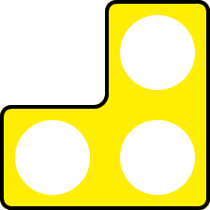



Talk task (3)
What is the same? What is different?
Key words
fraction
non-unit fraction
part
whole
same
different
__ out of __ parts.
Notes:
Talk task (3) notes
Resources: alternative models to the ones shown on the slide (optional) ​
Oracy groupings: Pairs ​
This is an opportunity to consider that when the numerator and denominator are equal the fraction is equivalent to 1.
Ask pairs to discuss the three images on the slide, focusing on what is the same and what is different.
Look and listen for children who:​
recognise that each model shows a different whole, split into a different number of equal parts (4 parts, 2 parts and 3 parts)
recognise that, in each model, all parts of the whole are present
say that all the models can be described as 1 whole
say that the fractions shown by the models can be described as four-quarters, two-halves and three-thirds
say that the models all represent non-unit fractions
say that, for each model, the numerator and the denominator would be the same
use the correct vocabulary for the different parts of the fraction model
use the sentence stem ‘__ out of __ parts’ correctly.
Watch out for children who:​
think that because all the fractions have been split into different parts, they cannot all be equivalent to 1. ​
Reinforce that all three models show 1 whole, and that when the numerator and denominator are the same the fraction is always worth 1 whole.
Extension:​
You may wish to extend this Talk task and have children create their own fraction models that are equivalent to 1 and describe them to their partner. Encourage them to use the key words.
Assessment opportunities: ​
Strategy: verbal ​
Circulate the classroom, making note of children’s understanding.

Slide 10
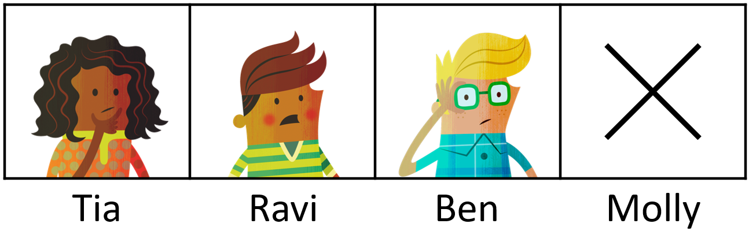
Switch on
Class A needs 4 children for its quiz team.
Tia, Ravi and Ben arrive on the day of the quiz.
But Molly is sick and can’t make it.
How can we represent this as a fraction using Numicon pieces and pegs?
The whole is split into __ equal parts.
We have __ out of __ parts.
whole | equal | part | fraction | unit fraction | non-unit fraction
Notes:
Switch on notes
Resources: Numicon pieces, Numicon pegs
Oracy groupings: Pairs ​
Set the scene: Class A needs 4 children for its quiz team. Tia, Ravi and Ben arrive on the day of the quiz. But Molly is sick and can’t make it.
Ask: How can we represent this problem using apparatus?
Ask children to discuss and explore in pairs. Encourage them to use Numicon pieces and pegs to model the problem, and to explain to each other what the model shows.
Look and listen for children who:
recognise that the whole (the quiz team) has 4 equal parts
recognise that each child is 1 part of the whole
recognise that only 3 out of 4 parts are present
use a Numicon 4-piece to represent the whole, and 3 pegs to represent the 3 children who turn up for the quiz
describe the children who turn up as three-quarters of the team.
Watch out for children who:​
do not associate the problem and the model with fractions, but instead see and describe them in whole-number terms. ​
Take feedback from pairs.
Demonstrate creating a model of the problem using a Numicon 4-piece and 3 pegs.
Together, use the sentence stems: ‘The whole is split into 4 equal parts. We have 3 out of 4 parts.’
Ask: What fraction of the team is present? (Three-quarters)
Write $\frac{3}{4}$ on the board.
Ask: Can you remind me what a unit fraction is? (1 equal part of a whole.)
Ask: Is this a unit fraction? (No.)
Say: This a non-unit fraction because non-unit fractions are always more than 1 equal part of a whole.
Ask: How many quarters are there in three-quarters? (3)

Slide 11
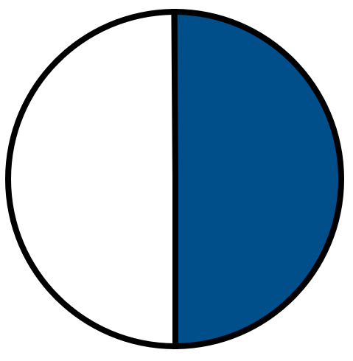

Teach: I do (1)
What fraction is represented?
Video demo
The whole has been split into __ equal parts.
We have __ out of __ parts.
whole | equal | part | fraction | unit fraction | non-unit fraction
Notes:
Teach: I do (1) notes
Before the lesson: Watch the video showing how to model this first 'I do' phase and the second ‘I do phase’ and use it to help prepare for your own modelling. It is beneficial that this is done live by you with the children.​
Resources: Numicon pieces, Numicon pegs, plastic stars or other shapes (optional), alternative models to the ones shown on the slide (optional), visualiser (optional), Numicon IWB Software (optional)
You can choose to model your thinking and what to do physically with manipulatives and drawings or using the Numicon IWB Software.
Ask: What fraction is represented by the three models?
For each model, explain the whole and the parts, then write the fraction $\frac{1}{2}$ below the model:
(Numicon 2-piece with 1 peg) The whole has been split into 2 equal parts. 1 of those parts has been covered with a peg. So we have 1 out of 2 equal parts.
(Circle with 1 half shaded) The whole circle has been split into 2 equal parts. 1 of those parts has been shaded. So we have 1 out of 2 equal parts.
(2 stars with 1 circled) The collection of stars is made of 2 equal stars. 1 of those stars has been circled. So we have 1 out of 2 equal parts.
Ask: What is the same and what is different? (They are all made of 2 equal parts, but the representations are different. In each model, the fraction that is represented is one-half.)
Say:
The denominator is the number at the bottom of the fraction. It shows how many equal parts the whole has been divided into. Here, the whole has been split into 2 equal parts.
The numerator is the number at the top of the fraction. It shows how many parts of the whole we have. Here we have 1 out of 2 parts.
One-half is a unit fraction because it describes 1 equal part of the whole. One-half is 1 out of 2 parts.
Let’s have a look at the division sign.
Write the ÷ sign.
Say: The division sign is used to show when the whole has been split into parts. This is also used to write fractions, which helps us to see the whole and the parts. A half is 1 out of 2 parts.

Slide 12




Teach: We do (1)
How many equal parts has the whole been split into?
How many parts of the whole are shown?
Write the fraction.
$$\frac{1}{4}$$
$$\frac{1}{2}$$
$$\frac{1}{3}$$
__ is __ out of __ equal parts.
whole | equal | part | fraction | unit fraction | non-unit fraction
Notes:
Teach: We do (1) notes
Resources: Numicon pieces, Numicon pegs
Oracy groupings: Pairs or trios
Ask children to look at the first model.
Ask them to discuss the following questions in pairs/trios:
How many parts has the whole been split into? (4)
How many parts of the whole are shown? (1)
Ask children to write the fraction on their individual whiteboards.
Click to display the fraction below the model.
Remind children that the denominator shows how many equal parts the whole has been divided into.
Ask: What is the denominator? (4)
Remind children that the numerator shows how many parts of the whole we have.
Ask: What is the numerator? (1)
Together, rehearse the sentence stem: ‘One-quarter is 1 out of 4 equal parts.’
Repeat for each of the other two models.
Ask: What is the same about all three models? How do you know? (They all represent unit fractions, because they all show 1 part out of the whole.)
Look and listen for children who:
identify how many parts the whole has been divided into
identify how many parts of the whole are shown
use the terms ‘denominator’ and ‘numerator’ correctly
describe each model correctly using the sentence stem ‘__ is __ out of __ equal parts’
recognise that the models all represent unit fractions.
Assessment opportunities: ​
Strategy: verbal ​
Circulate the classroom, making note of children’s understanding.

Slide 13

Teach: I do (2)
What fractions are represented?
The whole has been split into __ equal parts.
We have __ out of __ parts.
whole | equal | part | unit fraction | non-unit fraction | denominator | numerator
Notes:
Teach: I do (2) notes
Resources: Numicon pieces, Numicon pegs, plastic stars or other shapes (optional), alternative models to the ones shown on the slide (optional), visualiser (optional), Numicon IWB Software (optional)
You can choose to model your thinking and what to do physically with manipulatives and drawings or using the Numicon IWB Software.
Ask: Which fractions are represented by these models?
For each model, explain the whole and the parts, then write the fraction below the model:
(Numicon 4-piece with 3 pegs) This Numicon piece is split into 4 equal parts. (Below the model, draw the horizontal bar of the fraction and write ‘4’ as the denominator.) 3 of those parts are covered with pegs. (Write ‘3’ as the numerator.) So here we have three-quarters.
(Numicon 3-piece with 3 pegs) This Numicon piece is split into 3 equal parts. (Draw the horizontal bar and write ‘3’ as the denominator.) 3 of those equal parts have been covered with pegs. (Write ‘3’ as the numerator.) So here we have three-thirds.
(4 stars with 2 circled) The collection of stars has been split into 4 equal parts. (Draw the horizontal bar and write ‘4’ as the denominator.) 2 of those parts have been circled. (Write ‘2’ as the numerator.) So this is two-quarters.
Ask: What’s the same? (Each model is made up of equal parts.) What’s different? (The number of equal parts is different, and a different number of parts is shown.)
Ask:
Which number in the fraction is the denominator? (The bottom number. This tells us the number of equal parts the whole has been divided into.)
Which number in the fraction is the numerator? (The top number. This tells us the number of parts we have.)
Point to the first model.
Say: The whole has been split into 4 equal parts (point to the denominator). We have 3 (point to the numerator) out of 4 (point to the denominator) equal parts.
Repeat for the second and third models.
For the second model, draw out that when the numerator and denominator are the same, the fraction is equivalent to 1.
Ask: Are these unit fractions or non-unit fractions? How do you know?
Say: We know that these are all non-unit fractions because they all show more than 1 part of the whole. The numerator is more than 1. So these are all non-unit fractions.

Slide 14



Teach: We do (2)
How many equal parts has the whole been split into?
How many parts of the whole are shown?
Write the fraction.
$$\frac{2}{2}$$
$$\frac{2}{3}$$
$$\frac{3}{4}$$
__ is __ out of __ equal parts.
whole | equal | part | unit fraction | non-unit fraction | denominator | numerator
Notes:
Teach: We do (2) notes
Resources: Numicon pieces, Numicon pegs
Oracy groupings: Pairs or trios
Ask children to look at the first model.
Ask them to discuss the following questions in pairs/trios:
How many parts has the whole been split into? (2)
How many parts of the whole are shown? (2)
Ask children to write the fraction on their individual whiteboards.
Click to display the fraction below the model.
Remind children that the denominator shows how many equal parts the whole has been divided into.
Ask: What is the denominator? (2)
Remind children that the numerator shows how many parts of the whole we have.
Ask: What is the numerator? (2)
Together, rehearse the sentence stem: ‘Two halves is 2 out of 2 equal parts.’
Recall that when the numerator and denominator are equal the fraction is equivalent to 1.
Repeat for each of the other two models.
Ask: Are these unit fractions or non-unit fractions? How do you know? (Non-unit fractions, because more than 1 part of the whole is shown.)
Look and listen for children who:
identify how many parts the whole has been divided into
identify how many parts of the whole are shown
use the terms ‘denominator’ and ‘numerator’ correctly
describe each model correctly using the sentence stem ‘__ is __ out of __ equal parts’
recognise that the models all represent non-unit fractions
recognise that when the numerator and denominator are the same the fraction represents 1.
Assessment opportunities: ​
Strategy: verbal ​
Circulate the classroom, making note of children’s understanding.

Slide 15
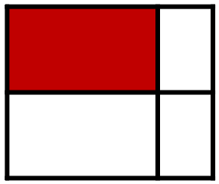
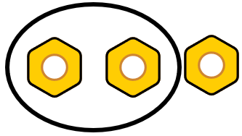
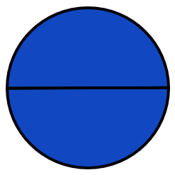
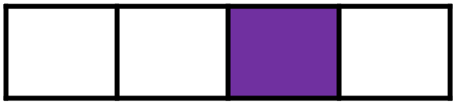
Hinge
Which of these models show unit fractions?
A
B
C
D
E
whole | equal | part | unit fraction | non-unit fraction | denominator | numerator
Notes:
Hinge notes
Oracy groupings: Pairs
Click to reveal the first model.
Ask: Does this show a unit fraction?
Children to use thumbs up/down to indicate their thinking. Next the children should write the fraction they think is represented on their whiteboard and compare with their partner.
Click to reveal each fraction in turn, asking the same question for a show of thumbs up/thumbs down.
Assessment opportunities:
Strategy: visual
If a significant number of children answer incorrectly, pause the lesson here to revisit/consolidate the key concepts before moving onto the You do phase.
Ask children to discuss their answers in pairs using the sentence starter ‘I think this is a unit fraction because …’ or ‘I think this is not a unit fraction because …’
If children disagree on any of the fractions, they should explain their reasoning clearly and try to convince their partner.
Look and listen for children who:
recognise that only models A and D show unit fractions (one-third and one-quarter)
can explain that unit fractions show 1 equal part out of the whole
understand that model B does not show a unit fraction, because the parts are not equal
recognise that models C and E show non-unit fractions (two-thirds and two-halves)
can explain that non-unit fractions show more than 1 equal part out of the whole
use the term ‘denominator’ correctly and understand that it shows the number of equal parts the whole is split into
use the term ‘numerator’ correctly and understand that it shows the number of parts we have.
Ask children to feed back to the class. Discuss responses and probe any misconceptions.

Slide 16
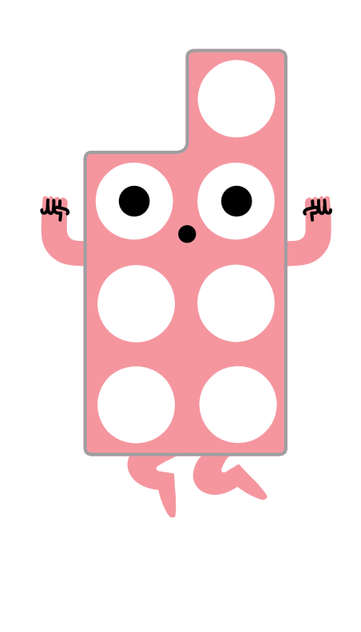
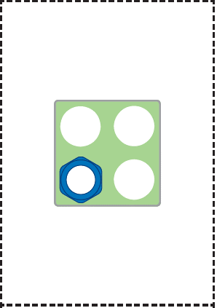
Teach: You do (1)
Place the cards face down in a pile.
Take turns to turn over a card.
Each write the fraction the card represents.
Compare your fraction with your partner.
What is the numerator?
What is the denominator?
Is it a unit fraction or a non-unit fraction?
whole | equal | part | unit fraction | non-unit fraction | denominator | numerator
Notes:
Teach: You do (1) notes
Before the lesson: You may want to cut out the fraction cards in advance to save time.
Resources: Fraction cards (photocopy master), Numicon pieces, Numicon pegs
Oracy groupings: Pairs
Provide pairs with the photocopy master. Ask them to cut out the cards and place them face down in a pile.
Children take it in turns to turn over a fraction card.
Each player independently writes down the fraction the card represents on their whiteboard, and then they compare their answers with their partner.
Ask:
Have you both identified the correct fraction?
What is the denominator?
What is the numerator?
Is it a unit fraction or a non-unit fraction?
Assessment opportunities:
Strategy: verbal and visual
Circulate the classroom, making note of children’s understanding.

Slide 17
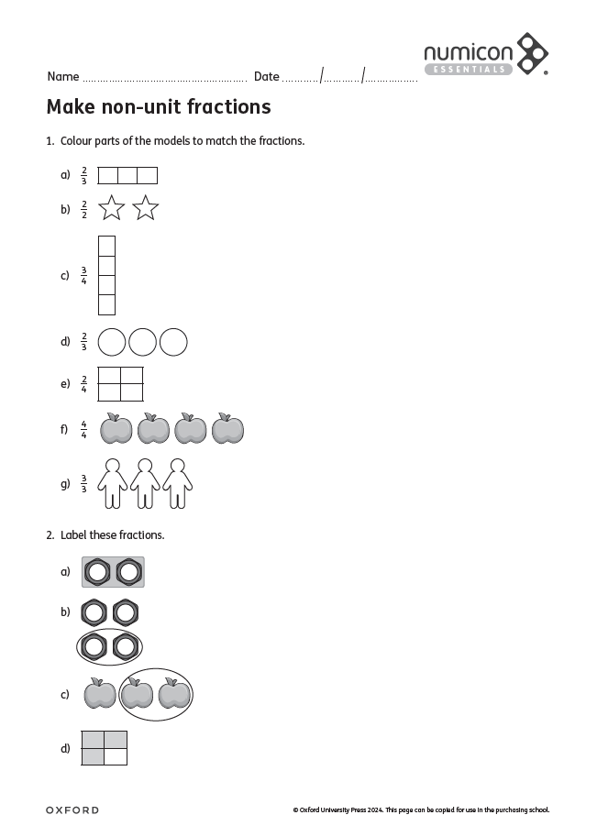
Teach: You do (2)
Colour the models to match the fractions.
Label the fractions.
whole | equal | part | unit fraction | non-unit fraction | denominator | numerator
Notes:
Teach: You do (2) notes
Resources: Make non-unit fractions (photocopy master), Numicon pieces and pegs
Provide children with copies of the photocopy master. They will also need colouring pencils.
Children look at each fraction in turn on the photocopy master and colour parts of the model to match.
Ask:
What is the denominator?
What is the numerator?
Is it a unit fraction or a non-unit fraction? How do you know?
Have you coloured in the model correctly? How do you know?
Assessment opportunities:
Strategy: marking
Mark children’s completed photocopy masters.

Slide 18
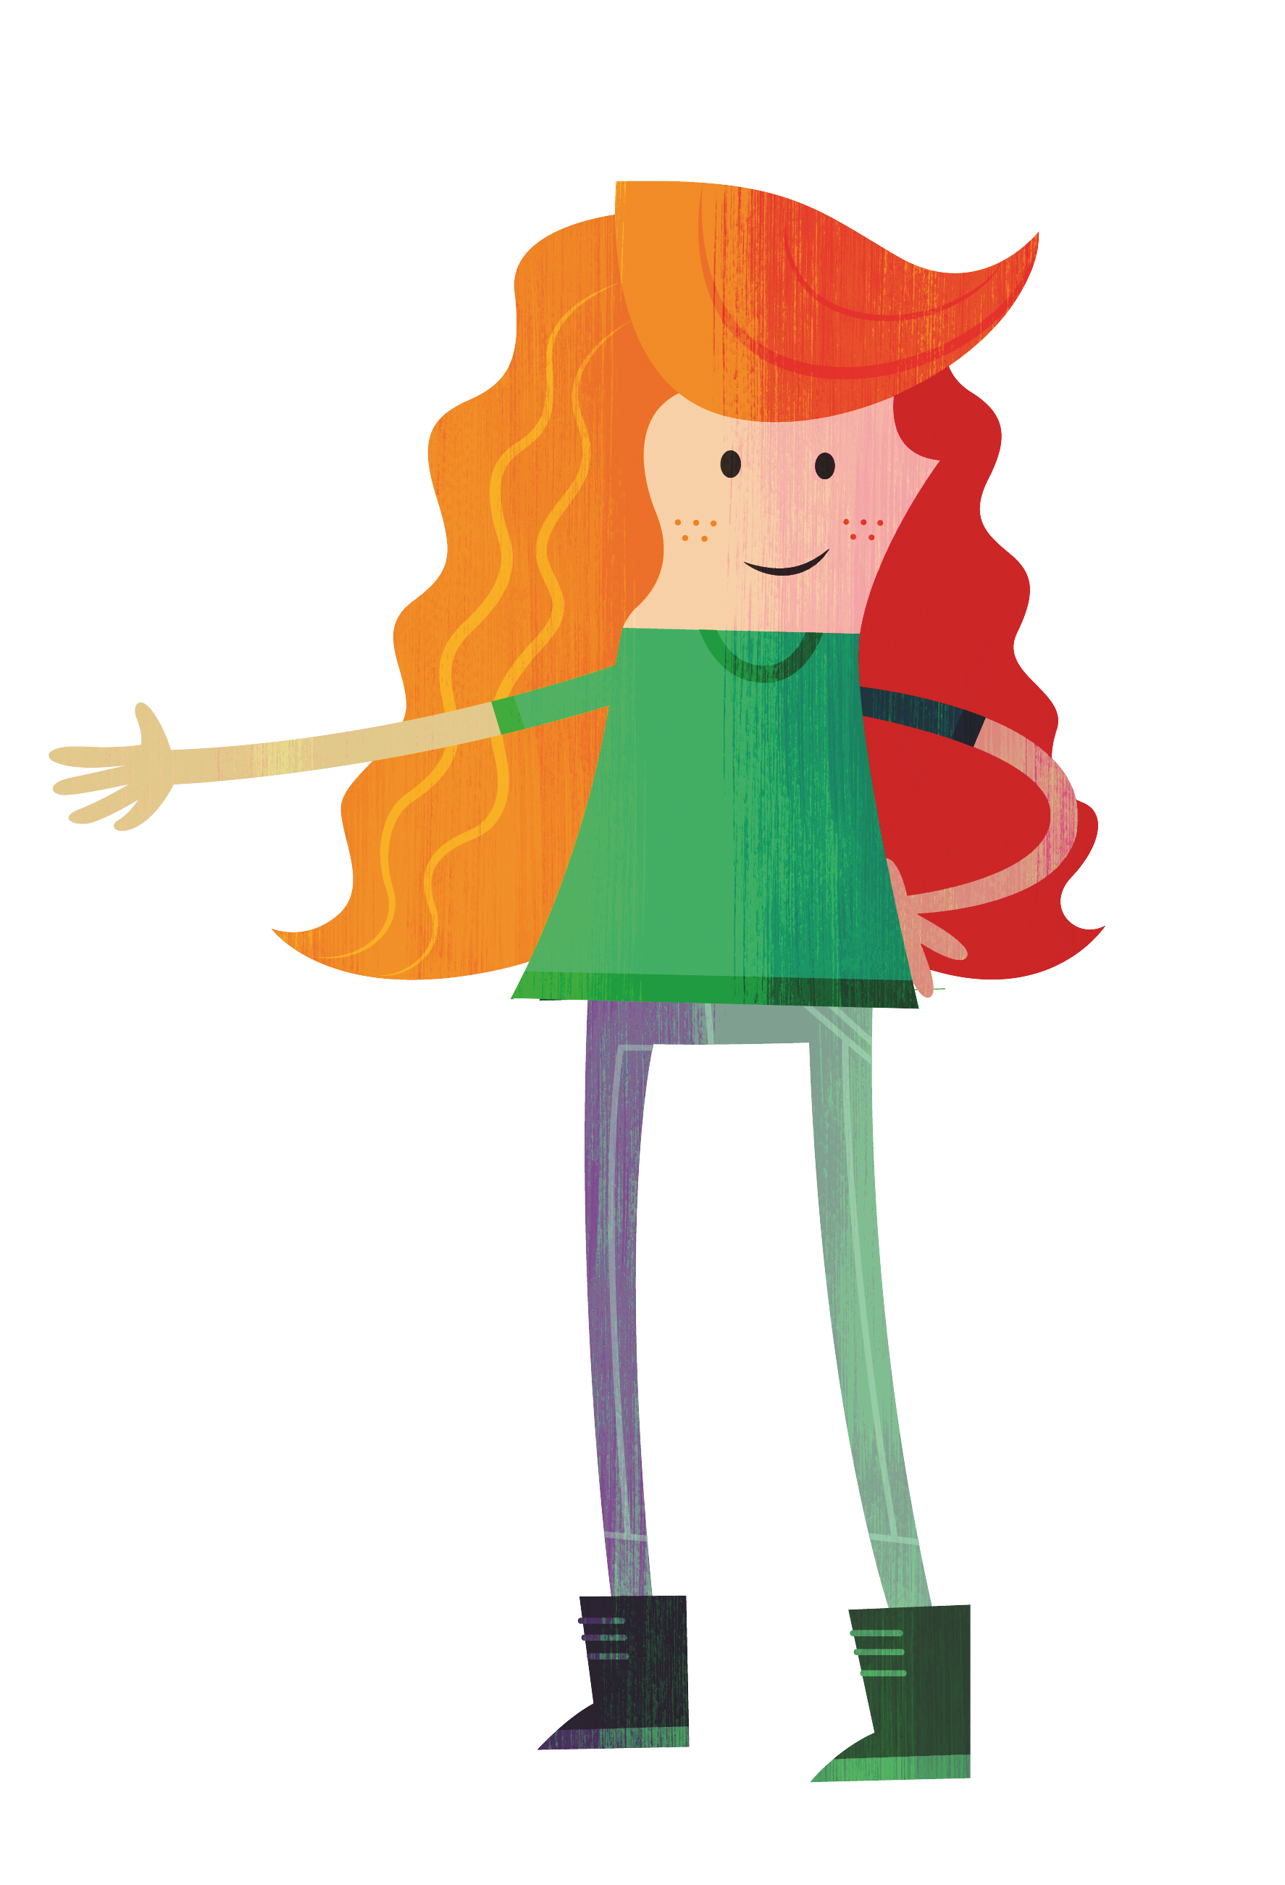
Exit
Do you agree or disagree?
These can both be written as unit fractions.
Molly
whole | equal | part | unit fraction | non-unit fraction | denominator | numerator
Notes:
Exit notes
Resources: Numicon pieces and pegs (optional)
At the end of this lesson, children should be able to:
recognise unit and non-unit fractions
understand and accurately use the terms ‘fraction’, ‘numerator’ and ‘denominator’.
Ask:
What do you think?
Do you agree that both of these models can be written as unit fractions?
Discuss both models and ask children to identify the fraction that they represent.
Draw children’s attention to the second model, which shows $\frac{2}{4}$. Discuss that the 2-piece covers 2 of the 4 holes in the 4-piece, which is half of the holes. Show children that two 2-pieces would together make the 4-piece, but we only have 1 of those 2-pieces. Listen for any children who notice that $\frac{2}{4}$ could also be written as $\frac{1}{2}$, which is a unit fraction.
Assessment opportunities:
Strategy: verbal

Slide 19
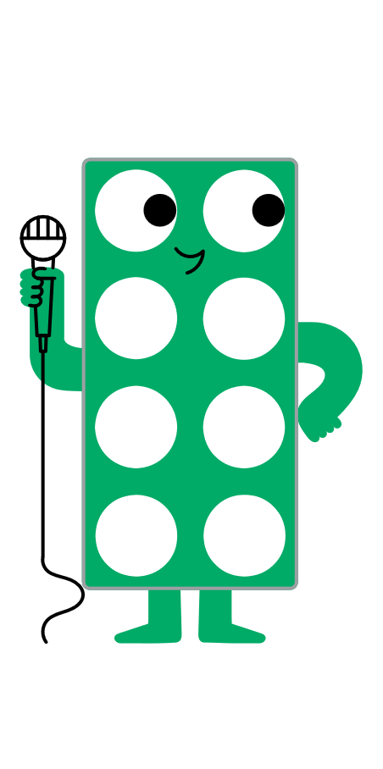
Reflection
Find the Numicon piece that shows how you feel about recognising unit and non-unit fractions.
Notes:
Reflection notes
Resources: Numicon pieces
Ask children to hold up a Numicon piece to show how they feel about recognising unit and non-unit fractions.
Encourage them to choose a higher number if they feel more confident about their learning.
You might also choose to ask children to share how confident they feel in their understanding of the words ‘numerator’ and ‘denominator’.
Assessment opportunities:
Strategy: visual
Make a note of any children who show a lower number.

Slide 20



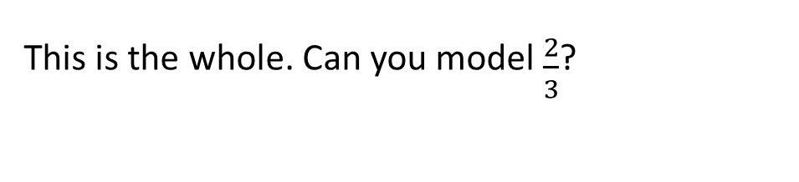
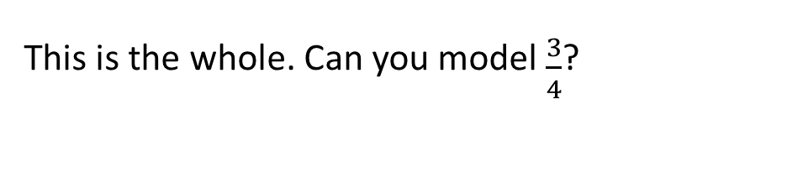
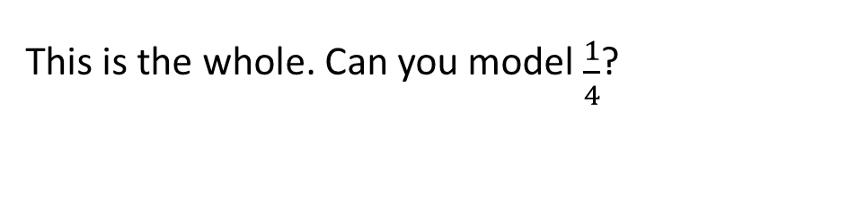
Extend and explore
This is the whole. Can you model $\frac{1}{4}$?
This is the whole. Can you model $\frac{2}{3}$?
This is the whole. Can you model $\frac{3}{4}$?
whole | equal | part | unit fraction | non-unit fraction | denominator | numerator
Notes:
Extend and explore notes
Resources: Print-outs of this slide, number rods
Oracy groupings: Pairs
This has been provided as an extra resource you can use as a follow-up to the lesson, for retrieval practice, or as an activity you can print out and give to children who need meaningful extension during the lesson.
Provide children with print-outs of this slide and number rods to support their thinking and exploration.
Look and listen for children who:
identify the number of equal parts each whole represents
find the correct number rods to use to represent the numerator and denominator for each fraction (white rod and pink rod for $\frac{1}{4}$; two red rods and one dark green rod for $\frac{2}{3}$; three red rods and one brown rod for $\frac{3}{4}$).
Assessment opportunities:
Strategy: visual

