Slide 1
© Oxford University Press 2024

Slide 2
Explore parts and wholes
Year 1 (P2) | Fractions
Notes:
Teacher information slide

Slide 3
Learning outcomes
Are children ready?
  I can compare quantities in different contexts.
  I can explore how quantities can be distributed equally.
Learning outcomes
  I can identify the whole.
  I can identify the parts.
  I can recognise when the whole is split into equal and unequal parts.
  I know that fair sharing means splitting the whole into equal parts.
Lesson summary
  In this lesson, children will be splitting the whole into parts in different ways to develop their understanding of fair sharing and equal and unequal parts.
Where next?
  I can recognise half of an object or shape.
  I can find half of an object or shape.
  I can recognise and find half of a quantity.
  Ready to move on? Try Numicon Essentials: Recognise and find half
  of a quantity
Notes:
Teacher information slide

Slide 4
Curriculum links
White Rose small steps
  Year 1 | Summer term | Block 2 – Fractions
Curriculum charts
  Northern Ireland | Numicon | Oxford International Curriculum | PYP |
  Ready to Progress | Republic of Ireland | Scotland | Te Mātaiaho | Wales
English National Curriculum
  Curriculum chart
  Recognise, find and name a half as one of two equal parts of an object, shape or quantity.
NCETM
  Curriculum chart
  Year 1 Comparison of quantities and part-whole relationships:
  7. Pupils explain what a whole is.
  8. Pupils explain that a whole can be split into parts.
  9. Pupils explain that a whole can represent a group of objects.
  10. Pupils identify a part of a whole group.
  11. Pupils explain what a part-whole model is.
  12. Pupils use a part-whole model to represent a whole partitioned into two parts.
  13. Pupils use a part-whole model to represent a whole partitioned into more than two parts.
This lesson is a pre-teach to White Rose small step 1, focusing on the identification of wholes and parts. Children are encouraged to recognise the size of the whole, the number and size of the parts, and whether those parts are equal or unequal. This provides a key foundation for work on fractions that follows.
  ▮ This step:: Prep Identify wholes and parts
  Step 1 Recognise a half of an object or a shape
  Step 2 Find a half of an object or a shape
  Step 3 Recognise a half of a quantity
  Step 4 Find a half of a quantity
Click here for the full White Rose curriculum mapping chart.
Click here for a full list of Numicon Essentials lessons.
Notes:
Teacher information slide

Slide 5
Lesson essentials
Resources
  Interlocking cubes | Numicon pegs | Small pots | Squares and circles in 2 colours (optional) | Numicon baseboards | Numicon pieces | Visualiser (optional) | Numicon IWB Software (optional) | Print-outs of Extend and explore slide
  Resource pack (PCMs):
  Numicon dot patterns
  Part-whole models
  Blank part-whole models
  Equal or unequal?
Key vocabulary
  whole, part, equal, unequal, share, group, fair, more, fewer
  Click here for glossary definitions.
Key ideas and tips
  The whole can be any size and can be split into any number of parts.
  If each part is the same size, the whole has been split into equal parts.
  If the size of each part is not the same, the whole has been spilt into unequal parts.
  Fair sharing means splitting the whole into groups of equal sizes.
Sentence stems
  The whole amount is __ .
  The whole has been split into __ parts.
  The whole has been split into __ equal parts.
  The whole has been split into __ unequal parts.
  The __ is the part. The __ is the whole.
Watch points and misconceptions
  Look and listen for children who think the whole means 1. Give children experience of establishing the whole where the size of the group is varied.
  Social constructs around ‘fair’ do not always match the mathematical meaning of fair. Look and listen for children who think fair is not about equality
  (e.g. the oldest needs more food than the youngest).
Notes:
Teacher information slide

Slide 6
Explore parts and wholes
Notes:
Title slide

Slide 7



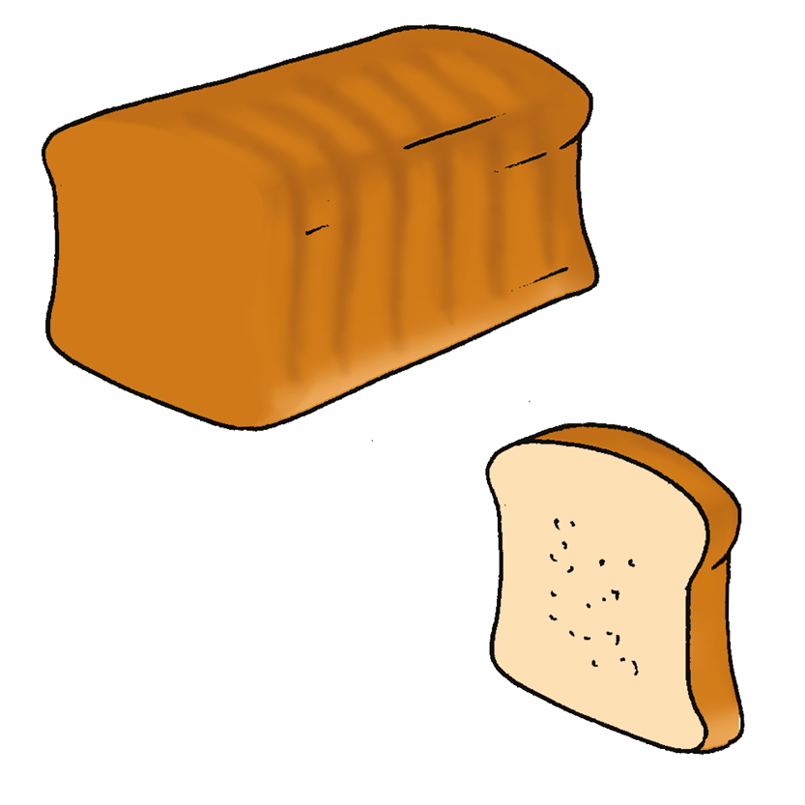
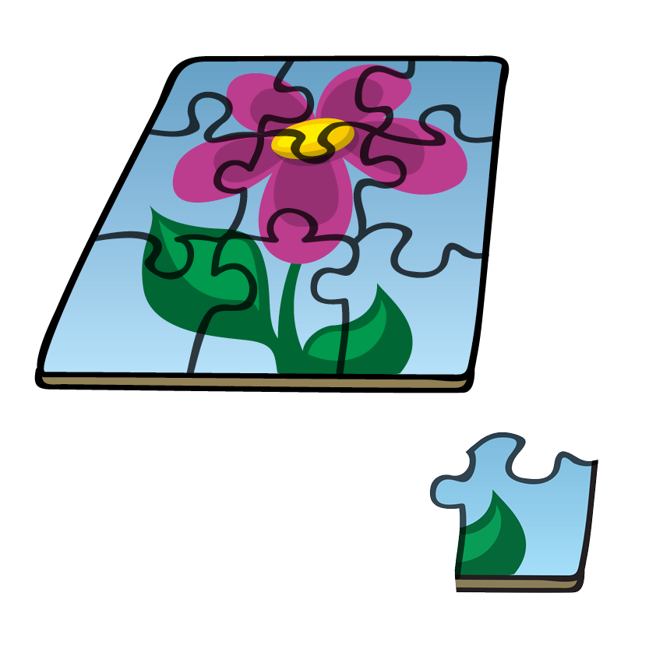
Talk task (1)
What do you notice?
What do you wonder?
Key words
whole
part
The … is the part. The … is the whole.
Notes:
Talk task (1) notes
Resources: concrete apparatus to make models, e.g. interlocking cubes (optional)
Oracy groupings: Pairs
This is an opportunity to rehearse the vocabulary of ‘whole’ and ‘part’.
Ask children to discuss in pairs the images on the slide.
Model and encourage children to use the sentence stems shown on the slide, e.g. ‘The petal is the part. The flower is the whole.’
You may also choose to create models using concrete apparatus and ask children to match the part to the whole, e.g. a tower of 5 interlocking cubes, and a single interlocking cube.
Encourage children to look around the classroom for any parts and wholes they can identify in their environment, e.g. a pencil pot (the whole) containing individual pencils (the parts); a tray cupboard (the whole) containing individual trays (the parts); a stack of chairs (the whole) made up of individual chairs (the parts).

Slide 8




Talk task (2)
What does the whole mean?
Who do you agree with?
Key words
whole
part
I have a whole bowl of 5 strawberries.
The whole is not 1, it is 5.
I have a whole banana.
So, the whole means 1.
Tia
Ben
Notes:
Talk task (2) notes
Oracy groupings: Pairs
Ask: What do you think ‘the whole’ means?
Give children a minute to discuss in pairs.
Say: Tia has a whole banana. She thinks that means that the whole is 1.
Say: Ben has a whole bowl of 5 strawberries. He thinks that means that the whole is 5.
Ask: Who do you agree with? Why?
Ask children to discuss in their pairs.
Look and listen for children who:
recognise that both Tia and Ben are right, but not always: Tia’s whole is 1, and Ben’s whole is 5.
Watch out for children who:
say that the whole is always 1.
Draw out that the whole always describes how many there are in the entire group altogether (the total).
Say: The whole might be 1, but the whole is not always 1. The whole can be any amount.

Slide 9

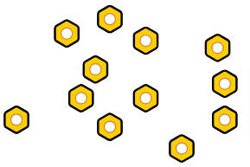
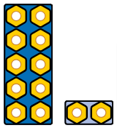
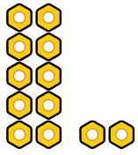
Switch on
What is the whole?
The whole amount is __.
whole | part
Notes:
Switch on notes
Before the lesson: Place 12 Numicon pegs into a small pot. Prepare one pot per pair/group of children, each containing up to 20 Numicon pegs (some quantities should be less than 12, some should be greater). Provide a Numicon dot pattern photocopy master for each pair/group.
Oracy groupings: Trios
Resources: Numicon dot patterns (photocopy master), Numicon pegs, small pots, Numicon baseboards, Numicon pieces (optional)
Show children the pot containing 12 pegs.
Say: This pot contains some pegs.
Ask: How can we find out the whole amount?
Agree that you need to carefully count all the pegs to find out how many altogether.
Model placing the pegs in the Numicon patterns on the baseboard to support identifying the whole: place the pegs in the 10-pattern and then the 2-pattern, building from the bottom up.
Click to reveal the 12 pegs organised into the 10-pattern and the 2-pattern.
Click again to reveal the pegs inside the Numicon pieces.
Give each trio of children a baseboard, the Numicon dot patterns photocopy master and a pot containing up to 20 Numicon pegs.
Encourage trios to find the whole by placing their pegs into the Numicon patterns on the baseboard.
Ask them to use the sentence stem, ‘The whole amount is __.’
Children could hold up the Numicon pieces that represent their whole.
Encourage children to compare the size of their whole with the one you modelled to the class. Establish who has a whole greater than or less than 12.
Ask: Who has the greatest whole amount?
Ask: Who has the smallest whole amount?

Slide 10
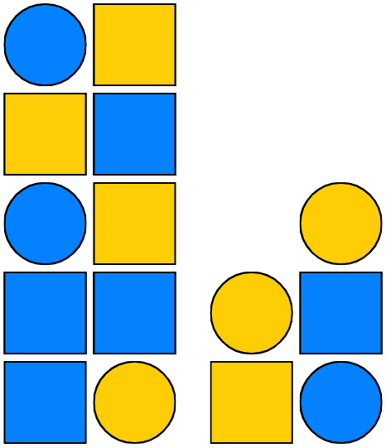
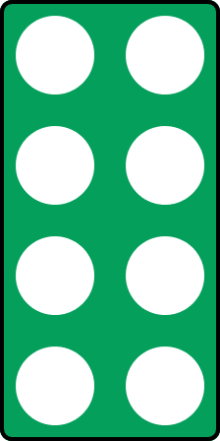
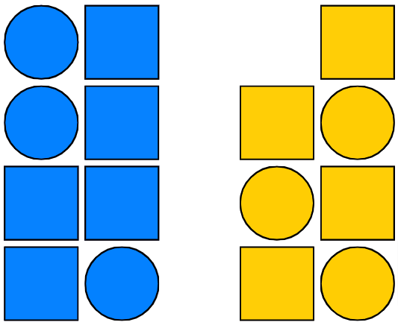

Teach: I do (1)
There are 15 shapes altogether, so the whole is 15.
The whole can be split in different ways.
Video demo
The whole has been split into 2 unequal parts of __ and __ .
whole | part | equal | unequal | group | more | fewer
Notes:
Teach: I do (1) notes
Before the lesson: Watch the video showing how to model the first and second 'I do' phases and use it to help prepare for your own modelling. It is beneficial that this is done live by you with the children.
Resources: plastic circles and squares (or interlocking cubes and Numicon pegs in two colours), Numicon pieces, Numicon pegs (optional), visualiser (optional), Numicon IWB Software (optional)
You can choose to model your thinking and what to do physically with manipulatives or using the Numicon IWB Software. If possible, we recommend using manipulatives.
Lay out the 15 shapes as shown.
Ask children to look at the set of shapes.
Say: There are 15 shapes altogether, so the whole is 15.
Ask: How could I split the whole into parts?
Say that you will split the whole according to colour. Agree that you will have one part blue and one part yellow.
Arrange the shapes by colour, keeping them set out in Numicon patterns.
Click to reveal the sorted shapes on the slide if needed.
You may choose to explain that arranging the shapes into Numicon patterns helps us to see how many there are more easily, without needing to count, once we know the patterns.
Ask: Are the two parts equal? How do you know?
Agree that no, the two parts are not equal.
Say: One part has 8 shapes. (Place the Numicon 8-piece alongside the group of blue shapes.)
Say: The other has 7. (Place the Numicon 7-piece alongside the group of yellow shapes.)
Click to reveal the two Numicon pieces and the sentence stem on the slide if needed.
Model the sentence stem: The whole has been split into 2 unequal parts of 8 and 7.
Say: The two parts are unequal. 7 is less than 8. 8 is more than 7. There are fewer yellow shapes and more blue shapes.
If children need more reinforcement here, they could select Numicon pieces to match the two parts (an 8-piece and a 7-piece), and place Numicon pegs into the holes to help them to recognise the size of each part.

Slide 11
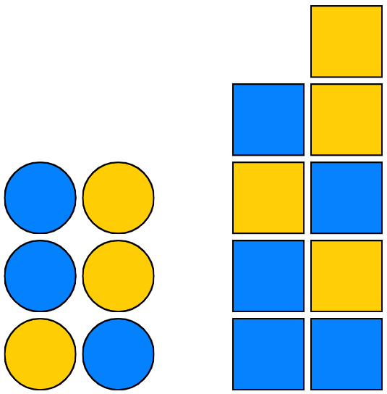



Teach: I do (2)
There are still 15 shapes, so the whole is still 15.
Can I split the whole in a different way?
What is the same?
What is different?
The whole has been split into 2 unequal parts of __ and __ .
whole | part | equal | unequal | group
Notes:
Teach: I do (2) notes
Resources: plastic circles and squares (or interlocking cubes and Numicon pegs in two colours), Numicon pieces, Numicon pegs (optional), visualiser (optional), Numicon IWB Software (optional)
You can choose to model your thinking and what to do physically with manipulatives or using the Numicon IWB Software. If possible, we recommend using manipulatives.
Display the 15 shapes in the same arrangement as at the start of ‘I do (1)’, with the colours and shapes mixed up.
Say: This is the same set of 15 shapes as I had before. Last time, I split them by colour.
Ask: How else could I split the shapes into two parts?
Agree that this time you could split the whole according to shape.
Say: So the whole can be split into two parts, one part circles and one part squares.
Arrange the shapes into circles and squares or click to reveal this.
Set these out in Numicon patterns.
Ask: Are the two parts equal? How do you know?
Agree that, no, the two parts are not equal.
Say: One part has 6 shapes. (Place a Numicon 6-piece alongside the group of circles.)
Say: The other part has 9. (Place a Numicon 9-piece alongside the group of squares.)
Click to reveal the two Numicon pieces and the sentence stem on the slide if needed.
Say: The two parts are unequal. 6 is less than 9. 9 is more than 6. So there are fewer circles and more squares.
Model the sentence stem: The whole has been split into 2 unequal parts of 6 and 9.
Click to reveal the speech bubble.
Ask: What’s the same about the two parts?
Agree that both parts have some yellow shapes and some blue shapes.
Ask: What’s different about the two parts?
Agree that each part has a different type of shape, pointing out the part which is just circles and the part which is just squares.
Children may also say that each part has a different number of shapes.
If children need more reinforcement here, they could select Numicon pieces to match the two parts (a 6-piece and a 9-piece), and place Numicon pegs into the holes to help them to recognise the size of each part.
Ensure all children recognise that there are not the same number of circles as squares, so the whole set of shapes has not been shared equally.

Slide 12

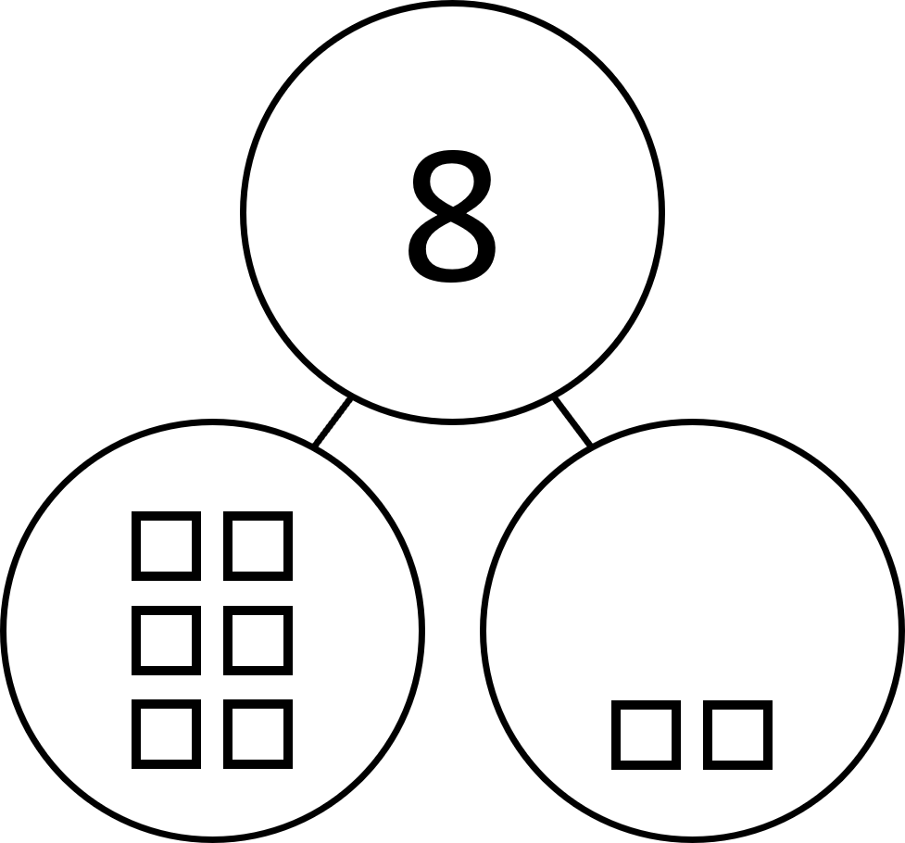
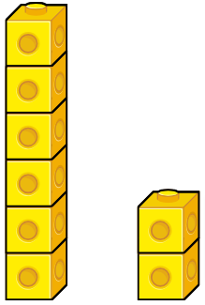

Teach: I do (3)
This is my whole tower.
Video demo
I have split the tower into 2 parts.
Are the parts equal or unequal?
The whole amount is __.
The whole has been split into 2 unequal parts of __ and __ .
whole | part | equal | unequal | share | group | fair
Notes:
Teach: I do (3) notes
Before the lesson: Watch the video showing how to model the third and fourth 'I do' phases and use it to help prepare for your own modelling. It is beneficial that this is done live by you with the children.
Resources: interlocking cubes, Numicon pieces, visualiser (optional), Numicon IWB Software (optional)
You can choose to model your thinking and what to do physically with manipulatives or using the Numicon IWB Software. If possible, we recommend using manipulatives.
Create a tower of 8 interlocking cubes (all the same colour).
Say: Here I have a tower of interlocking cubes. Let’s count them to find the size of the tower.
Count the 8 cubes to establish the size of the tower.
Model using the sentence stem: The whole amount is 8.
Say: I am going to break the whole into two parts.
Break the tower into a tower of 6 and a tower of 2.
Click to reveal the towers of 6 and 2 on the slide if needed.
Place the two parts side by side for comparison.
Ask: Are the parts equal or unequal?
Agree that the parts are unequal.
Ask: Have they been shared fairly?
Agree that no, they have not. Draw out from children how they know and how you can check.
Count the cubes in each part. Count the tower of 2 and place a Numicon 2-piece alongside.
Count the tower of 6 and place a Numicon 6-piece alongside.
Click to reveal the Numicon pieces and the second sentence stem on the slide if needed.
Model using the sentence stem: The whole has been split into 2 unequal parts of 6 and 2.
Say: I am going to show how you would record this in a part-whole model.
Display or draw a blank part-whole model.
Say: So, we are going to write the total at the top.
Ask children to confirm the total, then write ‘8’ in the ‘whole’ circle.
Say: So the total of the whole is 8.
In one part of the model, draw 6 squares (to represent 6 cubes) in the same arrangement as the Numicon 6-pattern.
In the other part, draw 2 squares in the same arrangement as the Numicon 2-pattern.
Click to reveal the completed part-whole model on the slide if needed.
Say: In this part we have 6 and in this part we have 2. (Indicating each part.)

Slide 13
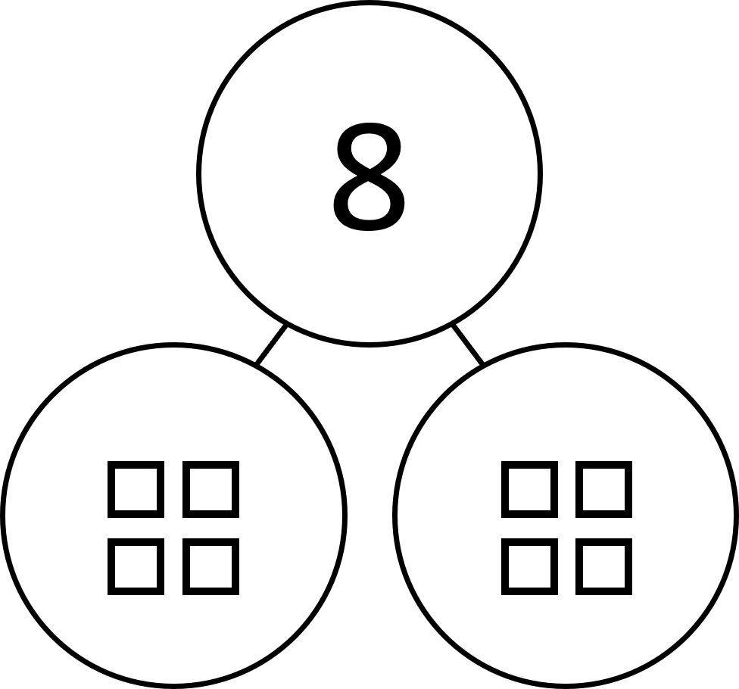
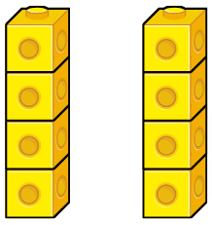

Teach: I do (4)
This is my whole tower.
I have split the tower into 2 parts.
Are the parts equal or unequal?
The whole amount is __.
The whole has been split into 2 equal parts of __ .
whole | part | equal | unequal | share | group | fair
Notes:
Teach: I do (4) notes
Resources: interlocking cubes, Numicon pieces, visualiser (optional), Numicon IWB Software (optional)
You can choose to model your thinking and what to do physically with manipulatives or using the Numicon IWB Software. If possible, we recommend using manipulatives.
Put all 8 interlocking cubes back together to make a single tower.
Say: Let’s count to find the size of the whole.
Some children may recall there were 8 cubes. Count the cubes again to check the size of the tower.
You may choose to re-model the sentence stem: The whole amount is 8.
Say: I am going to break the whole into two parts.
Now break the tower into two equal towers of 4 cubes.
Place them side by side for comparison.
Click to reveal the two towers of 4 on the slide if needed.
Ask: Are the parts equal or unequal? (Equal.) How do you know?
Agree that each part is the same size, so the parts are equal.
Ask: Have they been shared fairly?
Agree that yes, they have. Draw out from the children how they know and how you can check.
Count the cubes to find out how many are in each part.
Place a Numicon 4-piece alongside each part.
Click to reveal the two Numicon pieces and the sentence stem on the slide if needed.
Model the sentence stem: The whole has been split into 2 equal parts of 4.
Display or draw a blank part-whole model.
Say: I am going to write 8 to represent the size of the whole.
Write the numeral ‘8’ in the ‘whole’ circle.
In each part of the model, draw 4 squares in the same arrangement as the Numicon 4-pattern.
Click to reveal the completed part-whole model on the slide if needed.
Say: On this side we have 4 squares to represent the size of one of the parts. On the other side we have 4 squares to represent the size of the other part. Each part is worth 4.

Slide 14
Teach: We do
How could we make a model of the parts?
Are the parts equal or unequal? What is the whole?
1.
2.
3.
7
3
3
3
12
2
4.
5.
6.
6
4
5
5
6
3
3
3
  The whole amount is __.
The whole has been split into 2 unequal parts of __ and __ .
whole | part | equal | unequal | share | group | fair
Notes:
Teach: We do notes
Resources: Part-whole models (photocopy master), Blank part-whole models (photocopy master, printed on A3), concrete apparatus to make models (Numicon pieces, Numicon pegs or interlocking cubes)
Oracy groupings: Pairs
Provide each child with a copy of Part-whole models (photocopy master) and provide each pair with an A3 copy of Blank part-whole models (photocopy master).
Ask children to look at part-whole model 1.
Ask: How could we make a model of the parts? (E.g. ‘We could use Numicon pieces.’)
Ask children to work in pairs to make a model of the two parts, on their blank part-whole model.
They could use Numicon pieces (a 7-piece and a 3-piece), Numicon pegs or interlocking cubes (all one colour).
You could then challenge children to replicate the model they have made using different apparatus to illustrate their understanding of the same concept being represented with different manipulatives.
Demonstrate how to model the parts, e.g. by holding a Numicon 7-piece and a 3-piece next to the numbers.
Ask: How many parts has the whole been split into? (two)
Are the parts equal or unequal? How do we know? (E.g. ‘They are unequal because they are not the same. 7 is more than 3.’
What is the whole? How do we know? (E.g. ‘The whole is 10, because 3 more than 7 is 10.’)
Write ’10’ in the whole.
Encourage children to rehearse the sentence stems: ‘The whole amount is 10. It has been split into 2 unequal parts of 7 and 3.’
Ask children to write the whole in the part-whole model on their sheet and decide whether the parts are equal or unequal.
Repeat for each of the other five part-whole models. Work through the answers as a class.

Slide 15
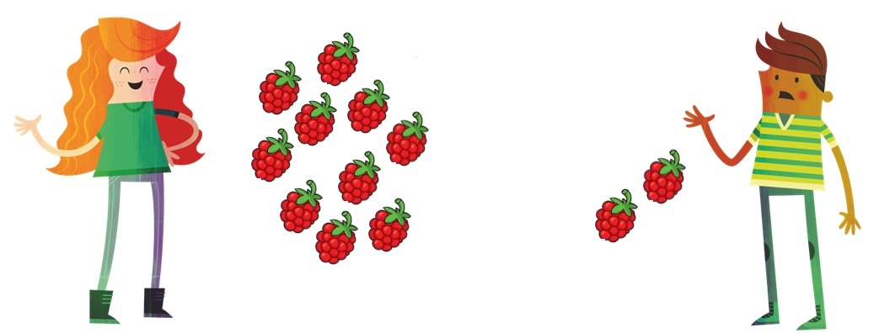
Hinge
Has the whole been split into equal parts?
Molly Ravi
whole | part | equal | unequal | share | group | fair
Notes:
Hinge notes
Resources: concrete apparatus to make models (Numicon pieces, Numicon pegs or interlocking cubes)
Use this to assess children's understanding of the concept of fair sharing and equal and unequal groups.
Ask children to look at the images on the slide: Molly with 10 raspberries and Ravi with 2.
Ask: Has the whole been split into equal parts?
Give children the opportunity to think independently about this question, then ask them to indicate yes or no (e.g. by showing thumbs up or down).
Assessment opportunities:
If a significant number of children answer incorrectly, pause the lesson here to revisit/consolidate the key concepts before moving onto the ‘You do’ phase.
Ask: Can you explain your answer? How can you convince me that you are right?
Look and listen for children who:
realise that fair sharing means creating parts of equal size
explain their reasoning using the key vocabulary accurately
use a model to support their reasoning.
Watch out for children who:
confuse the idea of ‘equal’ in a mathematical sense with the concept of ‘fair’ in a social sense (e.g. ‘If Molly is older, it is fair for her to get more’).
If no children have used Numicon pieces to model the problem, hold up a Numicon 10-piece and a Numicon 2-piece to represent the two parts.
Ask children to confirm that the two parts are unequal, because 10 is greater than 2.
Ask: How could we split this whole into two equal groups?
Look and listen for children who:
use a model to find the answer, e.g. counting out 12 Numicon pegs to represent the whole, then sharing them equally into two groups
realise that sharing 12 equally into 2 parts means each part will be 6.

Slide 16
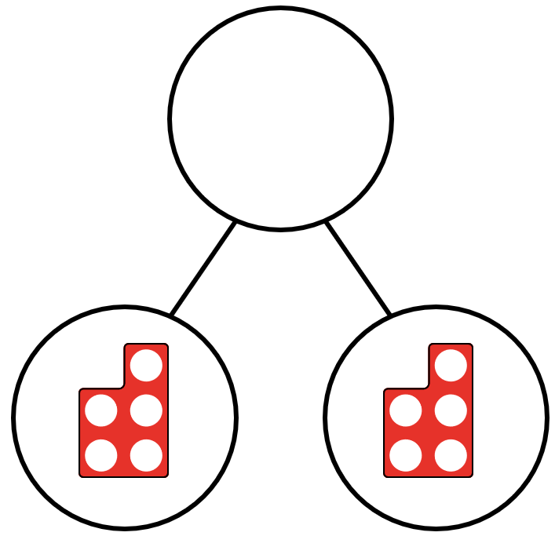
Teach: You do
Make a model of the parts.
How many parts are there? Are they equal or unequal?
What is the whole?
1.
There are 2 parts.
Each part is 5.
The parts are ___________. The whole is ____.
whole | part | equal | unequal | share | group | fair
Notes:
Teach: You do notes
Resources: Blank part-whole models (photocopy master, printed on A3), Equal or unequal (photocopy master), concrete apparatus to make models (Numicon pieces, Numicon pegs or interlocking cubes)
Oracy groupings: Pairs
Provide each child with a copy of Equal or unequal? (photocopy master), and provide each pair with an A3 copy of Blank part-whole models (photocopy master).
Ask children to work in pairs.
Child A chooses a problem and reads it out.
Child B makes a model of the parts, on the blank part-whole model. They could use Numicon pieces, Numicon pegs or interlocking cubes.
Children decide together whether the model matches the problem.
They agree whether the parts they have created are equal or unequal.
Children then swap roles. They answer the rest of the questions, taking it in turns to read the problem and model the parts.
Use problem 1. as an example on the slide. Show children that, in this example, they would write ‘equal’ and ‘10’ in the gaps.
Assessment opportunities:
Strategy: verbal, marking

Slide 17
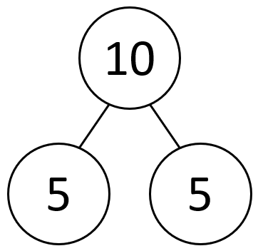
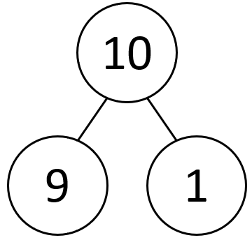
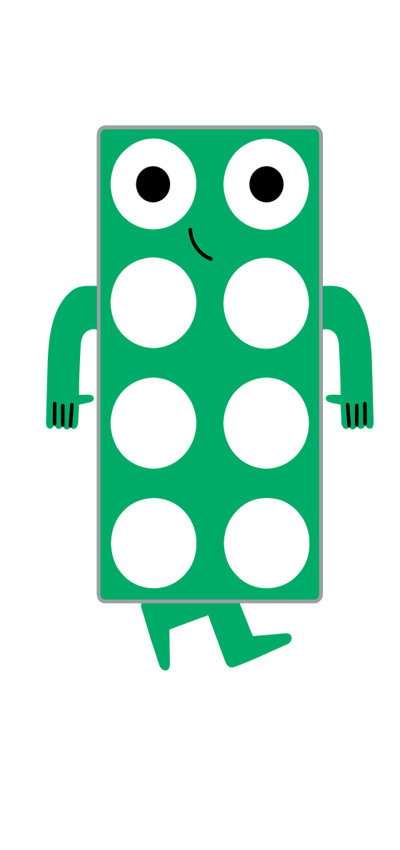
Exit
What is the same?
What is different?
Can you make models to show what you mean?
whole | part | equal | unequal | share | group | fair
Notes:
Exit notes
Resources: concrete apparatus to make models (Numicon pieces, Numicon pegs or interlocking cubes)
Oracy groupings: Pairs
At the end of this lesson, children should be able to:
identify the whole
identify the parts
recognise when the whole is spilt into equal and unequal parts
explain that fair sharing means splitting the whole into equal parts.
Ask children to look at the two part-whole models on the slide.
Ask: What is the same? (the number of parts and the size of the whole)
What is different? (the size of the parts)
Ask children to discuss in pairs, using concrete apparatus such as Numicon pieces to support their reasoning.
Assessment opportunities:
Strategy: verbal

Slide 18
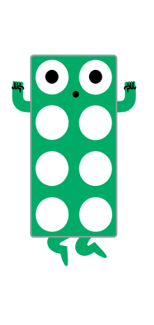
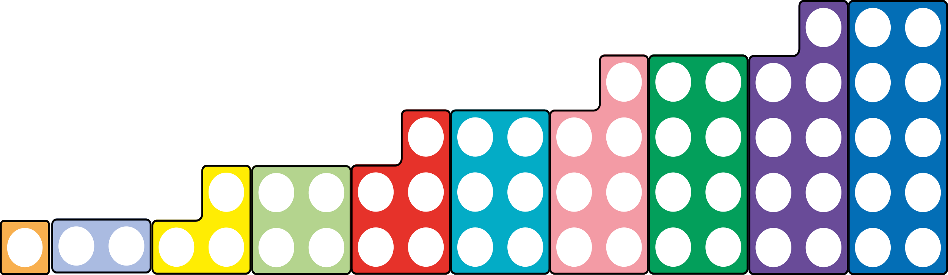
Reflection
Find the Numicon piece to show how you feel about finding a whole and equal or unequal parts.
Notes:
Reflection notes
Resources: Numicon pieces
Ask children to hold up a Numicon piece to show how they feel about finding a whole and equal or unequal parts.
Encourage children to choose a higher number if they feel more confident about their learning.
Assessment opportunities:
Strategy: visual
Make a note of any children who show a lower number.

Slide 19
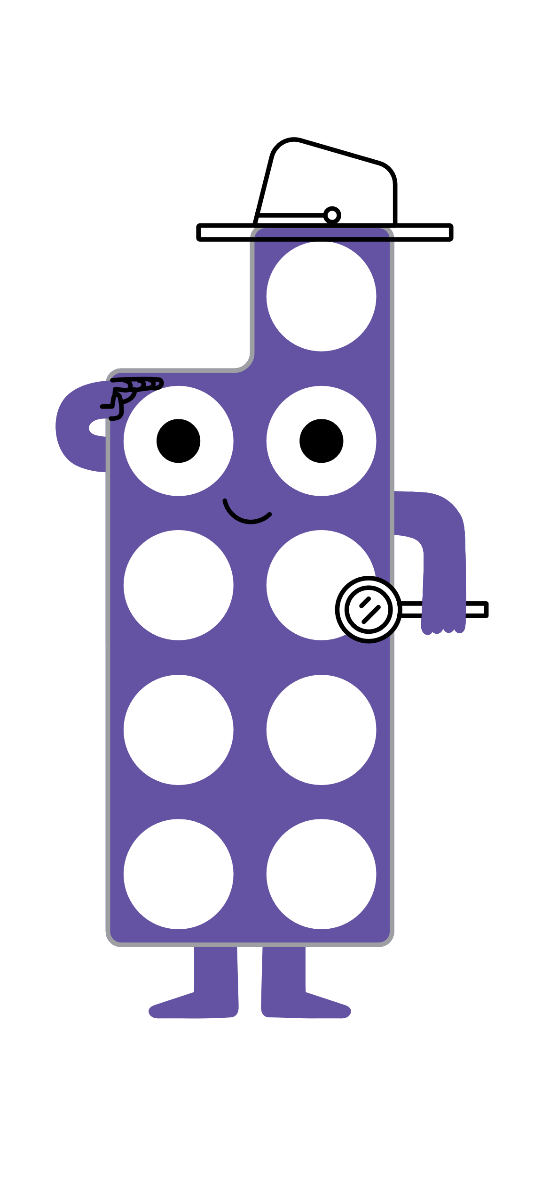
Extend and explore
The whole is 12.
How many different ways can you split the whole into equal parts?
What about if the whole is 20?
Use apparatus to help you explore.
How many ways can you find?
whole | part | equal | unequal | share | group | fair
Notes:
Extend and explore notes
Resources: print-outs of this slide, Numicon pieces (alternative options are Numicon pegs or interlocking cubes)
This has been provided as an extra resource you can use as a follow-up to the lesson, for retrieval practice, or as an activity you can print out and give to children who need meaningful extension during the lesson.
Ask children to use manipulatives (Numicon pieces) to explore the two problems.
Alternatively, if children are struggling, they could use objects such as Numicon pegs or interlocking cubes to build the whole and split it in different ways.
The use of manipulatives should alleviate some of the cognitive load and allow children to consider the structure of the problem.
Look and listen for children who:
focus on making equal parts, and recognise when they have made parts that are unequal
check to make sure their whole is 12 (or 20 for the second problem)
find multiple ways to split 12 into equal parts: 2 parts of 6, 3 parts of 4, 4 parts of 3 and 6 parts of 2
find multiple ways to split 20 into equal parts: 2 parts of 10, 4 parts of 5, 5 parts of 4 and 10 parts of 2.

